Slide 1
End of Tradition? Reconnecting British people back with Nature through OPAL
Maxwell A. Ayamba
(Sheffield Hallam University/OPAL)

Slide 2
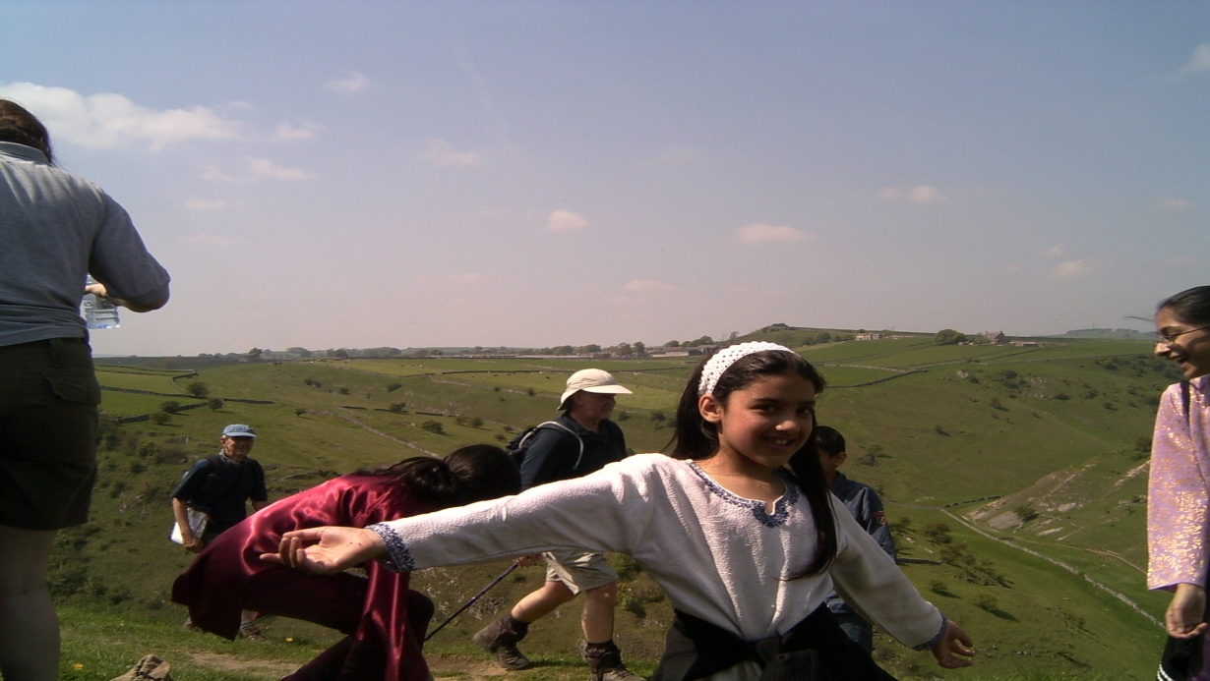
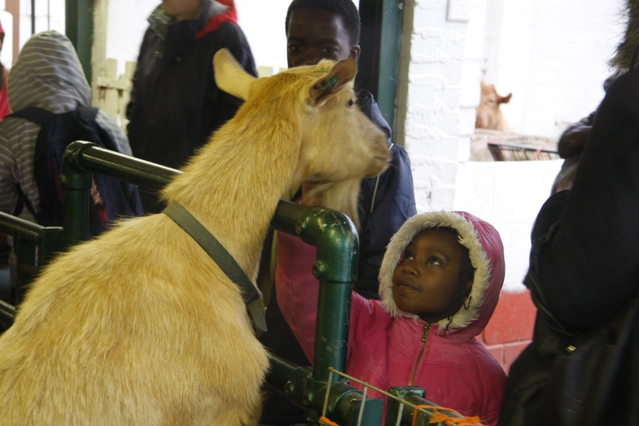
Introduction
Nature provides the umbilical cord linking humanity to 'Mother Earth', but in recent decades not only has the physical cord been severed, but the emotional, psychological and spiritual ones too
In Western countries such as Great Britain a new generation is growing up who for the most part cannot even recognize and identify the commonplace animals and plant species

Slide 3
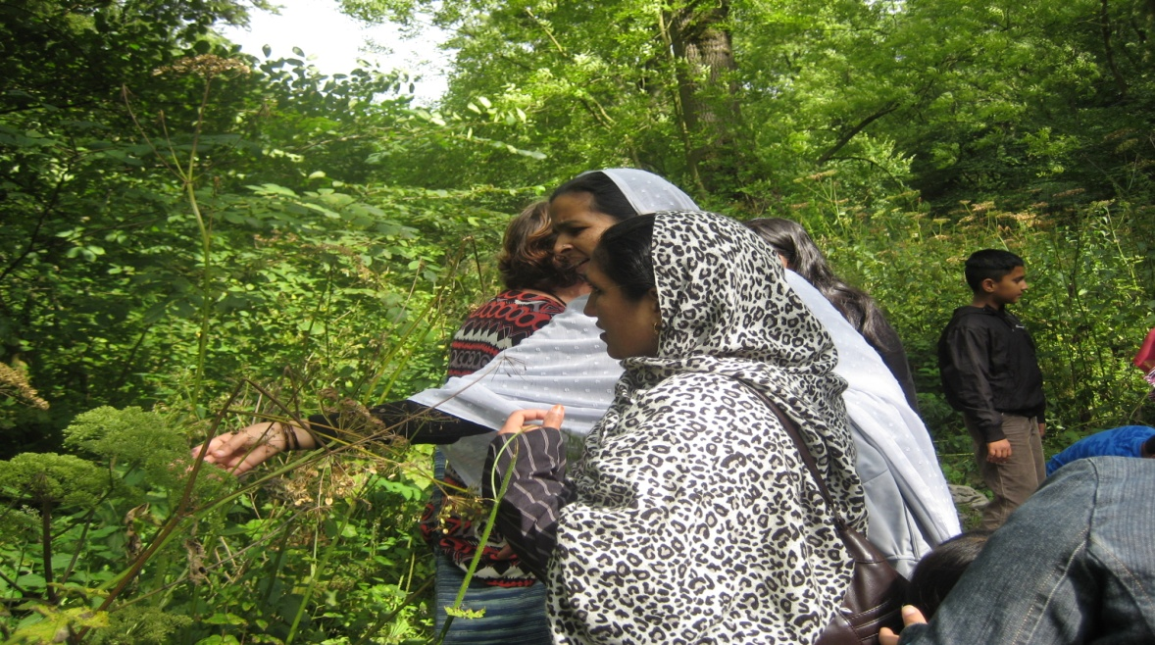
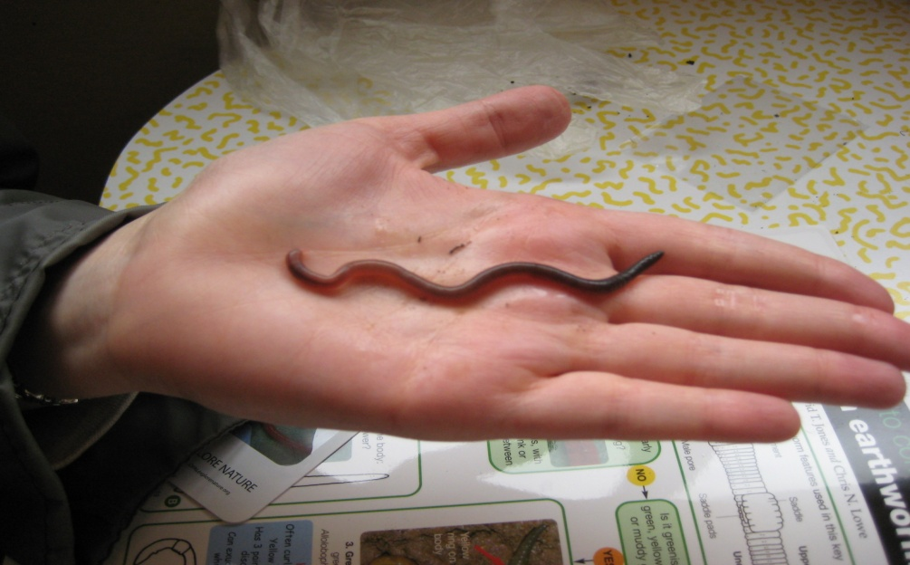
Severance from nature
At this point, the umbilical cord of nature linking communities to their local environment is truly cut and there are major implications of this separation
The consequences for ecology, biodiversity, and perhaps for people must be on a scale which approaches that of human-induced climate change
The severance between nature and people caused by the separation due to economic reasons has rarely been considered in debates

Slide 4
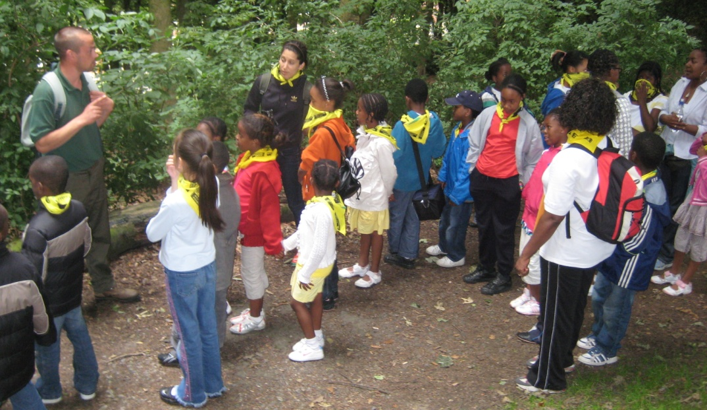
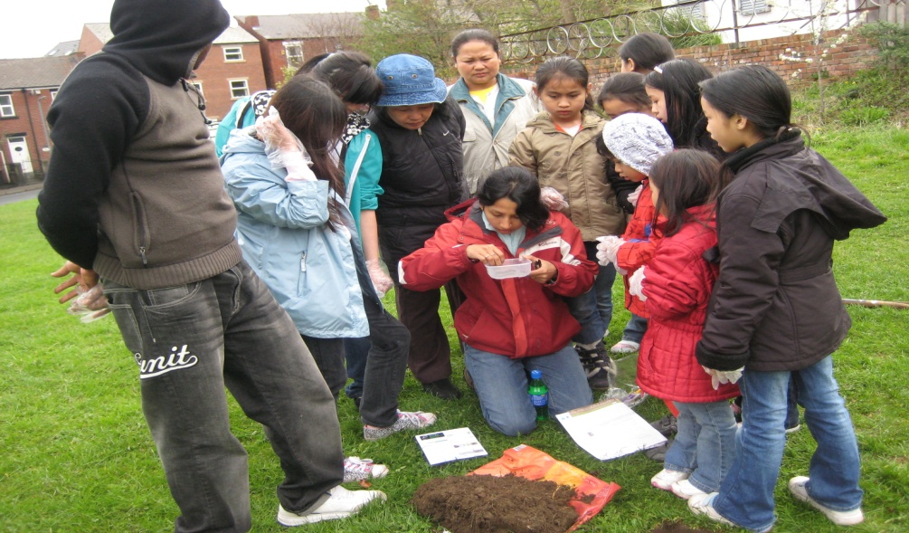
Modernism and nature
In the beginning land and people were two essential and complimentary parts of any culture with deep rooted connections
Peoples' cultures were inherently close to nature (e.g. the Commons or 'common land) which were particularly of rural subsistence and supported peoples livelihood
Common land was widely recognised to be high value for biodiversity conservation, often attributed to the maintenance of traditional patterns of land use
However the post-industrial period has seen urban settings, and lifestyles, which are at the core of the transformation in human-nature relationships which hitherto used to be deeply philosophical

Slide 5

Reconnecting people back with nature through OPAL
Open Air Laboratories (OPAL) was launched in December 2007
To develop a wide range of local and national programmes to encourage people from all backgrounds to get back in touch with nature
By creating and inspiring a new generation of nature-lovers, getting people to explore, study, enjoy and protect their local environment
OPAL key objectives is to maintain an equal balance between scientific research and community engagement or sciences communication

Slide 6




Background to the project
Devised and Managed by:
Collaborators:

Slide 7
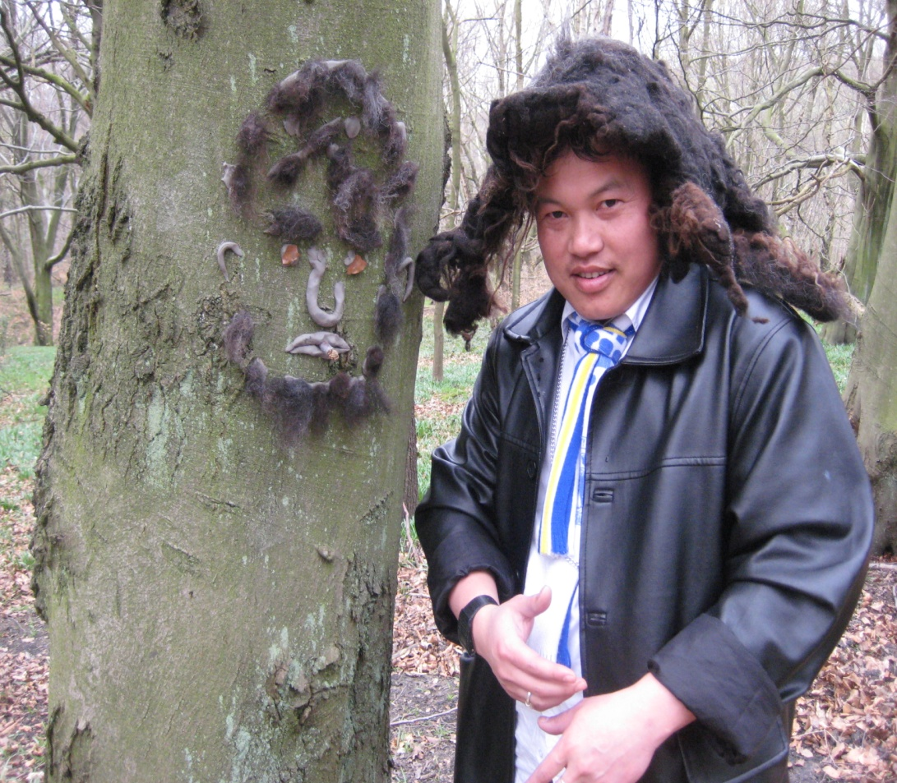
OPAL PARTNERS
Imperial College London
University of Birmingham
University of Herfordshire
National Biodiversity Network (NBN)
Newcastle University
Open University
The Royal Parks
University of York
Field Studies Council (FSC)
University of Central Lancashire (UCLan)
Natural History Museum
University of Nottingham
University of Plymouth
University College London

Slide 8
Why OPAL is different from other Environmental Projects
There are three national research centres and two educational centres developing the five OPAL national surveys
Soil & Air (Imperial College)
Water (UCL)
Biodiversity (Open University supported by the Natural History Museum)
Climate Change (Met Office)
OPAL has 9 regional projects researching local environmental issues, with the exception being UCLan (OPAL North West ) which has a social science focus and looks at the public's experience taking part in OPAL activities
Each regional project has a Community Scientist who is responsible for building relationships with local communities, training the public in supporting the use of OPAL national surveys
Each region also has a PhD student working on a topic of local environmental interest and receive support from volunteers

Slide 9
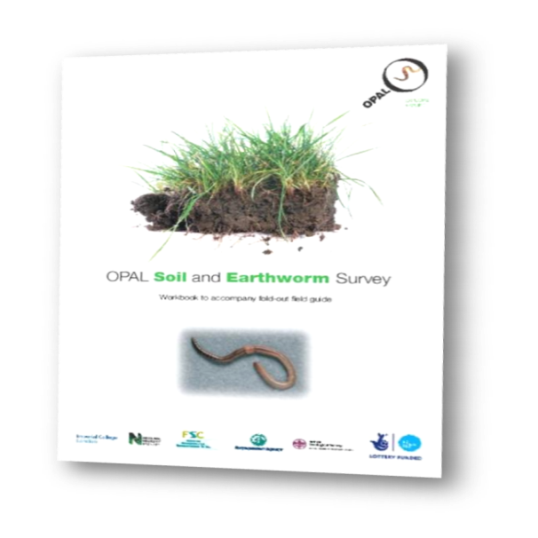
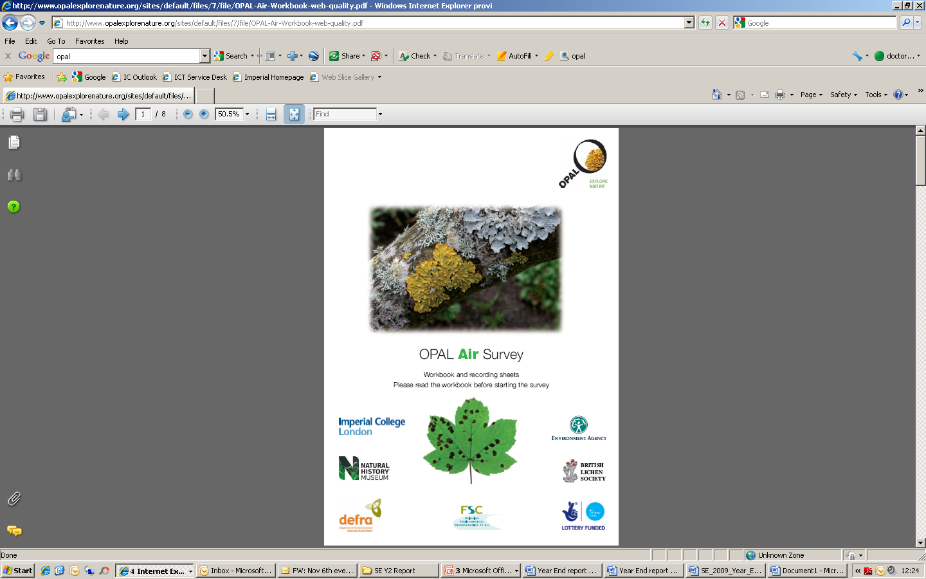

OPAL is running 5 surveys
Soil - Spring 2009
Air - Autumn 2009
Water - Spring 2010
Biodiversity - Autumn 2010
Climate Change -Spring 2011

Slide 10
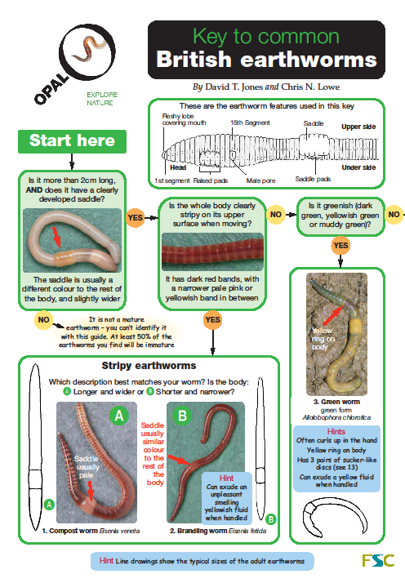
Overall aim of the Soil surveys
To develop a method to identify areas of soil degradation and its effect on earthworm populations through the collection of data on soil conditions and earthworms, by people of all ages and ability
The survey helps communities to explore the health of soils, with thousands of people submitting results to the OPAL website
The data is meant to help scientists better understand modern pressures facing soils in England and to provide detailed information about earthworm populations in those areas

Slide 11
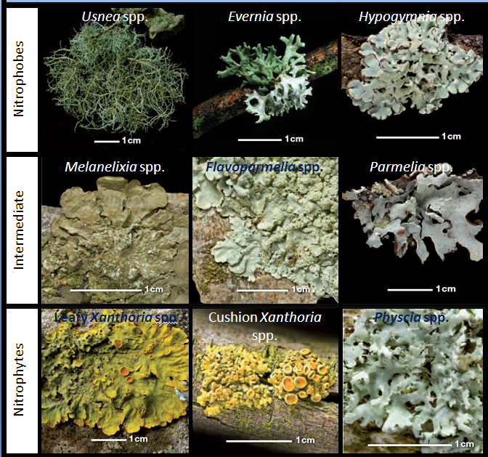
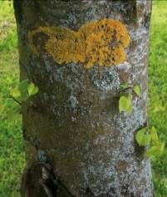
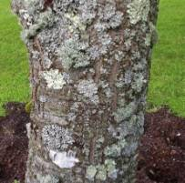
Overall aim of the air quality survey
The air quality survey was led by Imperial College London, with the British Lichen Society
Participants are asked to look at lichens as indicators of air quality survey is focused on nitrogen-containing pollutants and the use of lichens to give an indication of local air quality
The results from the survey will build a national picture of the distribution and abundance of lichens that can be affected by pollution
This will create a database for mapping the individual indicator species in relations to pollution concentrations to be compared with past records to provide an insight into environmental changes geographically

Slide 12
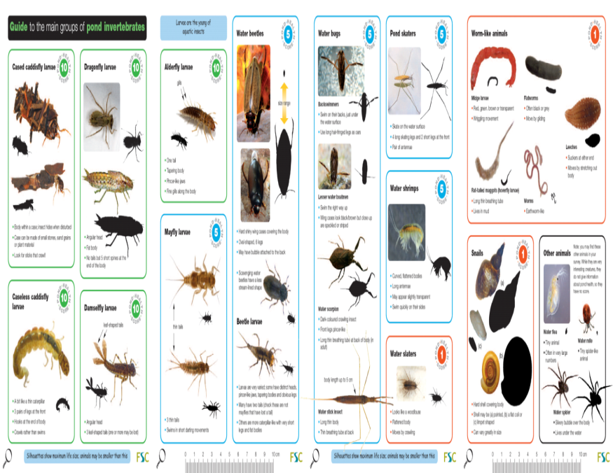
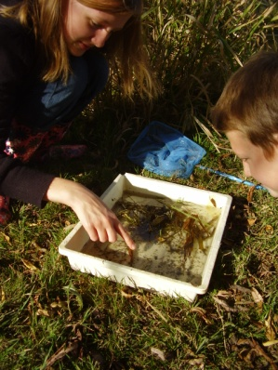
Overall aim of water quality survey
The aim of the water survey is meant to enthuse as many people as possible about freshwater environment
At the same time to collect data on lakes and ponds across England particularly garden and urban ponds which usually get overlooked in national studies
The water survey encourages people to explore local lakes and ponds and to identify the aquatic invertebrates they find into simple classes
The health of these can be used to produce a health score for a site, participants can then see whether the pond surveyed is rich in aquatic life or biodiversity
The water survey pack also includes basic measurements for two water quality indicators e.g. pH

Slide 13
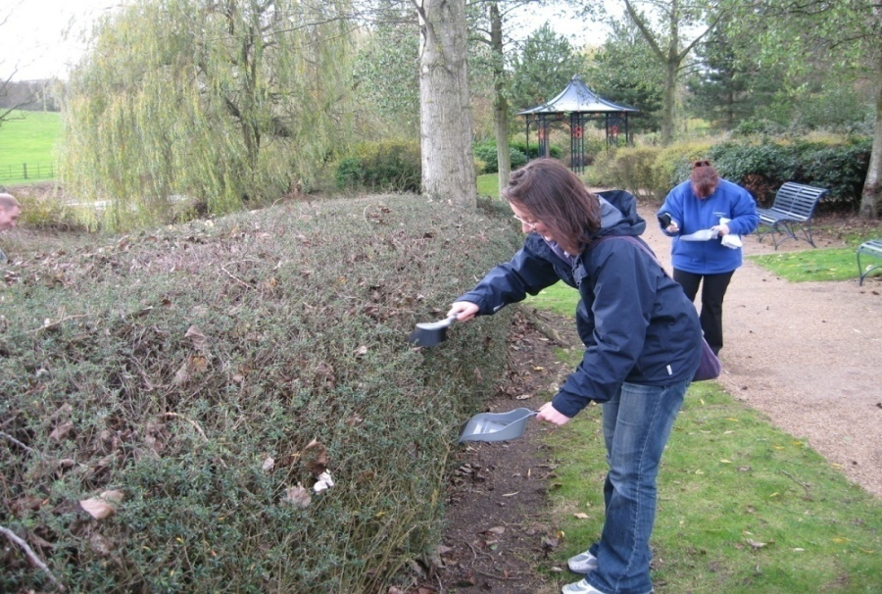
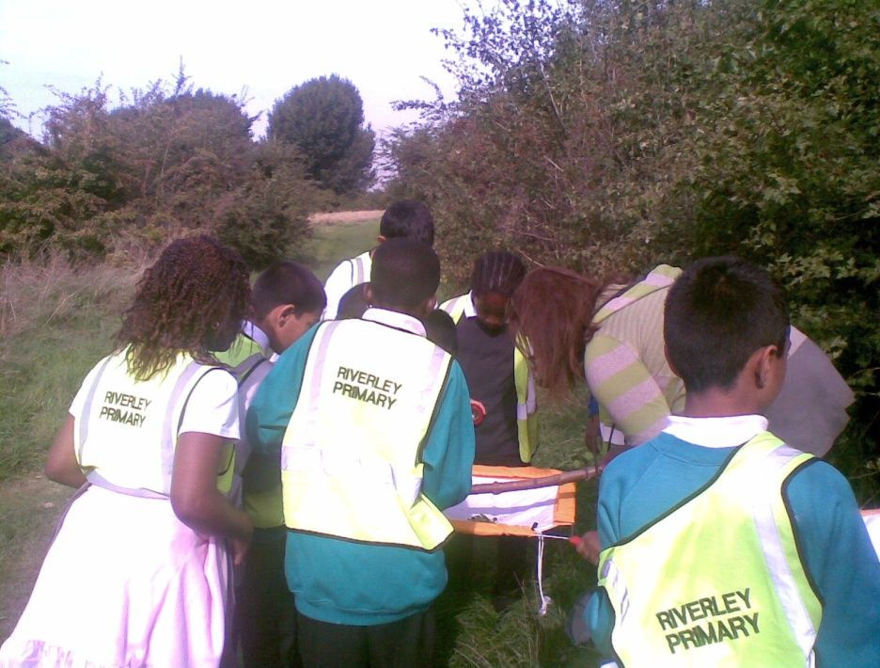
Overall aim of the Biodiversity survey
2010 has been declared the international Year of Biodiversity by the United Nations - it is the year we celebrate the diversity of life on Earth and to take action to safeguard it for future generations
Enthuse people of all backgrounds and abilities to take an interest in biodiversity and to develop peoples interest in biodiversity
By encourage people to explore the biodiversity of hedges, learning about nature and enjoying being outdoors
Help people discover the animals and plants that live in hedges, linking this to hedge structure and management

Slide 14
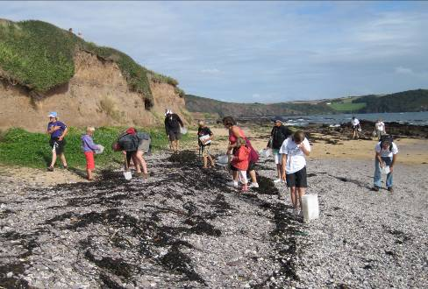
Overall aim of the Climate Change survey
The aim of this survey is to help us find out more about the impact our activities are having on climate and how to adapt
The survey looks at how we can affect the climate, from aircraft contrails which may be helping to warm the planet
To how the built environment disrupts the flow of wind near the ground
By taking part in this survey it will help improve peoples understanding of the influence of our activities on climate and the influence of climate on people

Slide 15

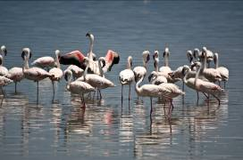
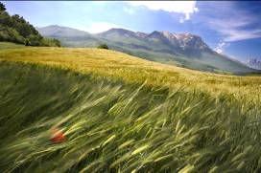
Conclusion
The natural environment has a broader national value
It underpins our economic prosperity, food security, our health and our ability to adopt to climate change and reduce greenhouse gases
A healthy natural environment has great personal value to everybody - our contact with green spaces, countryside, wildlife, rivers and seas shape the quality of life in all of our communities
Yet globally it is estimate that the degradation of our planet's ecosystems is costing us $50 billion dollars each year

Slide 16
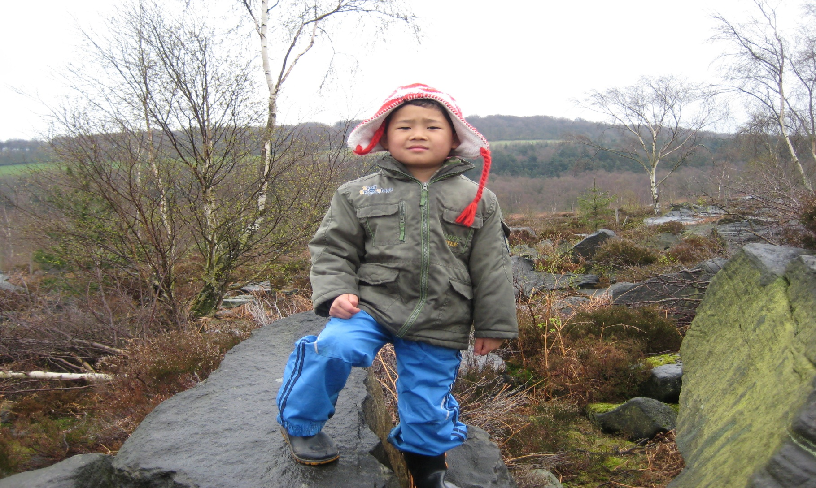
THANK YOU & ANY QUESTIONS?

