Slide 1
Building Values-Driven Organisations, Communities and Nations
December 2010

Slide 2
Presentation in Four Parts
Part 1: Communities and Nations – Social Change
Part 2: Organisations – Cultural Change
Part 3: The New Leadership Paradigm
Part 4: The Values Journal

Slide 3
Communities and Nations
Social Change

Slide 4










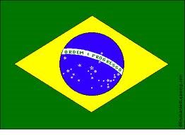



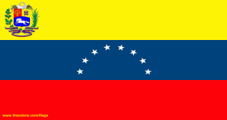
National/Regional Values Assessments
Denmark
Latvia
Sweden
Canada
Iceland
Bhutan
USA
Belgium
Finland
UK North West)
Australia
Brazil
Spain (Extremadura)
Macedonia (Skopje)
Argentina
Venezuela

Slide 5
Assessment Questions
1) Personal Values
Please select ten of the following values/behaviours that most reflect who you are, not who you desire to become.
2) Current National Culture Values
Please select ten of the following values/behaviours that most reflect how your society currently operates.
3) Desired National Culture Values
Please select ten of the following values/behaviours that you would most like to see reflected in your nation.
For more information: http://www.valuescentre.com/sectors/?sec=nations

Slide 6
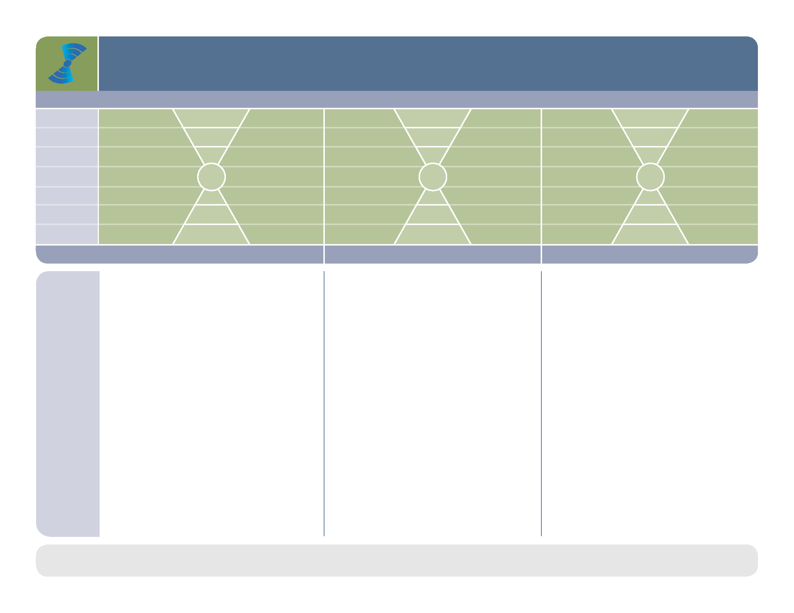
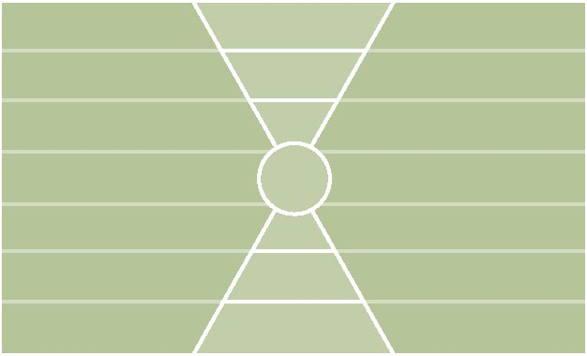
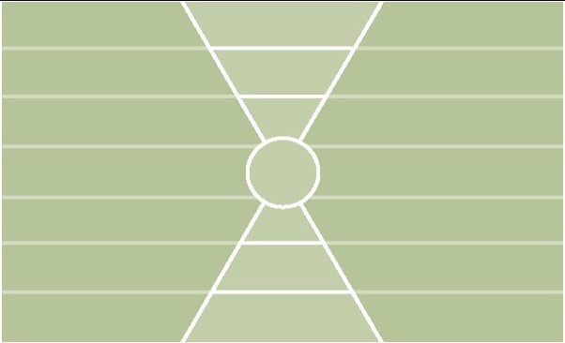

Swedish National 2010 (1002)
What the people believe is necessary for them to improve their lives and help the nation achieve its full potential?
Personal Values
Current Culture Values
Desired Culture Values
Level 7
Level 6
Level 5
Level 4
Level 3
Level 2
Level 1
The values that are important to people in their personal lives.
IRS (P)= 5-5-0 | IRS (L)= 0-0-0
IROS (P)= 0-1-1-3 | IROS (L)= 1-1-3-0
IROS (P)= 3-0-2-5 | IROS (L)= 0-0-0-0
Matches
PV - CC 0
CC - DC 1
PV - DC 2
Health Index (PL)
PV: 10-0
CC: 5-5
DC: 10-0
1. honesty | 501 | 5(I)
2. family | 452 | 2(R)
3. humour/fun | 437 | 5(I)
4. responsibility | 380 | 4(I)
5. compassion | 326 | 7(R)
6. accountability | 318 | 4(R)
7. independence | 268 | 4(I)
8. positive attitude | 265 | 5(I)
9. fairness | 247 | 5(R)
10. respect | 243 | 2(R)
1. freedom of speech | 458 | 4(O)
2. bureaucracy (L) | 448 | 3(O)
3. unemployment (L) | 424 | 1(O)
4. peace | 398 | 7(S)
5. wasted resources (L) | 314 | 3(O)
6. environmental awareness | 303 | 6(S)
7. democratic process | 298 | 4(R)
8. blame (L) | 297 | 2(R)
9. human rights | 281 | 7(S)
10. uncertainty about the future (L) | 280 | 1(I)
1. employment opportunities | 568 | 1(O)
2. financial stability | 423 | 1(I)
3. concern for future generations | 380 | 7(S)
4. honesty | 314 | 5(I)
5. nature conservancy | 297 | 6(S)
6. caring for the elderly | 296 | 4(S)
7. caring for the disadvantaged | 245 | 4(S)
8. quality of life | 239 | 6(I)
9. fairness | 233 | 5(O)
10. peace | 229 | 7(S)
How the people experience their society-- What is working well? What is undermining the sustainability nation and quality of life of the citizens
Black Underline = PV & CC Orange = CC & DC P = Positive L = Potentially Limiting I = Individual O = Organizational
Orange = PV, CC & DC Blue = PV & DC (white circle) R = Relationship S = Societal
Values Plot
Copyright 2010 Barrett Values Centre
March 2010

Slide 7


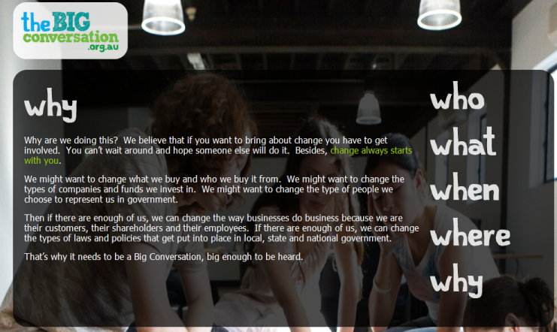
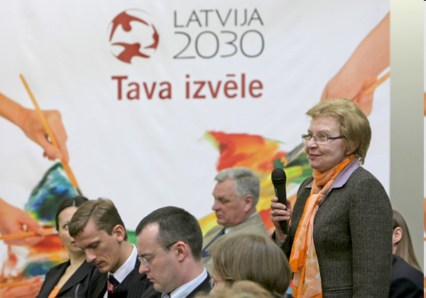


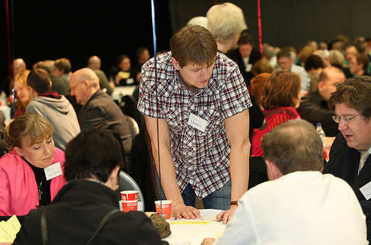
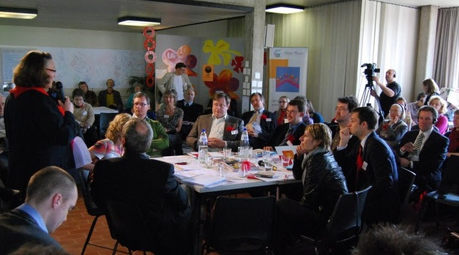
Example Outcomes
Australia National Conversation: Corporations, Government NGOs and Citizens.
Latvia 2030: Sustainable development strategy based on the values of the people. Highest planning document in Latvian Government
Iceland National Assembly. 1300 citizens from voting register chosen to help government rebuild a values driven nation.
Belgium Assessment under the Protection of the Royal Family. Politicians and mayors engaged in the dialogue with people.

Slide 8
Cultural Entropy in Nations
Cultural entropy is a measure of the degree of dysfunction in a community or nation as represented by the proportion of votes for potentially limiting values in the Current Culture.
Cultural entropy provides a snap shot of the overall well-being of a community or nation as perceived by the population. It reflects current and past events, as well as the collective history of the community or nation.

Slide 9
Entropy Percentages by Nation (2007 – 2010)
Cultural entropy is a measure of dysfunction or toxic energy in a system

Slide 10
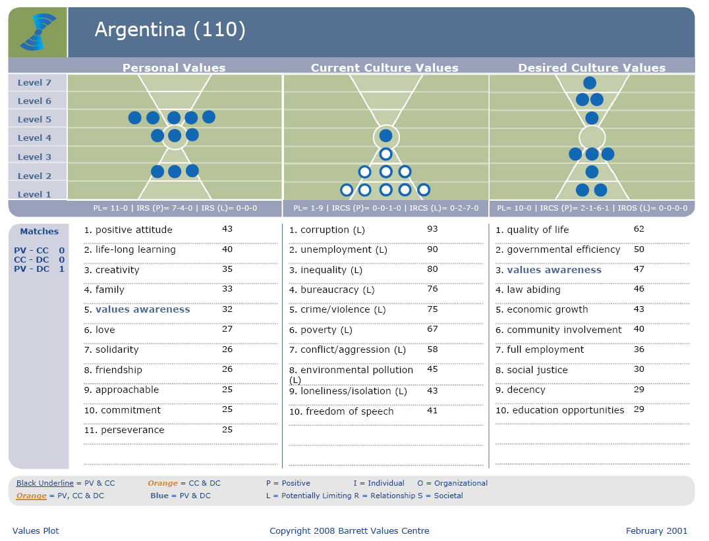

Argentina
Entropy ≈60%

Slide 11
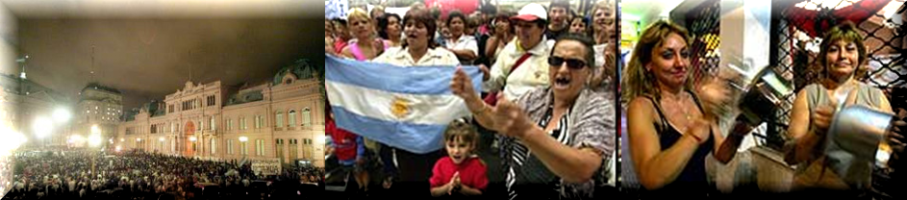
Argentina
Argentina financial crisis 2001

Slide 12

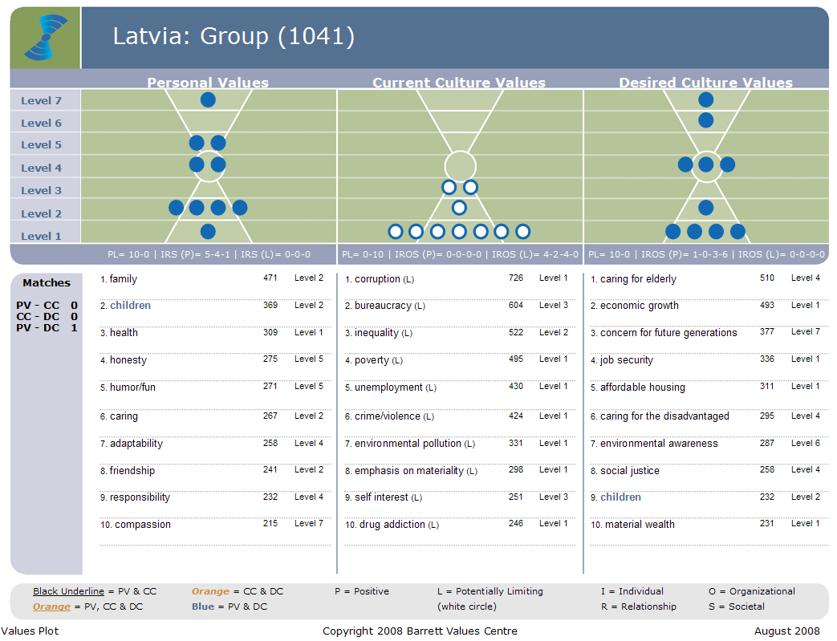
Iceland
Entropy 54%
August 2007

Slide 13
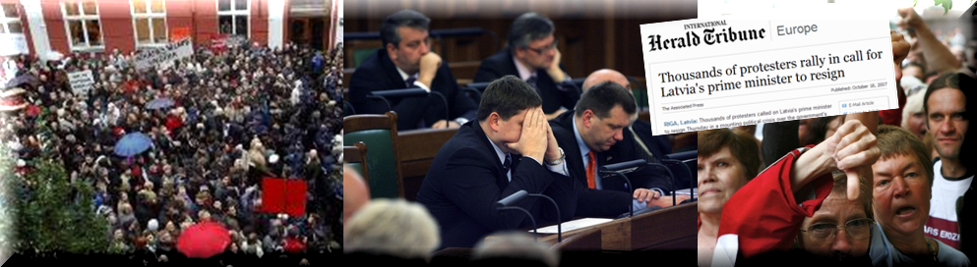
Latvia
Latvia Government dissolved after failure to agree budget - 2007

Slide 14
Latvia
Latvia start to rebuild the nation based on values

Slide 15

National Assessment Denmark 2008 (923)
Personal Values
Current Culture Values
Desired Culture Values
Level 7
Level 6
Level 5
Level 4
Level 3
Level 2
Level 1
PL= 10-0 | IRS (P)= 4-6-0 | IRS (L)= 0-0-0
PL= 7-3 | IROS (P)= 3-1-2-1 | IROS (L)= 1-0-2-0
PL= 10-0 | IROS (P)= 3-1-2-4 | IROS (L)= 0-0-0-0
Matches
PV - CC 0
CC - DC 6
PV - DC 0
1. family | 450 | Level 2
2. honesty | 431 | Level 5
3. humor/fun | 400 | Level 5
4. responsibility | 381 | Level 4
5. positive attitude | 302 | Level 5
6. friendship | 291 | Level 2
7. caring | 284 | Level 2
8. fairness | 243 | Level 5
9. listening | 233 | Level 2
10. cooperation | 230 | Level 5
1. freedom of speech | 471 | Level 4
2. educational opportunities | 437 | Level 3
3. prosperity | 356 | Level 3
4. democratic process | 344 | Level 4
5. financial stability | 322 | Level 1
6. personal freedom | 293 | Level 4
7. human rights | 263 | Level 7
8. tradition (L) | 256 | Level 2
9. bureaucracy (L) | 253 | Level 3
10. materialistic (L) | 232 | Level 1
1. freedom of speech | 356 | Level 4
2. social responsibility | 345 | Level 4
3. educational opportunities | 341 | Level 3
4. human rights | 306 | Level 7
5. financial stability | 300 | Level 1
6. peace | 289 | Level 7
7. democratic process | 272 | Level 4
8. social justice | 261 | Level 4
9. personal freedom | 249 | Level 4
10. quality of life | 233 | Level 6
Entropy 21%
Black Underline = PV & CC Orange = CC & DC P = Positive L = Potentially Limiting I = Individual O = Organizational
Orange = PV, CC & DC Blue = PV & DC (white circle) R = Relationship S = Societal
Values Plot
Copyright 2008 Barrett Values Centre
September 2008

Slide 16
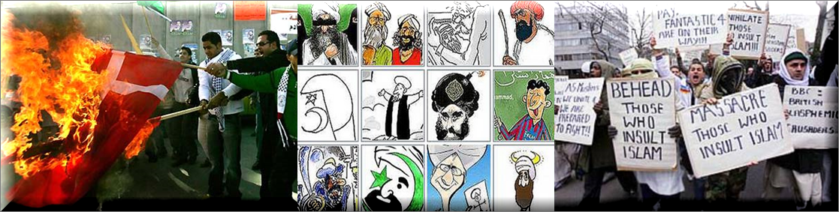
Denmark
Denmark - Mohammed cartoon protests 2005 (freedom of speech)
Notes:
http://en.wikipedia.org/wiki/Jyllands-Posten_Muhammad_cartoons_controversy

Slide 17
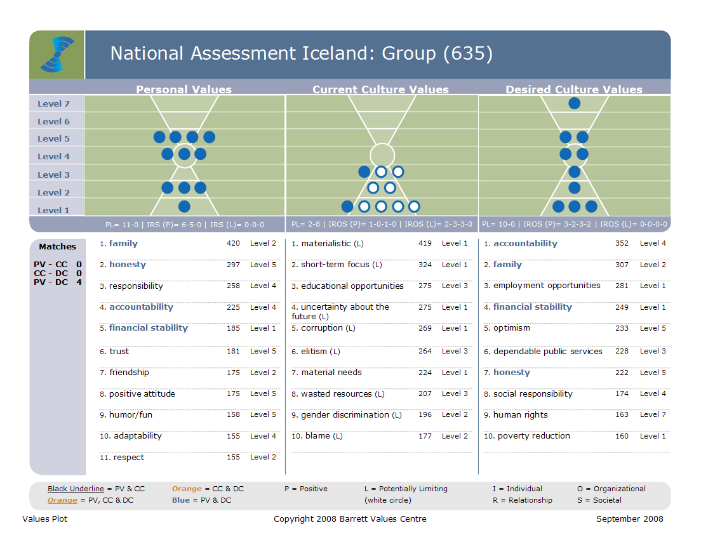

Iceland
Entropy 54%

Slide 18
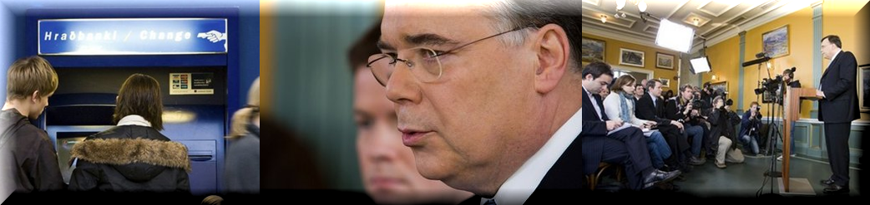
Iceland
Iceland Economic Collapse 2008

Slide 19
Iceland National Assessment 2010 (1094)
Personal Values
Current Culture Values
Desired Culture Values
Level 7
Level 6
Level 5
Level 4
Level 3
Level 2
Level 1
IRS (P)= 5-5-0 | IRS (L)= 0-0-0
IROS (P)= 0-0-0-1 | IROS (L)= 2-3-4-0
IROS (P)= 2-3-4-1 | IROS (L)= 0-0-0-0
Matches
PV - CC 0
CC - DC 0
PV - DC 3
Health Index (PL)
PV: 10-0
CC: 1-9
DC: 10-0
1. family | 598 | 2(R)
2. honesty | 497 | 5(I)
3. friendship | 357 | 2(R)
4. positive attitude | 335 | 5(I)
5. trust | 298 | 5(R)
6. fairness | 292 | 5(R)
7. health | 273 | 1(I)
8. accountability | 268 | 4(R)
9. financial stability | 268 | 1(I)
10. responsibility | 264 | 4(I)
1. uncertainty about the future (L) | 530 | 1(I)
2. corruption (L) | 507 | 1(O)
3. unemployment (L) | 495 | 1(O)
4. blame (L) | 442 | 2(R)
5. concern for future generations | 347 | 7(S)
6. poverty (L) | 326 | 1(I)
7. short-term focus (L) | 307 | 1(O)
8. elitism (L) | 296 | 3(R)
9. conflict/aggression (L) | 283 | 2(R)
10. wasted resources (L) | 282 | 3(O)
1. honesty | 295 | 5(I)
2. financial stability | 267 | 1(I)
3. employment opportunities | 259 | 1(O)
4. family | 235 | 2(R)
5. respect | 230 | 2(R)
6. dependable public services | 228 | 3(O)
7. poverty reduction | 228 | 1(O)
8. educational opportunities | 220 | 3(O)
9. caring for the elderly | 219 | 4(S)
10. democratic process | 217 | 4(R)
Entropy 63%
Black Underline = PV & CC Orange = CC & DC P = Positive L = Potentially Limiting I = Individual O = Organizational
Orange = PV, CC & DC Blue = PV & DC (white circle) R = Relationship S = Societal
Values Plot
Copyright 2010 Barrett Values Centre
September 2010

Slide 20

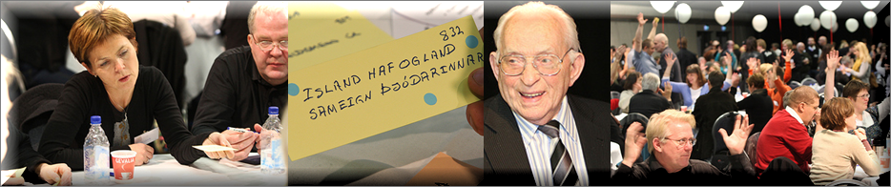
Iceland
Iceland National Assembly 2009/2010
1200 Citizens + 300 Government, NGOs & Institution Leaders + 500 Volunteers
Themes: Education, Economy, Equal rights, Family, Environment, Public administration, Welfare, Sustainability

Slide 21

USA National Assessment 2009 (1502)
Personal Values
Current Culture Values
Desired Culture Values
Level 7
Level 6
Level 5
Level 4
Level 3
Level 2
Level 1
IRS (P)= 5-6-0 | IRS (L)= 0-0-0
IROS (P)= 0-0-0-0 | IROS (L)= 3-3-4-0
IROS (P)= 2-1-3-4 | IROS (L)= 0-0-0-0
Matches
PV - CC 0
CC - DC 0
PV - DC 1
Health Index (PL)
PV: 11-0
CC: 0-10
DC: 10-0
1. family | 691 | 2(R)
2. caring | 657 | 2(R)
3. honesty | 576 | 5(I)
4. humor/fun | 548 | 5(I)
5. compassion | 469 | 7(R)
6. responsibility | 461 | 4(I)
7. friendship | 407 | 2(R)
8. respect | 392 | 2(R)
9. accountability | 388 | 4(R)
10. independence | 359 | 4(I)
11. patience | 359 | 5(I)
1. corruption (L) | 748 | 1(O)
2. blame (L) | 681 | 2(R)
3. bureaucracy (L) | 681 | 3(O)
4. crime/violence (L) | 628 | 1(R)
5. uncertainty about the future (L) | 567 | 1(I)
6. wasted resources (L) | 552 | 3(O)
7. materialistic (L) | 527 | 1(I)
8. unemployment (L) | 466 | 1(O)
9. conflict/aggression (L) | 426 | 2(R)
10. poverty (L) | 358 | 1(I)
1. accountability | 703 | 4(R)
2. concern for future generations | 516 | 7(S)
3. employment opportunities | 497 | 1(O)
4. caring for the elderly | 467 | 4(S)
5. affordable housing | 429 | 1(O)
6. peace | 429 | 7(S)
7. caring for the disadvantaged | 398 | 4(S)
8. financial stability | 368 | 1(I)
9. quality of life | 335 | 6(I)
10. poverty reduction | 325 | 1(O)
Entropy 52%
Black Underline = PV & CC Orange = CC & DC P = Positive L = Potentially Limiting I = Individual O = Organizational
Orange = PV, CC & DC Blue = PV & DC (white circle) R = Relationship S = Societal
Values Plot
Copyright 2009 Barrett Values Centre
January 2009

Slide 22
USA National Assessment 2010 (1504)
Personal Values
Current Culture Values
Desired Culture Values
Level 7
Level 6
Level 5
Level 4
Level 3
Level 2
Level 1
IRS (P)= 4-6-0 | IRS (L)= 0-0-0
IROS (P)= 0-0-1-0 | IROS (L)= 2-3-4-0
IROS (P)= 1-1-4-4 | IROS (L)= 0-0-0-0
Matches
PV - CC 0
CC - DC 0
PV - DC 2
Health Index (PL)
PV: 10-0
CC: 1-9
DC: 10-0
1. family | 655 | 2(R)
2. caring | 646 | 2(R)
3. honesty | 610 | 5(I)
4. humor/fun | 573 | 5(I)
5. responsibility | 508 | 4(I)
6. accountability | 485 | 4(R)
7. independence | 435 | 4(I)
8. friendship | 434 | 2(R)
9. compassion | 427 | 7(R)
10. respect | 379 | 2(R)
1. bureaucracy (L) | 761 | 3(O)
2. corruption (L) | 727 | 1(O)
3. blame (L) | 680 | 2(R)
4. uncertainty about the future (L) | 651 | 1(I)
5. wasted resources (L) | 647 | 3(O)
6. materialistic (L) | 586 | 1(I)
7. crime/violence (L) | 534 | 1(R)
8. unemployment (L) | 510 | 1(O)
9. conflict/aggression (L) | 437 | 2(R)
10. military strength | 402 | 3(O)
1. accountability | 826 | 4(R)
2. concern for future generations | 567 | 7(S)
3. honesty | 529 | 5(I)
4. employment opportunities | 488 | 1(O)
5. caring for the elderly | 457 | 4(S)
6. effective healthcare | 435 | 1(O)
7. economic growth | 398 | 1(O)
8. caring for the disadvantaged | 395 | 4(S)
9. affordable housing | 390 | 1(O)
10. peace | 378 | 7(S)
Entropy 58%
Black Underline = PV & CC Orange = CC & DC P = Positive L = Potentially Limiting I = Individual O = Organizational
Orange = PV, CC & DC Blue = PV & DC (white circle) R = Relationship S = Societal
Values Plot
Copyright 2010 Barrett Values Centre
January 2010

Slide 23
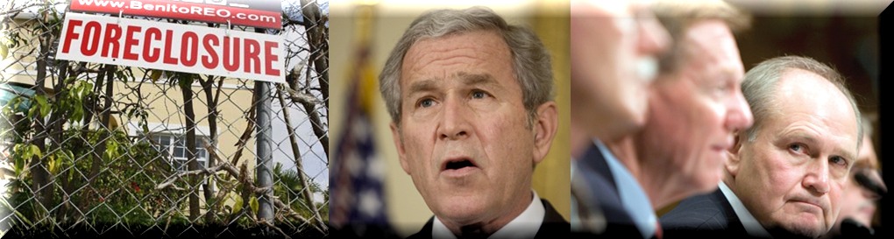
USA 2009
US Government forced to bail out banks and industry -2007 / 2008

Slide 24

Bhutan: Group (403)
Personal Values
Current Culture Values
Desired Culture Values
Level 7
Level 6
Level 5
Level 4
Level 3
Level 2
Level 1
IRS (P)= 4-4-1 | IRS (L)= 1-0-0
IROS (P)= 1-0-8-2 | IROS (L)= 0-0-0-0
IROS (P)= 1-1-7-1 | IROS (L)= 0-0-0-0
Matches
PV - CC 1
CC - DC 6
PV - DC 2
Health Index (PL)
PV: 9-1
CC: 11-0
DC: 10-0
1. friendship | 180 | 2(R)
2. continuous learning | 160 | 4(I)
3. compassion | 128 | 7(R)
4. caution (L) | 122 | 1(I)
5. sincerity | 121 | 5(I)
6. social justice | 118 | 7(S)
7. self-discipline | 102 | 1(I)
8. optimism | 95 | 5(I)
9. helpfulness | 94 | 2(R)
10. caring | 92 | 2(R)
1. continuous improvement | 195 | 4(O)
2. environmental protection | 104 | 1(O)
3. strict moral/religious codes | 104 | 3(O)
4. political rights | 102 | 3(O)
5. education | 100 | 4(O)
6. nature conservancy | 91 | 6(S)
7. shared vision | 90 | 5(O)
8. information availability | 88 | 3(O)
9. shared values | 88 | 5(O)
10. contentment | 87 | 5(I)
11. social justice | 87 | 4(S)
1. education | 115 | 4(O)
2. continuous improvement | 113 | 4(O)
3. freedom of speech | 113 | 4(O)
4. economic growth | 107 | 1(O)
5. social justice | 100 | 4(S)
6. contentment | 93 | 5(I)
7. environmental protection | 89 | 1(O)
8. compassion | 83 | 7(R)
9. full employment | 82 | 3(O)
10. strict moral/religious codes | 82 | 3(O)
Entropy 4%
Black Underline = PV & CC Orange = CC & DC P = Positive L = Potentially Limiting I = Individual O = Organizational
Orange = PV, CC & DC Blue = PV & DC (white circle) R = Relationship S = Societal
Values Plot
Copyright 2009 Barrett Values Centre
January 2009

Slide 25
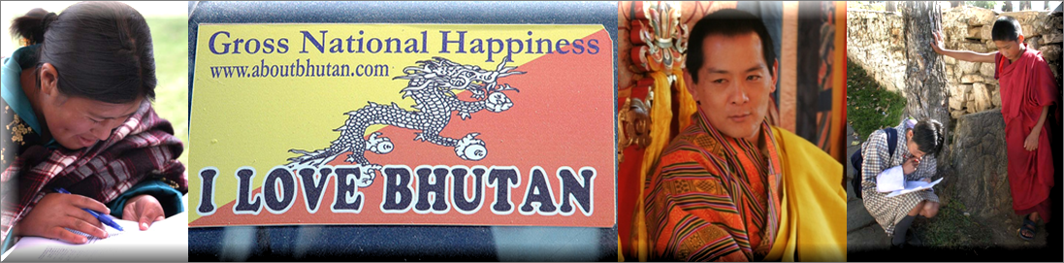
Bhutan
Bhutan prioritise *GNH above GDP
(*Gross National Happiness)
Notes:
http://en.wikipedia.org/wiki/Gross_National_Happiness
The pictures on the outside of the graphic are Bhutan citizens taking the CTT Values Assessment.

Slide 26


UK Northwest Region 2009 (2002)
Personal Values
Current Culture Values
Desired Culture Values
Level 7
Level 6
Level 5
Level 4
Level 3
Level 2
Level 1
IRS (P)= 3-7-0 | IRS (L)= 0-0-0
IROS (P)= 1-0-0-0 | IROS (L)= 3-3-3-0
IROS (P)= 2-0-4-4 | IROS (L)= 0-0-0-0
Matches
PV - CC 0
CC - DC 1
PV - DC 0
Health Index (PL)
PV: 10-0
CC: 1-9
DC: 10-0
1. caring | 995 | 2(R)
2. family | 907 | 2(R)
3. humour/fun | 866 | 5(I)
4. honesty | 841 | 5(I)
5. friendship | 720 | 2(R)
6. respect | 560 | 2(R)
7. fairness | 540 | 5(R)
8. trust | 521 | 5(R)
9. listening | 502 | 2(R)
10. patience | 497 | 5(I)
1. crime/violence (L) | 925 | 1(R)
2. uncertainty about the future (L) | 746 | 1(I)
3. unemployment (L) | 700 | 1(O)
4. wasted resources (L) | 699 | 3(O)
5. bureaucracy (L) | 610 | 3(O)
6. apathy/ pessimism (L) | 555 | 3(I)
7. blame (L) | 535 | 2(R)
8. conflict/aggression (L) | 528 | 2(R)
9. poverty (L) | 468 | 1(I)
10. community pride | 448 | 3(I)
1. community pride | 921 | 3(I)
2. affordable housing | 834 | 1(O)
3. caring for the elderly | 811 | 4(S)
4. caring for the disadvantaged | 664 | 4(S)
5. Employment opportunities | 635 | 1(O)
6. quality of life | 584 | 6(I)
7. economic growth | 556 | 1(O)
8. concern for future generations | 535 | 7(S)
9. community services | 516 | 6(S)
10. dependable public services | 509 | 3(O)
Entropy 43%
Black Underline = PV & CC Orange = CC & DC P = Positive L = Potentially Limiting I = Individual O = Organizational
Orange = PV, CC & DC Blue = PV & DC (white circle) R = Relationship S = Societal
Values Plot
Copyright 2009 Barrett Values Centre
February 2009

Slide 27
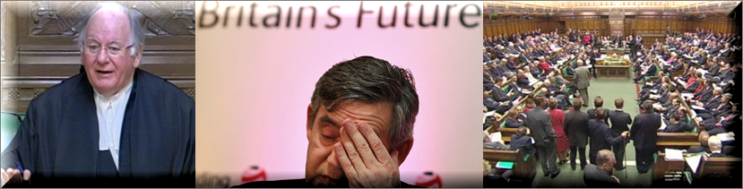
United Kingdom
Leadership crisis of trust, UK Members of Parliament expense claims– 2009
Notes:
http://en.wikipedia.org/wiki/Gross_National_Happiness
The pictures on the outside of the graphic are Bhutan citizens taking the CTT Values Assessment.

Slide 28

Spain (Extremadura Region) 2010 (1182)
Personal Values
Current Culture Values
Desired Culture Values
Level 7
Level 6
Level 5
Level 4
Level 3
Level 2
Level 1
IRS (P)= 5-5-0 | IRS (L)= 0-0-0
IROS (P)= 1-1-0-1 | IROS (L)= 3-1-3-0
IROS (P)= 1-4-3-2 | IROS (L)= 0-0-0-0
Matches
PV - CC 1
CC - DC 2
PV - DC 3
Health Index (PL)
PV: 10-0
CC: 3-7
DC: 10-0
1. family | 715 | 2(R)
2. respect | 583 | 2(R)
3. friendship | 558 | 2(R)
4. health | 495 | 1(I)
5. listening | 389 | 2(R)
6. diversity | 342 | 4(R)
7. positive attitude | 337 | 5(I)
8. well-being (physical/emotional/ mental/spiritual) | 320 | 6(I)
9. adaptability | 309 | 4(I)
10. continuous learning | 302 | 4(I)
1. unemployment (L) | 583 | 1(O)
2. illiteracy (L) | 432 | 3(I)
3. uncertainty about the future (L) | 391 | 1(I)
4. materialistic (L) | 342 | 1(I)
5. blame (L) | 318 | 2(R)
6. wasted resources (L) | 313 | 3(O)
7. caring for the elderly | 299 | 4(S)
8. family | 288 | 2(R)
9. quality of life | 259 | 6(I)
10. bureaucracy (L) | 255 | 3(O)
1. employment opportunities | 439 | 1(O)
2. equality | 394 | 4(R)
3. respect | 393 | 2(R)
4. diversity | 386 | 4(R)
5. family | 341 | 2(R)
6. quality of life | 313 | 6(I)
7. community pride | 298 | 5(O)
8. concern for future generations | 292 | 7(S)
9. affordable housing | 272 | 1(O)
10. peace | 269 | 7(S)
Entropy 39%
Black Underline = PV & CC Orange = CC & DC P = Positive L = Potentially Limiting I = Individual O = Organizational
Orange = PV, CC & DC Blue = PV & DC (white circle) R = Relationship S = Societal
Values Plot
Copyright 2010 Barrett Values Centre
April 2010

Slide 29
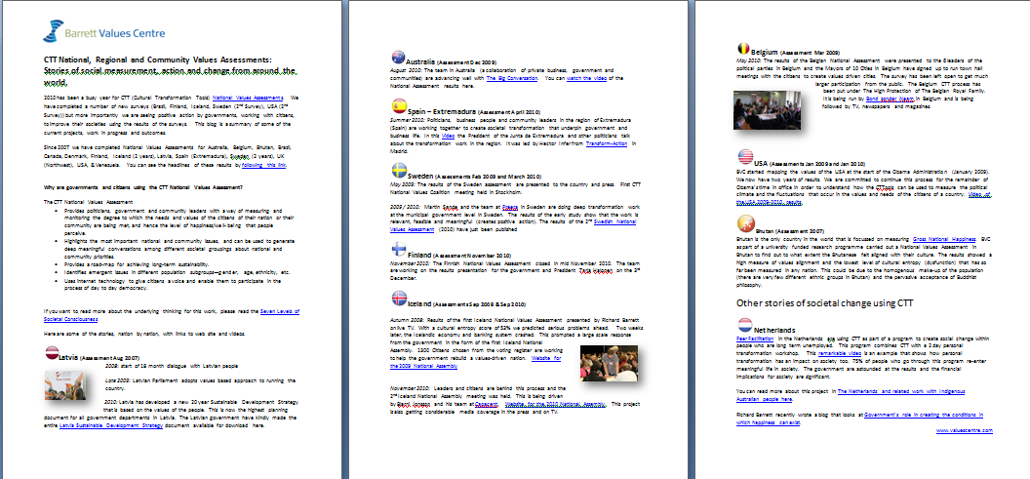
Stories of social measurement and change from around the world – continually updated blog
To get a copy: http://bit.ly/eL9zQF
Notes:
http://en.wikipedia.org/wiki/Gross_National_Happiness
The pictures on the outside of the graphic are Bhutan citizens taking the CTT Values Assessment.

Slide 30
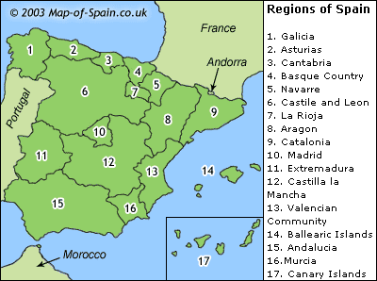
Spain Extremadura
Notes:
http://en.wikipedia.org/wiki/Gross_National_Happiness
The pictures on the outside of the graphic are Bhutan citizens taking the CTT Values Assessment.

Slide 31

Spain Extremadura
Notes:
http://en.wikipedia.org/wiki/Gross_National_Happiness
The pictures on the outside of the graphic are Bhutan citizens taking the CTT Values Assessment.

Slide 32
Organisations
Culture Change

Slide 33
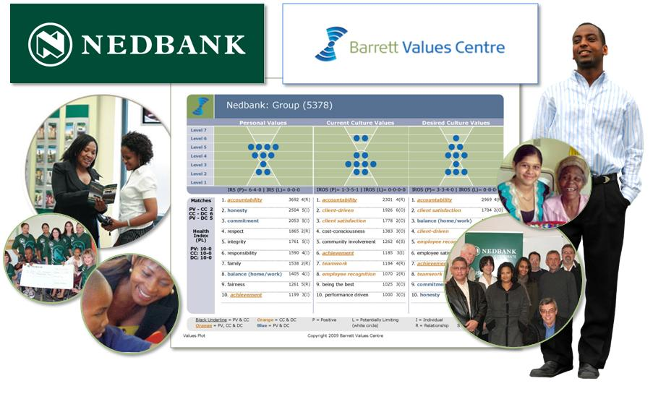
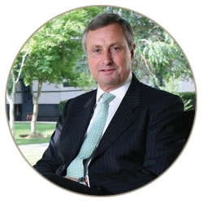
Nedbank (South Africa)

Slide 34
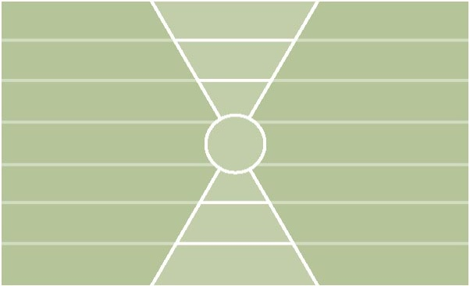
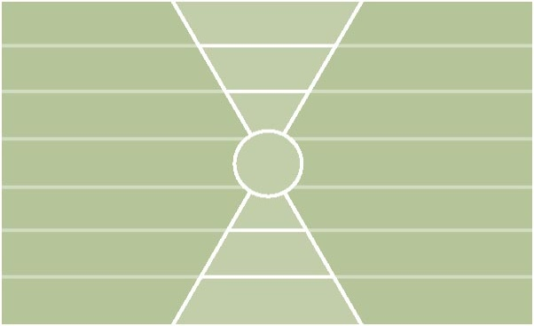
Nedbank 2005: Group (952)
Personal Values
Current Culture Values
Desired Culture Values
Level 7
Level 6
Level 5
Level 4
Level 3
Level 2
Level 1
IRS (P)= 5-5-0 | IRS (L)= 0-0-0
IROS (P)= 0-1-7-1 | IROS (L)= 0-0-2-0
IROS (P)= 1-4-5-0 | IROS (L)= 0-0-0-0
Matches
PV - CC 1
CC - DC 3
PV - DC 3
Health Index (PL)
PV: 10-0
CC: 9-2
DC: 10-0
1. accountability | 570 | 4(R)
2. honesty | 455 | 5(I)
3. commitment | 406 | 5(I)
4. integrity | 381 | 5(I)
5. responsibility | 290 | 4(I)
6. family | 287 | 2(R)
7. respect | 272 | 2(R)
8. trust | 268 | 5(R)
9. reliability | 229 | 3(R)
10. efficiency | 228 | 3(I)
1. cost-consciousness | 321 | 3(O)
2. profit | 287 | 1(O)
3. accountability | 265 | 4(R)
4. community involvement | 257 | 6(S)
5. client-driven | 232 | 6(O)
6. process-driven | 220 | 3(O)
7. bureaucracy (L) | 216 | 3(O)
8. results orientation | 216 | 3(O)
9. silo mentality (L) | 207 | 3(O)
10. client satisfaction | 205 | 2(O)
1. accountability | 503 | 4(R)
2. client satisfaction | 365 | 2(O)
3. client-driven | 347 | 6(O)
4. employee satisfaction | 332 | 2(O)
5. employee recognition | 288 | 2(R)
6. financial stability | 221 | 1(O)
7. integrity | 205 | 5(I)
8. teamwork | 205 | 4(R)
9. balance (home/work) | 200 | 4(O)
10. trust | 188 | 5(R)
Black Underline = PV & CC Orange = CC & DC P = Positive L = Potentially Limiting I = Individual O = Organizational
Orange = PV, CC & DC Blue = PV & DC (white circle) R = Relationship S = Societal
Values Plot
Copyright 2009 Barrett Values Centre
October 2009

Slide 35
Nedbank: Cultural Evolution
Entropy Scores
Entropy reduction leads to improved performance—increased revenues, profits
and share price. Working toward entropy of <10% will result in healthy functioning
of the organisation and improvement of staff morale.
Organisational Entropy Risk Bands
<10% Healthy functioning
10-19% Some problems requiring careful monitoring
20-29% Significant problems requiring attention
30-39% Crisis situation requiring immediate change
40%> Impending risk of implosion, bankruptcy or failure

Slide 36

Nedbank: Response Rate to Values Survey
63.0%
Response rate
50.4%
35.5%
number of participants
28.0%
20.2%
28,898 employees in 2009

Slide 37

Nedbank: Cultural Evolution
Nedbank Staff Survey Scores

Slide 38
Nedbank: Financial Impact of Cultural Evolution
Share Price grew
on average 20.4% (CAGR)
per year from 2004 to 2007
Revenue grew
on average 16.9% (CAGR)
per year from 2004 to 2007
CAGR : Compound Annual Growth Rate

Slide 39
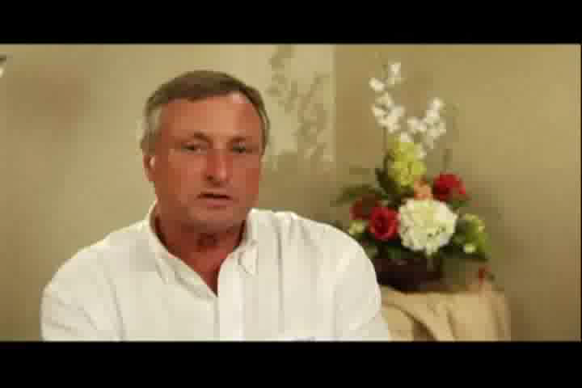
Tom Boardman, Former CEO Nedbank

Slide 40
The New Leadership Paradigm

Slide 41
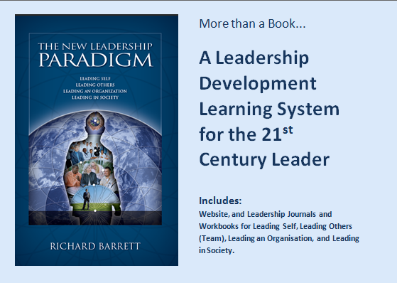
The New Leadership Paradigm

Slide 42
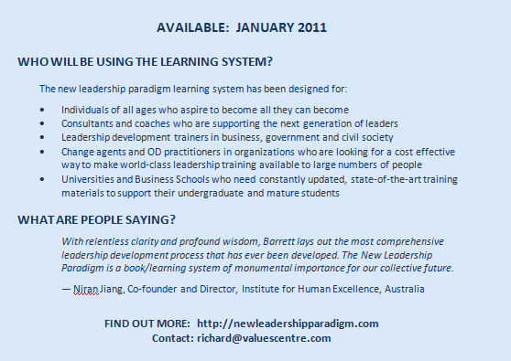
The New Leadership Paradigm

Slide 43
The Values Journal

Slide 44
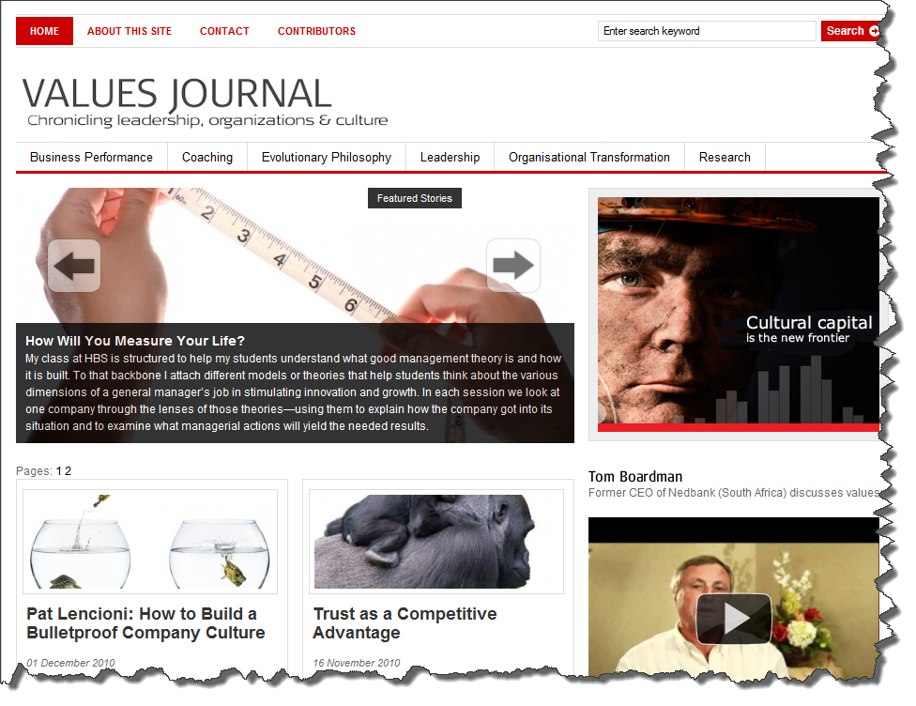
www.valuesjournal.com

Slide 45
To Get More Information – Richard Barrett
For this presentation:
  http://www.slideshare.net/BarrettValues
For Stories of Social Measurement and Change:
  http://www.bit.ly/eL9zQF
For information on Values Assessments:
  http://www.valuescentre.com
For the On-line Values Journal:
  http://www.valuesjournal.com
For my Blog:
  http://richardbarrett.posterous.com/
For Twitter:
  http://www.twitter.com/BarrettValues

