Slide 1

Partnership for
Education and research about
Responsible
Living
David Chittenden – PERL Daily manager
www.perlprojects.org
PERL@hihm.no

Slide 2


PERL
Over 110 institutions in 50 countries
EU academic network and international
Hedmark University College, Norway
Consumer Citizenship Network
Partnership for Education and Research about Responsible Living

Slide 3






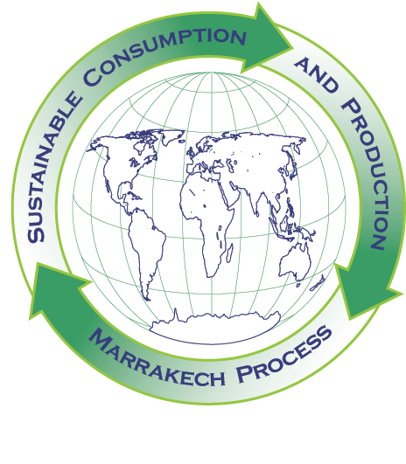
Support
Partnership for Education and Research about Responsible Living

Slide 4
PERL’s mission
To educate individuals to recognise their role as active citizens and to make more responsible daily choices
To influence governments, businesses and schools to educate individuals and to make better lifestyle choices both available and attractive.
Partnership for Education and Research about Responsible Living

Slide 5
PERL’s approach
build bridges and to collaborate by recognising that people need to determine their own lifestyle changes
based on good information, consultation and the principles of sustainable human
development
Partnership for Education and Research about Responsible Living

Slide 6
Macro-structural changes
(international agreements and standards, national policies,
taxes ,laws, controls, etc )
Infra-structural changes
(local policies, resources, curricula)
Research
Information
Collaboration and co-operation
(across disciplines, between
producers and consumers,
within communities)
Communication
Education
Identification of fundamental principles
Examples of social innovation
Collective and individual encouragement
Partnership for Education and Research about Responsible Living

Slide 7
PERL organisational structure
International Reference Group
Local support unit
Steering Group
PERL Core Unit
#1 Reflection & implementation
#4 Education for responsible living
WG leaders
WG leaders
#5 Communication & multimedia
#2 Social Innovation
WG leaders
WG leaders
#3 Enabling Sustainable Lifestyles
#6 International Dialogue & Consultation
Consultants’ Network
WG leaders
WG leaders

Slide 8
Partnerships
Essential for the sustainability challenges
Organisational values alignment + openness
Commitment, institutional agreements
Time, resources, coordination, relationship management
Right level, concrete activities
Many new partnerships, ICT platforms can help
Partnership for Education and Research about Responsible Living

Slide 10
PERL’s approach
Life Cycle Analysis
Social life cycle assessment
Life quality analysis
Partnership for Education and Research about Responsible Living

Slide 11
PERL’s approach to education
scientific investigation
and
an active social learning process
(physical, sociological, facts, values)
(open, participatory, reflecting, adapting)
Partnership for Education and Research about Responsible Living

Slide 12
PERL’s approach to education
“…learning which flows naturally into direct community engagement.
An exercise in anticipatory democracy”
Tøfler A. 1971
Partnership for Education and Research about Responsible Living

Slide 13
Core life skills
self-awareness
coping with emotions
coping with stress
empathy
decision-making
problem-solving
creative-thinking
critical thinking
effective communication
interpersonal relationship skills
Partnership for Education and Research about Responsible Living

Slide 14
Educational themes
Life quality
Lifestyles
Resources
Economics
Consumption and the environment
Consumer rights and responsibilities
Information management
Health and safety
Change management
Global awareness
Partnership for Education and Research about Responsible Living

Slide 15
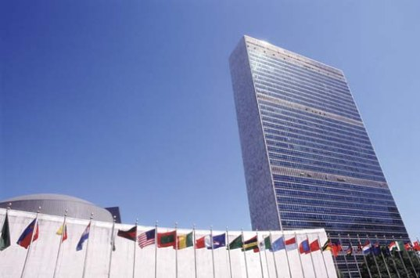
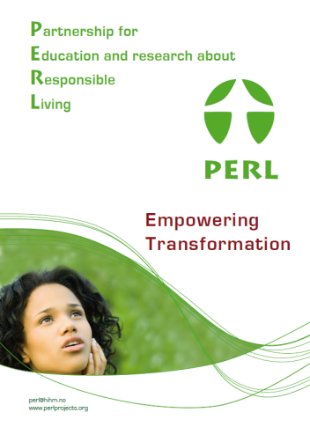
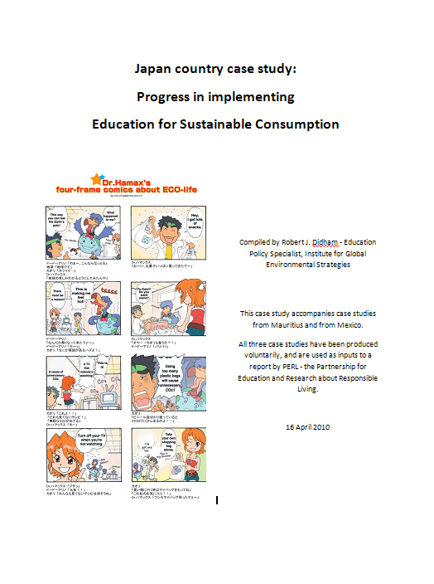
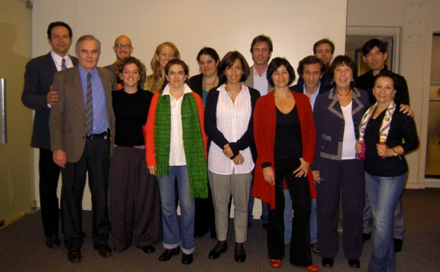
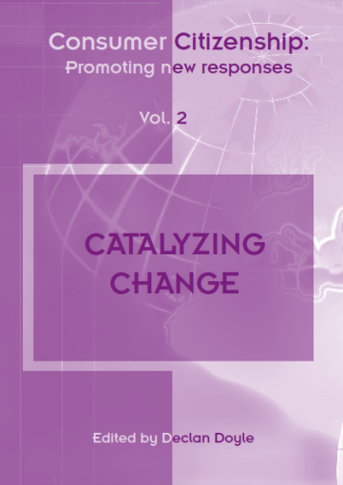
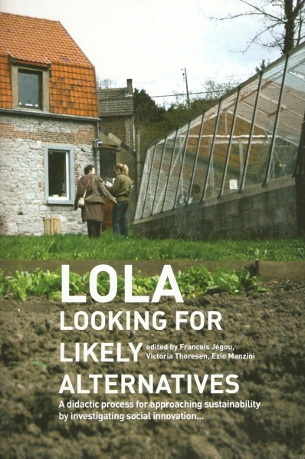
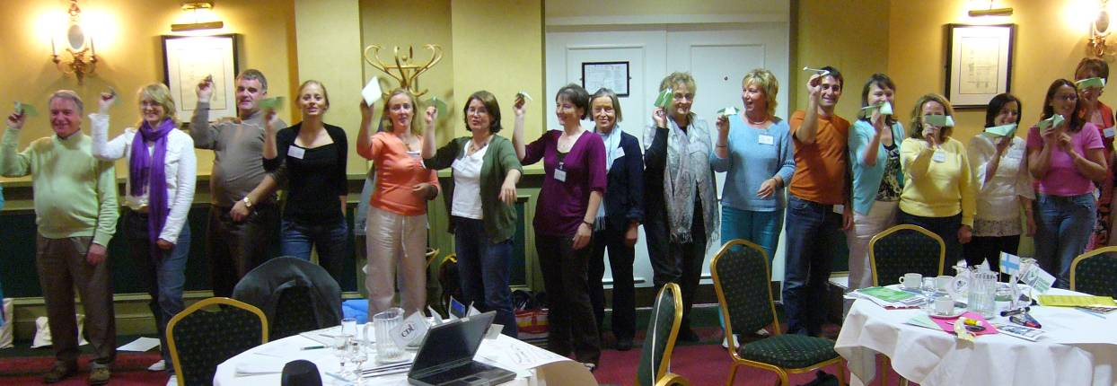
Partnership for Education and Research about Responsible Living

Slide 16
3. Example projects
Partnership for Education and Research about Responsible Living

Slide 17

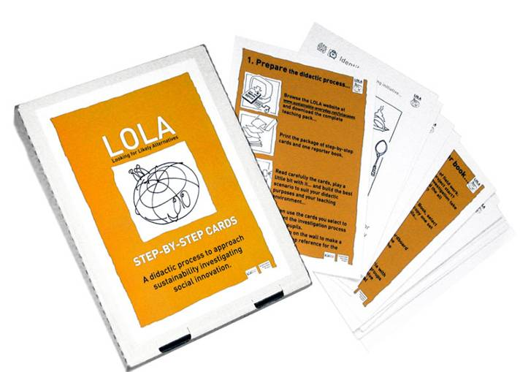

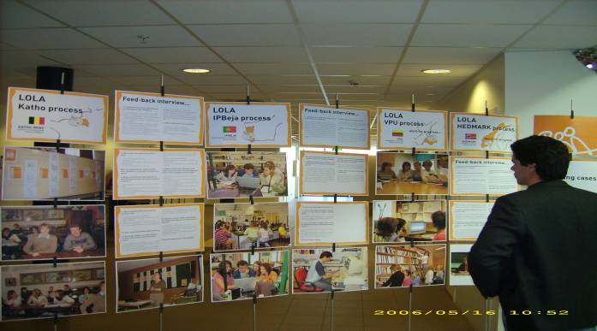
www.sustainable-everyday.net/lolaprocess
Partnership for Education and Research about Responsible Living

Slide 18
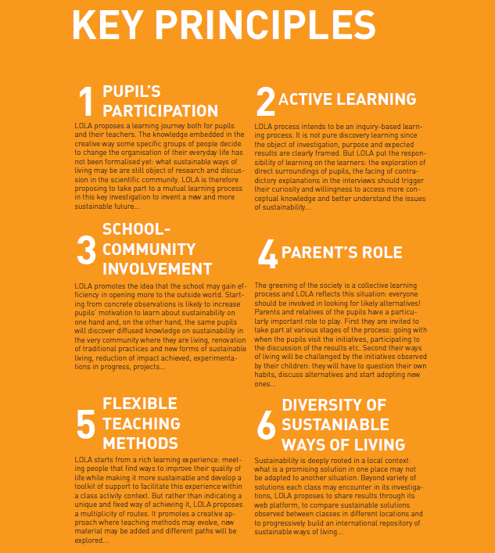
LOLA
Partnership for Education and Research about Responsible Living

Slide 19
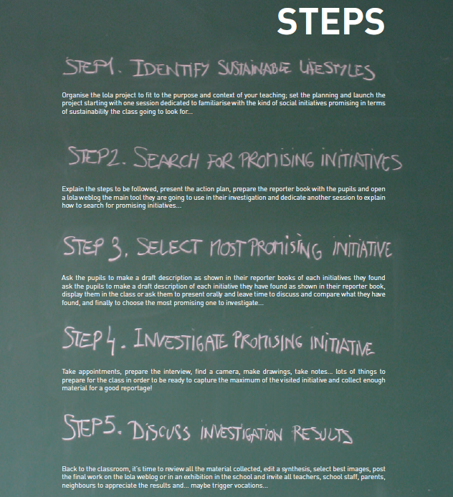
LOLA
Partnership for Education and Research about Responsible Living

Slide 20
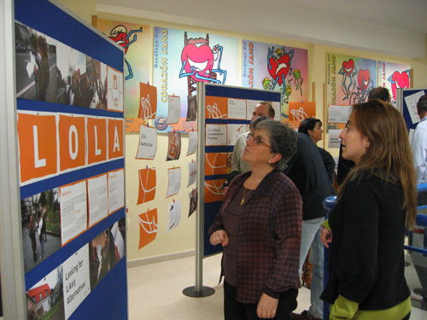
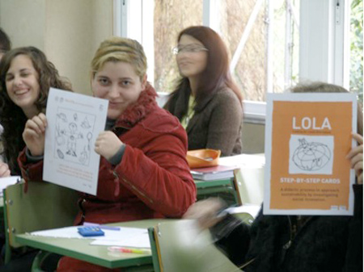
LOLA
Lithuania France
Latvia Italy
Ireland Germany
Belgium Finland
Portugal Spain
Norway Brazil
Partnership for Education and Research about Responsible Living

Slide 21
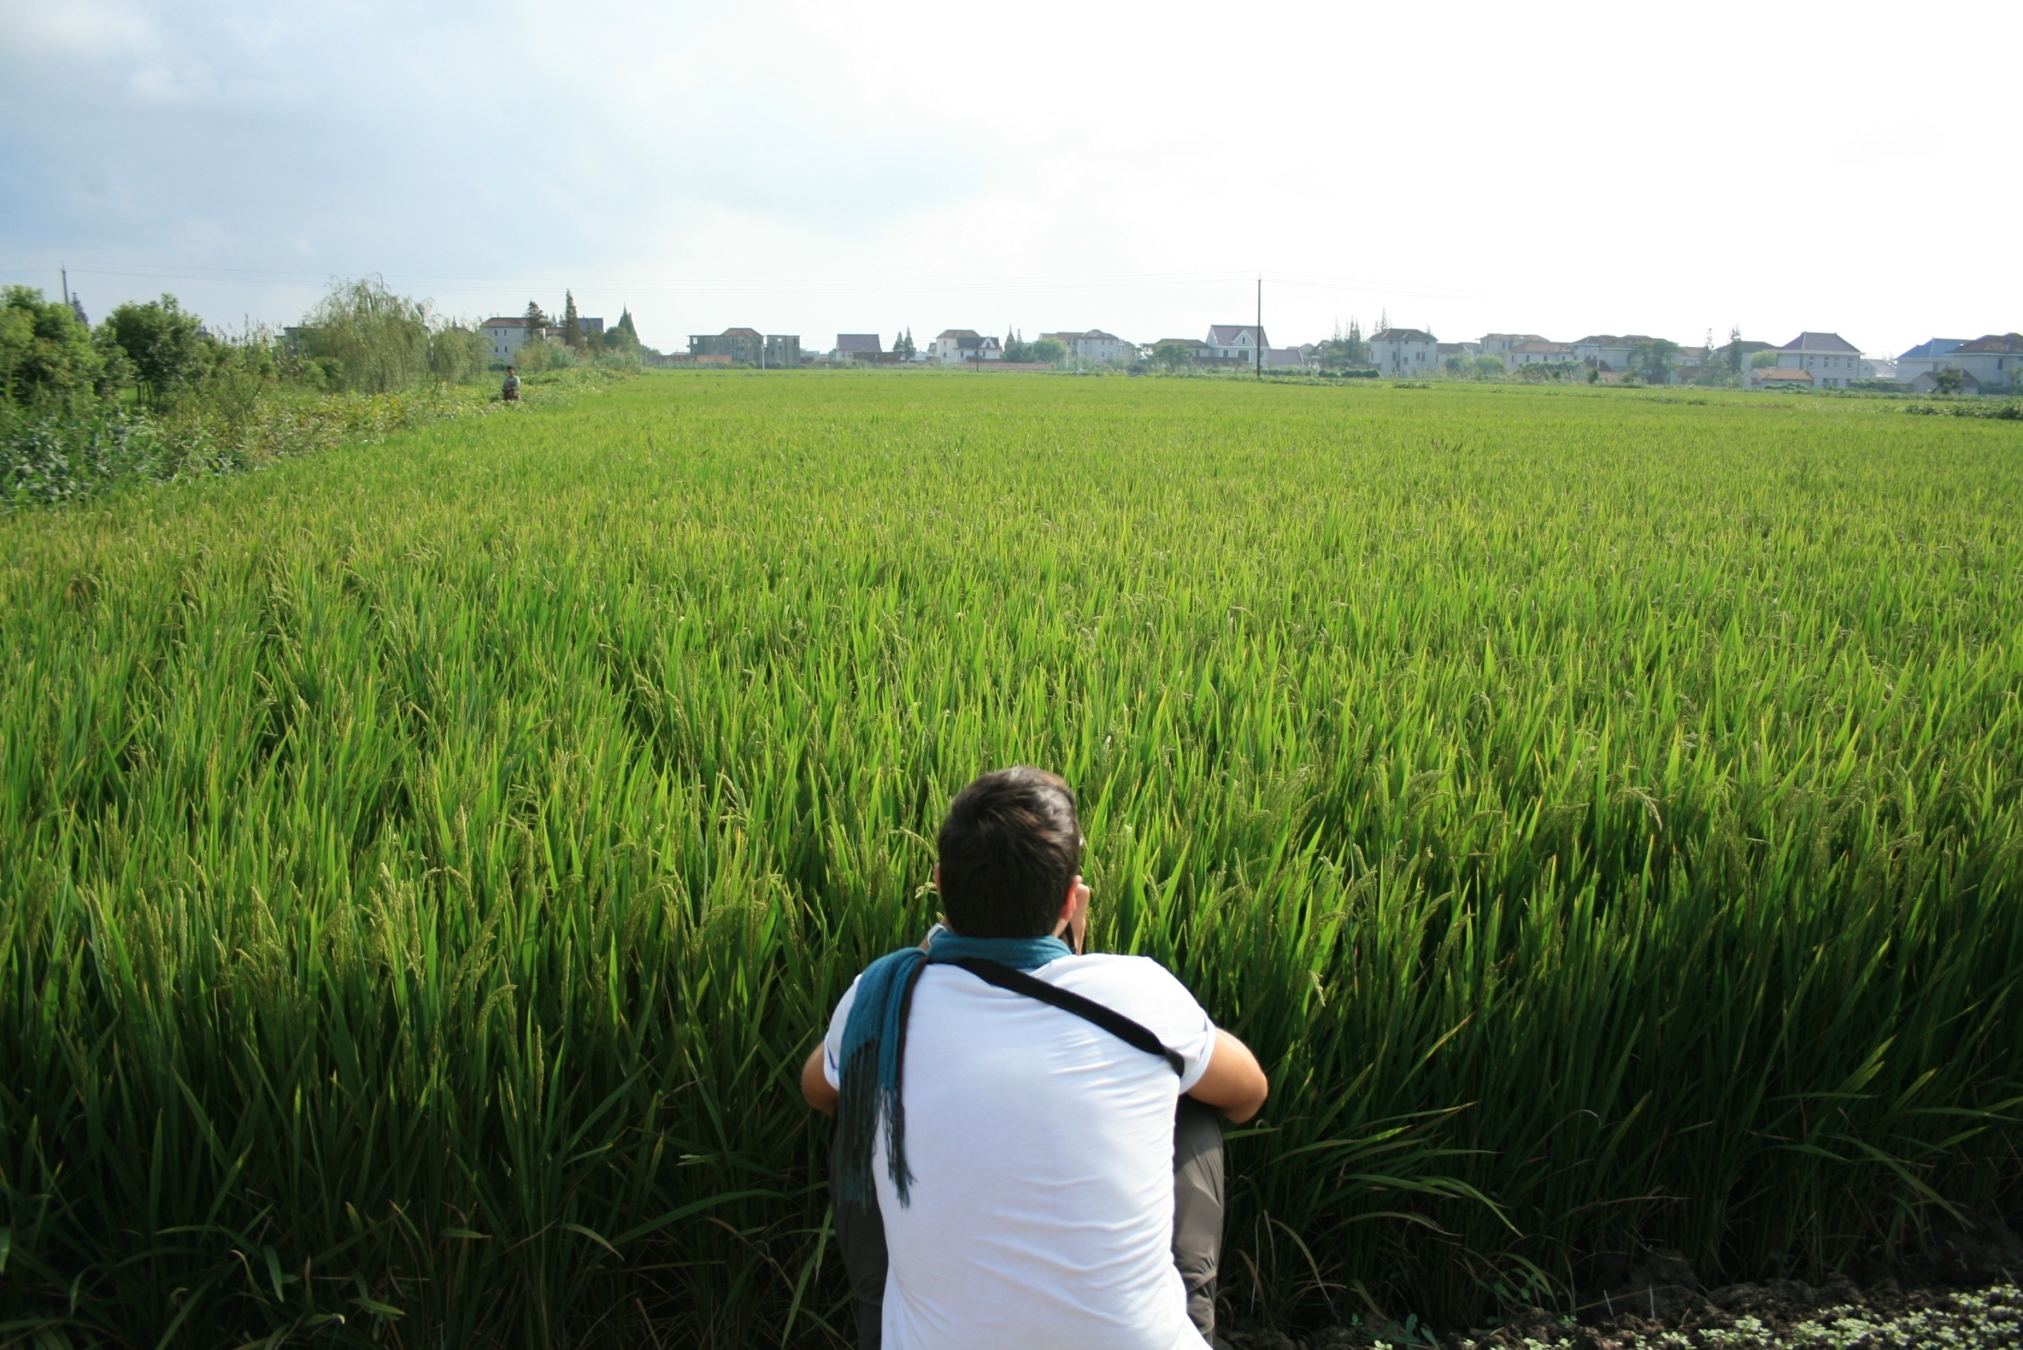
Framework project
Lv Cun (Green Village)
Xianqiao Village, Chongming Island, Shanghai
Partnership for Education and Research about Responsible Living

Slide 22
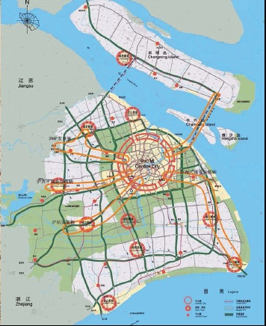
Vision
A rural-urban area where agriculture flourishes feeding the city and, at the same time, offering citizens opportunities for a multiplicity of farming and nature related activities.
To revitalize a rural village, improving the quality of life of both, farmers and citizens
To reinforce the connection between the urban and rural areas, therefore improve the social fabric
To activate under-exploited resources
To create new services for both citizens and farmers
To educate consumers to adopt more sustainable ways of eating
Goals
Partnership for Education and Research about Responsible Living

Slide 23



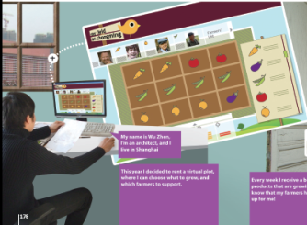

1. Scenario building
4. communication
3. Systemizing
Local projects
1
2
n
3
2. Involvement
Partnership for Education and Research about Responsible Living

Slide 24
Organic food distribution system
Collaboration with retailers, restaurants, mobile promotions
Food delivery system
Digital platform to subscribe for food deliveries
Virtual plot renting
For customers combining online game and community supported agriculture activity, involvement in harvesting
Partnership for Education and Research about Responsible Living

Slide 25
Partnership for Education and Research about Responsible Living

Slide 26
Partnership for
Education and research about
Responsible
Living
Thanks!
www.perlprojects.org
PERL@hihm.no
Notes:
Mention that we are interested in funding more of our work – please come and speak to us

Slide 27
PERL
Partnership for Education and Research about Responsible Living
Partnership for Education and Research about Responsible Living

