Slide 1

Partnership for
Education and research about
Responsible
Living
The role of values in achieving sustainability
David Chittenden – PERL Daily manager
December 17 2010, University of Brighton
www.perlprojects.org
PERL@hihm.no

Slide 2



Partnership for Education and Research about Responsible Living

Slide 3
Science – facts
Neo-liberal economics – ‘invisible hand’
Globalisation
Postmodernism
  Experts
Right, wrong, ought to be – ethics and values
Universal – Human rights
Moral experts (role models)?
  Everyone – society
Partnership for Education and Research about Responsible Living

Slide 4
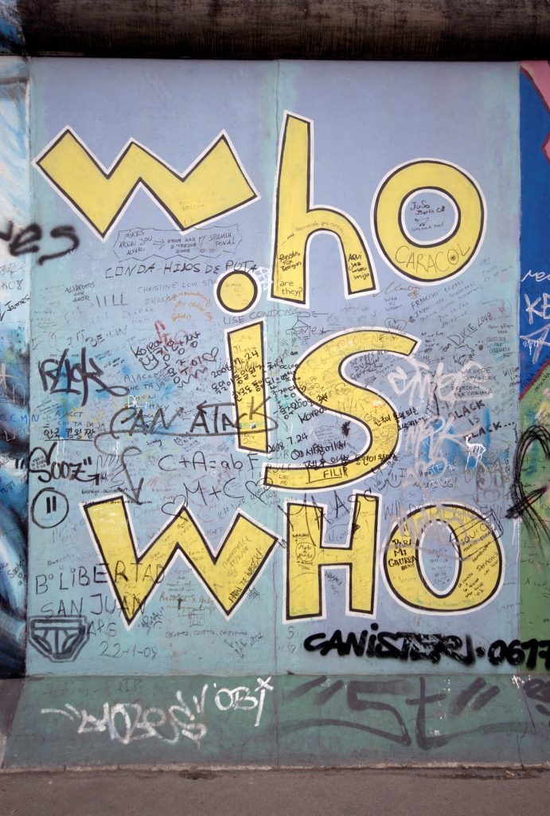
Loss of values?
More values and cultures
Loss of stable and enduring ‘frames of reference’
Partnership for Education and Research about Responsible Living

Slide 5
“What we are facing is not so much a crisis of values but rather a crisis concerning the very meaning of values and our capacity for self-governance.
The urgent question is this how to orient ourselves among values”
Kōichirō Matsuura, former DG UNESCO
Partnership for Education and Research about Responsible Living

Slide 6
Empower individuals
  Cope
  Create the future
Partnership for Education and Research about Responsible Living

Slide 7


What can we build on?
Idea of ‘global citizenship’
(sustainability?)
New forms of communication and expression, association and solidarity
Partnership for Education and Research about Responsible Living

Slide 8
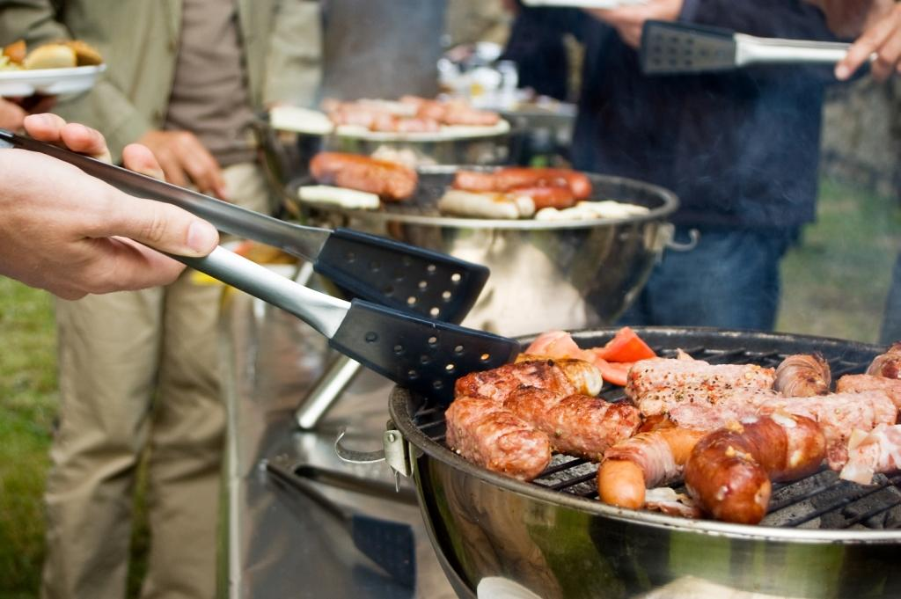
From psychology, people want to
  understand
  learn
  participate
Only if people are engaged in ways consistent with values and identities (how)
purchasing and other lifestyle behaviours are expressions of our identities (what)

Slide 9
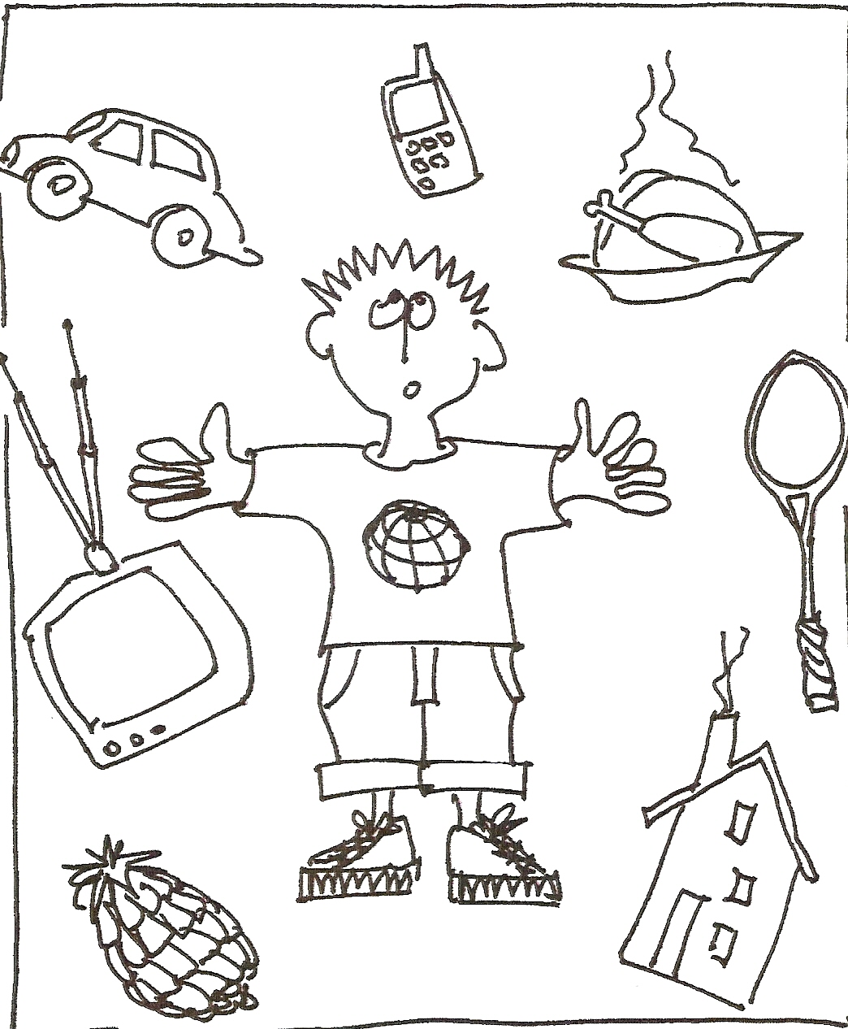
Consumption motivation
Love
Acceptance
Status
Fear
Need
Popularity
Availability
Price
Quality
(Ecological/social concerns)
“Price, chance, advertising” L. Berg SIFO 2009
Partnership for Education and Research about Responsible Living

Slide 10
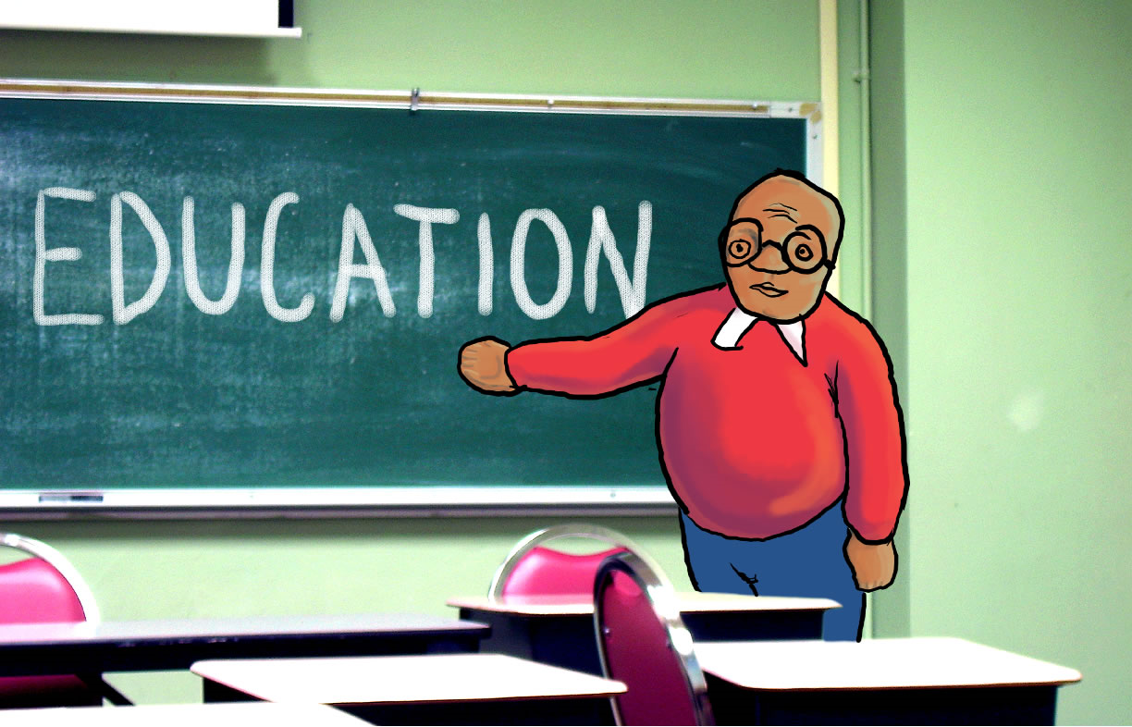
Partnership for Education and Research about Responsible Living

Slide 11
“…learning which flows naturally into direct community engagement.
An exercise in anticipatory democracy”
Tøfler A. 1971
Partnership for Education and Research about Responsible Living

Slide 12

Education for Sustainable Development (ESD)
ESD supports five types of learning
  learning to know
  learning to be
  learning to live together
  learning to do
  learning to transform oneself and society
Partnership for Education and Research about Responsible Living
Notes:
Learning to be - values

Slide 13
Core life skills
self-awareness
coping with emotions
coping with stress
empathy
decision-making
problem-solving
creative-thinking
critical thinking
effective communication
interpersonal relationship skills
Partnership for Education and Research about Responsible Living

Slide 14
ESC educational themes
Life quality
Lifestyles
Resources
Economics
Consumption and the environment
Consumer rights and responsibilities
Information management
Health and safety
Change management
Global awareness
Partnership for Education and Research about Responsible Living

Slide 15
PERL examples
  Policy Guidelines
    ESC and Consumer Citizenship Education
  Active teaching/learning methods & materials
    ‘Images and objects’, LOLA
  Research
    Global Survey Sustainable Lifestyles
  Highlight cases of Social Innovation
Partnership for Education and Research about Responsible Living

Slide 16
PERL values
The core values on which PERL's work is founded are
  Justice
  Equity
  Unity
  Diversity
  Dignity
  Cooperation
  Respect
  Honesty
  Transparency
  Accountability
  Fun
Partnership for Education and Research about Responsible Living

Slide 17


PERL values
The core values on which PERL's work is founded are
  Justice
  Equity
  Unity
  Diversity
  Dignity
  Cooperation
  Respect
  Honesty
  Transparency
  Accountability
  Fun
Partnership for Education and Research about Responsible Living

Slide 18

PERL values
The core values on which PERL's work is founded are
  Justice
  Equity
  Unity
  Diversity
  Dignity
  Cooperation
  Respect
  Honesty
  Transparency
  Accountability
  Fun
Partnership for Education and Research about Responsible Living

Slide 19

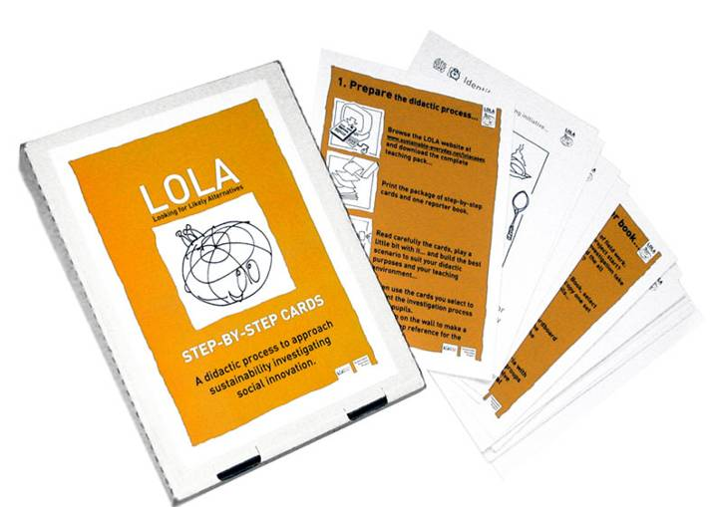
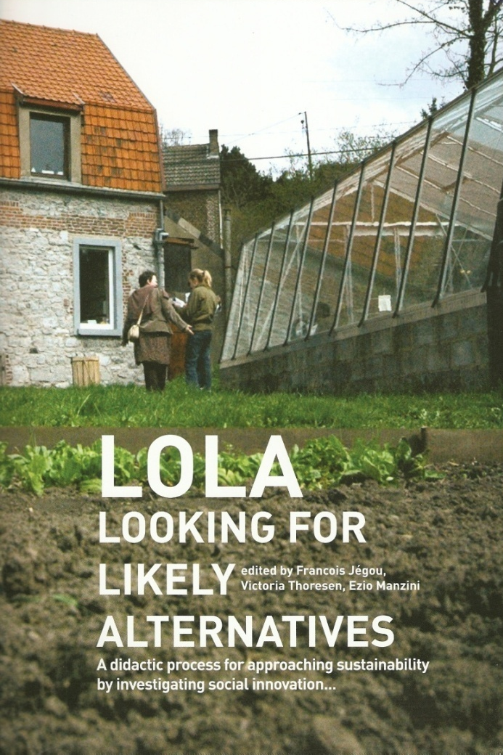
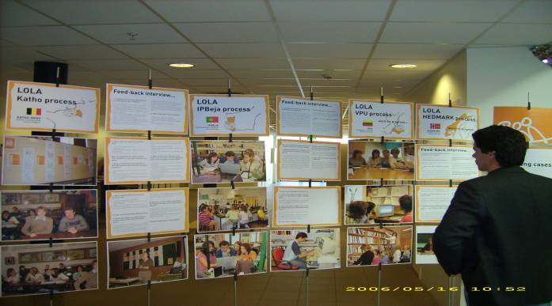
www.sustainable-everyday.net/lolaprocess
Partnership for Education and Research about Responsible Living

Slide 20
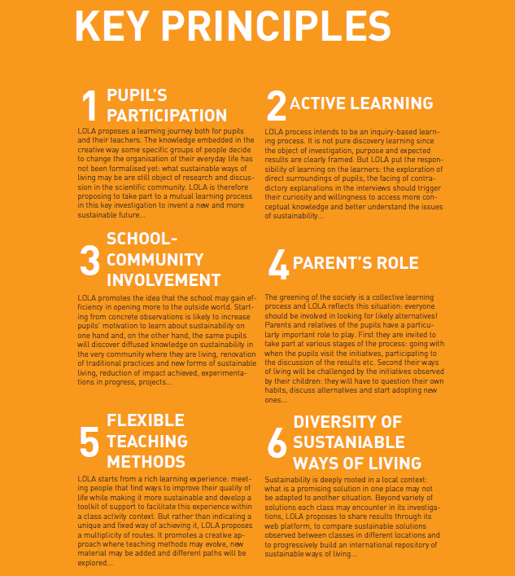
LOLA
Partnership for Education and Research about Responsible Living

Slide 21
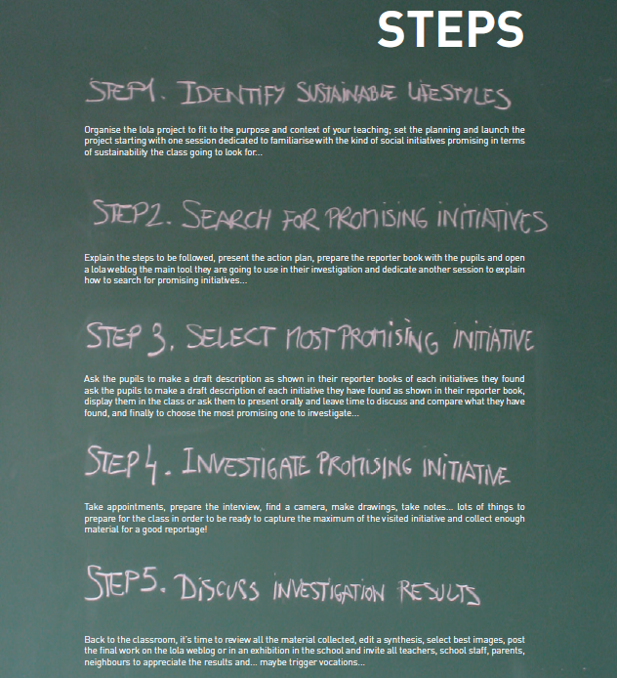
LOLA
Partnership for Education and Research about Responsible Living

Slide 22
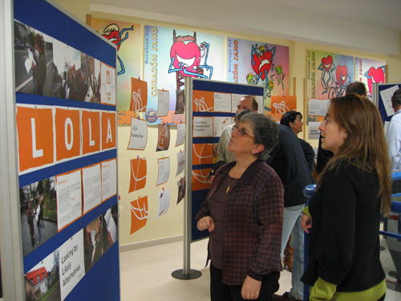
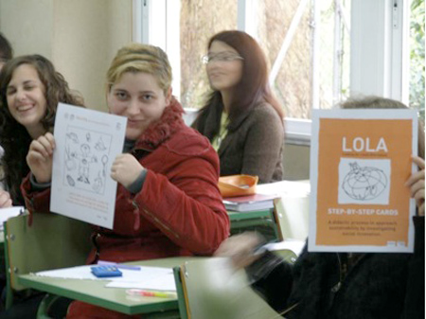
LOLA
Lithuania France
Latvia Italy
Ireland Germany
Belgium Finland
Portugal Spain
Norway Brazil
www.sustainable-everyday.net/lolaprocess
Partnership for Education and Research about Responsible Living

Slide 23
human history is a race between education and catastrophe
H. G. Wells
human history is a race between changing behaviour and catastrophe
Partnership for Education and Research about Responsible Living
Notes:
Education is fundamental, but it’s not just what is taught. How it is taought is equally important.
Everybody has a role in ’education’ not just schools and universities, but media, advertising friends.

Slide 24
Partnership for
Education and research about
Responsible
Living
Thanks!
PERL Conference, 14-15 March 2011, Istanbul
Student Essay and Film Compeitions close January 2011
www.perlprojects.org
PERL@hihm.no
Notes:
Mention that we are interested in funding more of our work – please come and speak to us

