Slide 1
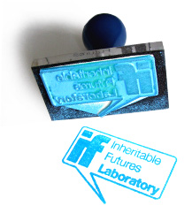
Nick Gant
University of Brighton – School of Architecture and Design
Co-Founder Inheritable Futures Laboratory [IF:Lab]
Industrial Designer
CO-DESIGN

Slide 2
A departure from the designer as the commodity, the ego, the brand, to being a facilitator and arbiter of collaboration, communal empowerment and considerate action.
A creative process not a ‘gift’.
Design as the cure, not the disease (in sustainability terms).
CO-DESIGN

Slide 3



Designing sustainable places for play, recreation, education and social engagement
COHESION
Notes:
Den as a unique entity – prime-evil, fundamental - play, learning, creativity, experimentation
Rural deprivation – social exclusion and engagement

Slide 4
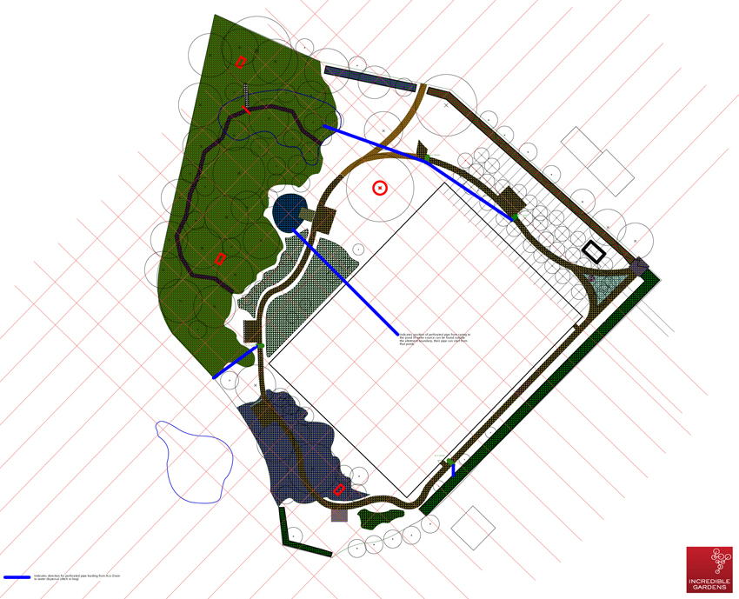
COHESION

Slide 5
COHESION

Slide 6
Orchard
Pond
Allotments
Dens
creative mutual / co-op
COHESION

Slide 7
“Youth Camp”
Orchard
Pond
Allotments
Dens
creative mutual / co-op
COHESION
Notes:
Lottery commissioned play areas

Slide 8
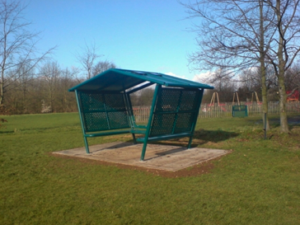
CONTEXT
Notes:
Rural deprivation – social exclusion and engagement

Slide 9
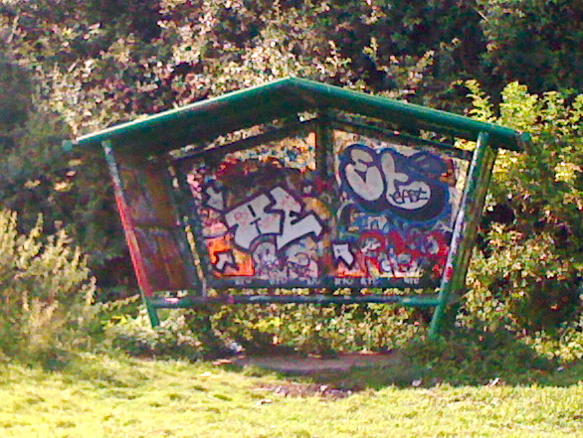
CONTEXT

Slide 10
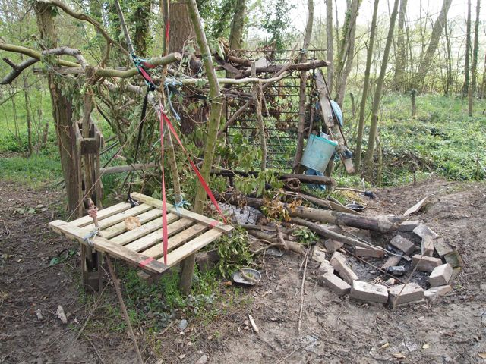
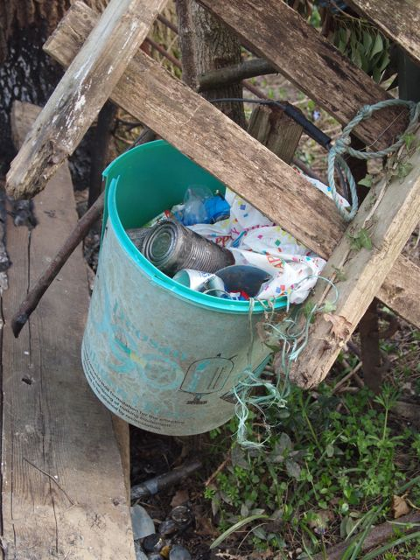
CO-CREATE

Slide 11
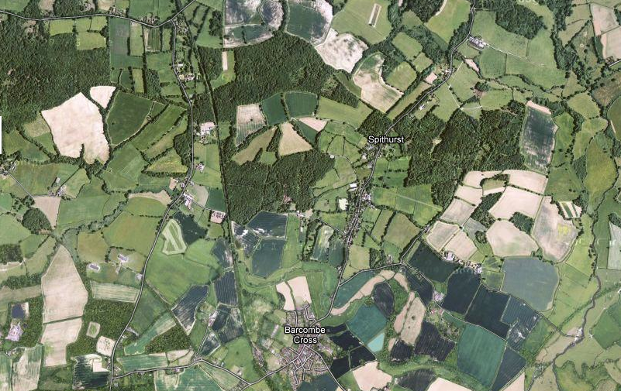
COMMUITY ASSETS

Slide 12
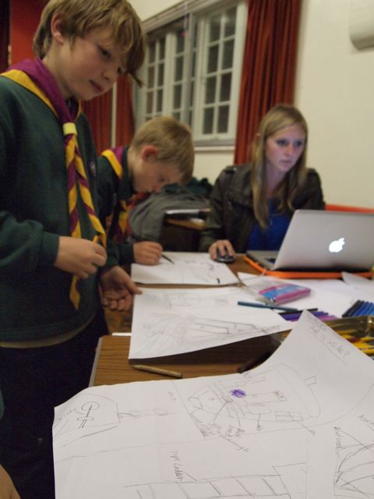
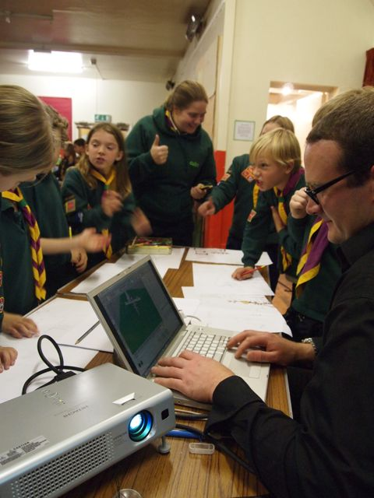
COLLABORATE
Notes:
Next generation of teenager
Their ideas

Slide 13
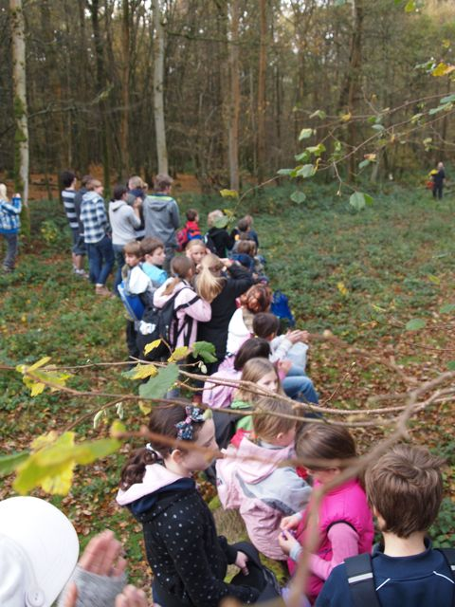
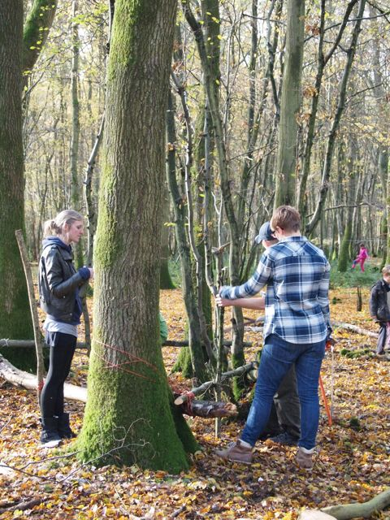
CO-CREATE / EDUCATE
Notes:
Grass roots – chainsaw and timber sustainably sourced

Slide 14
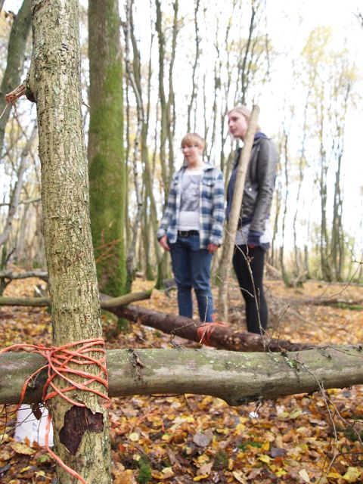
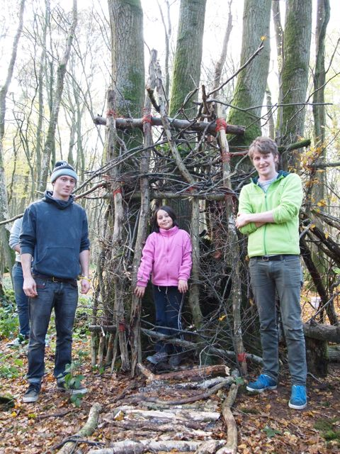
CO-CREATE / EDUCATE

Slide 15
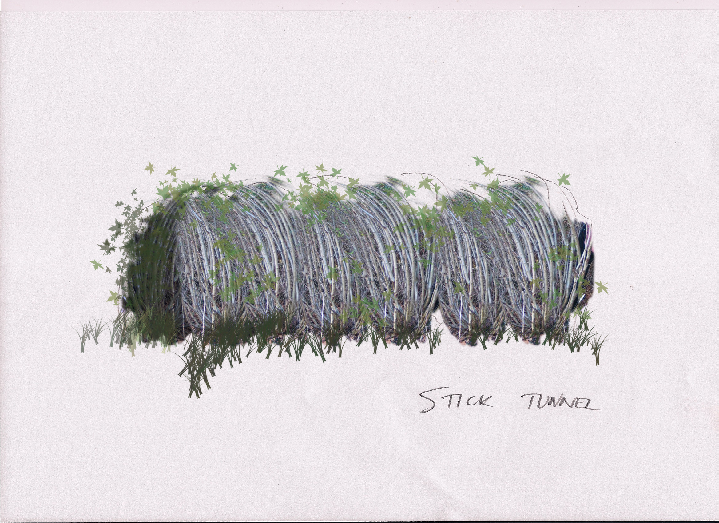
COHESION

Slide 16
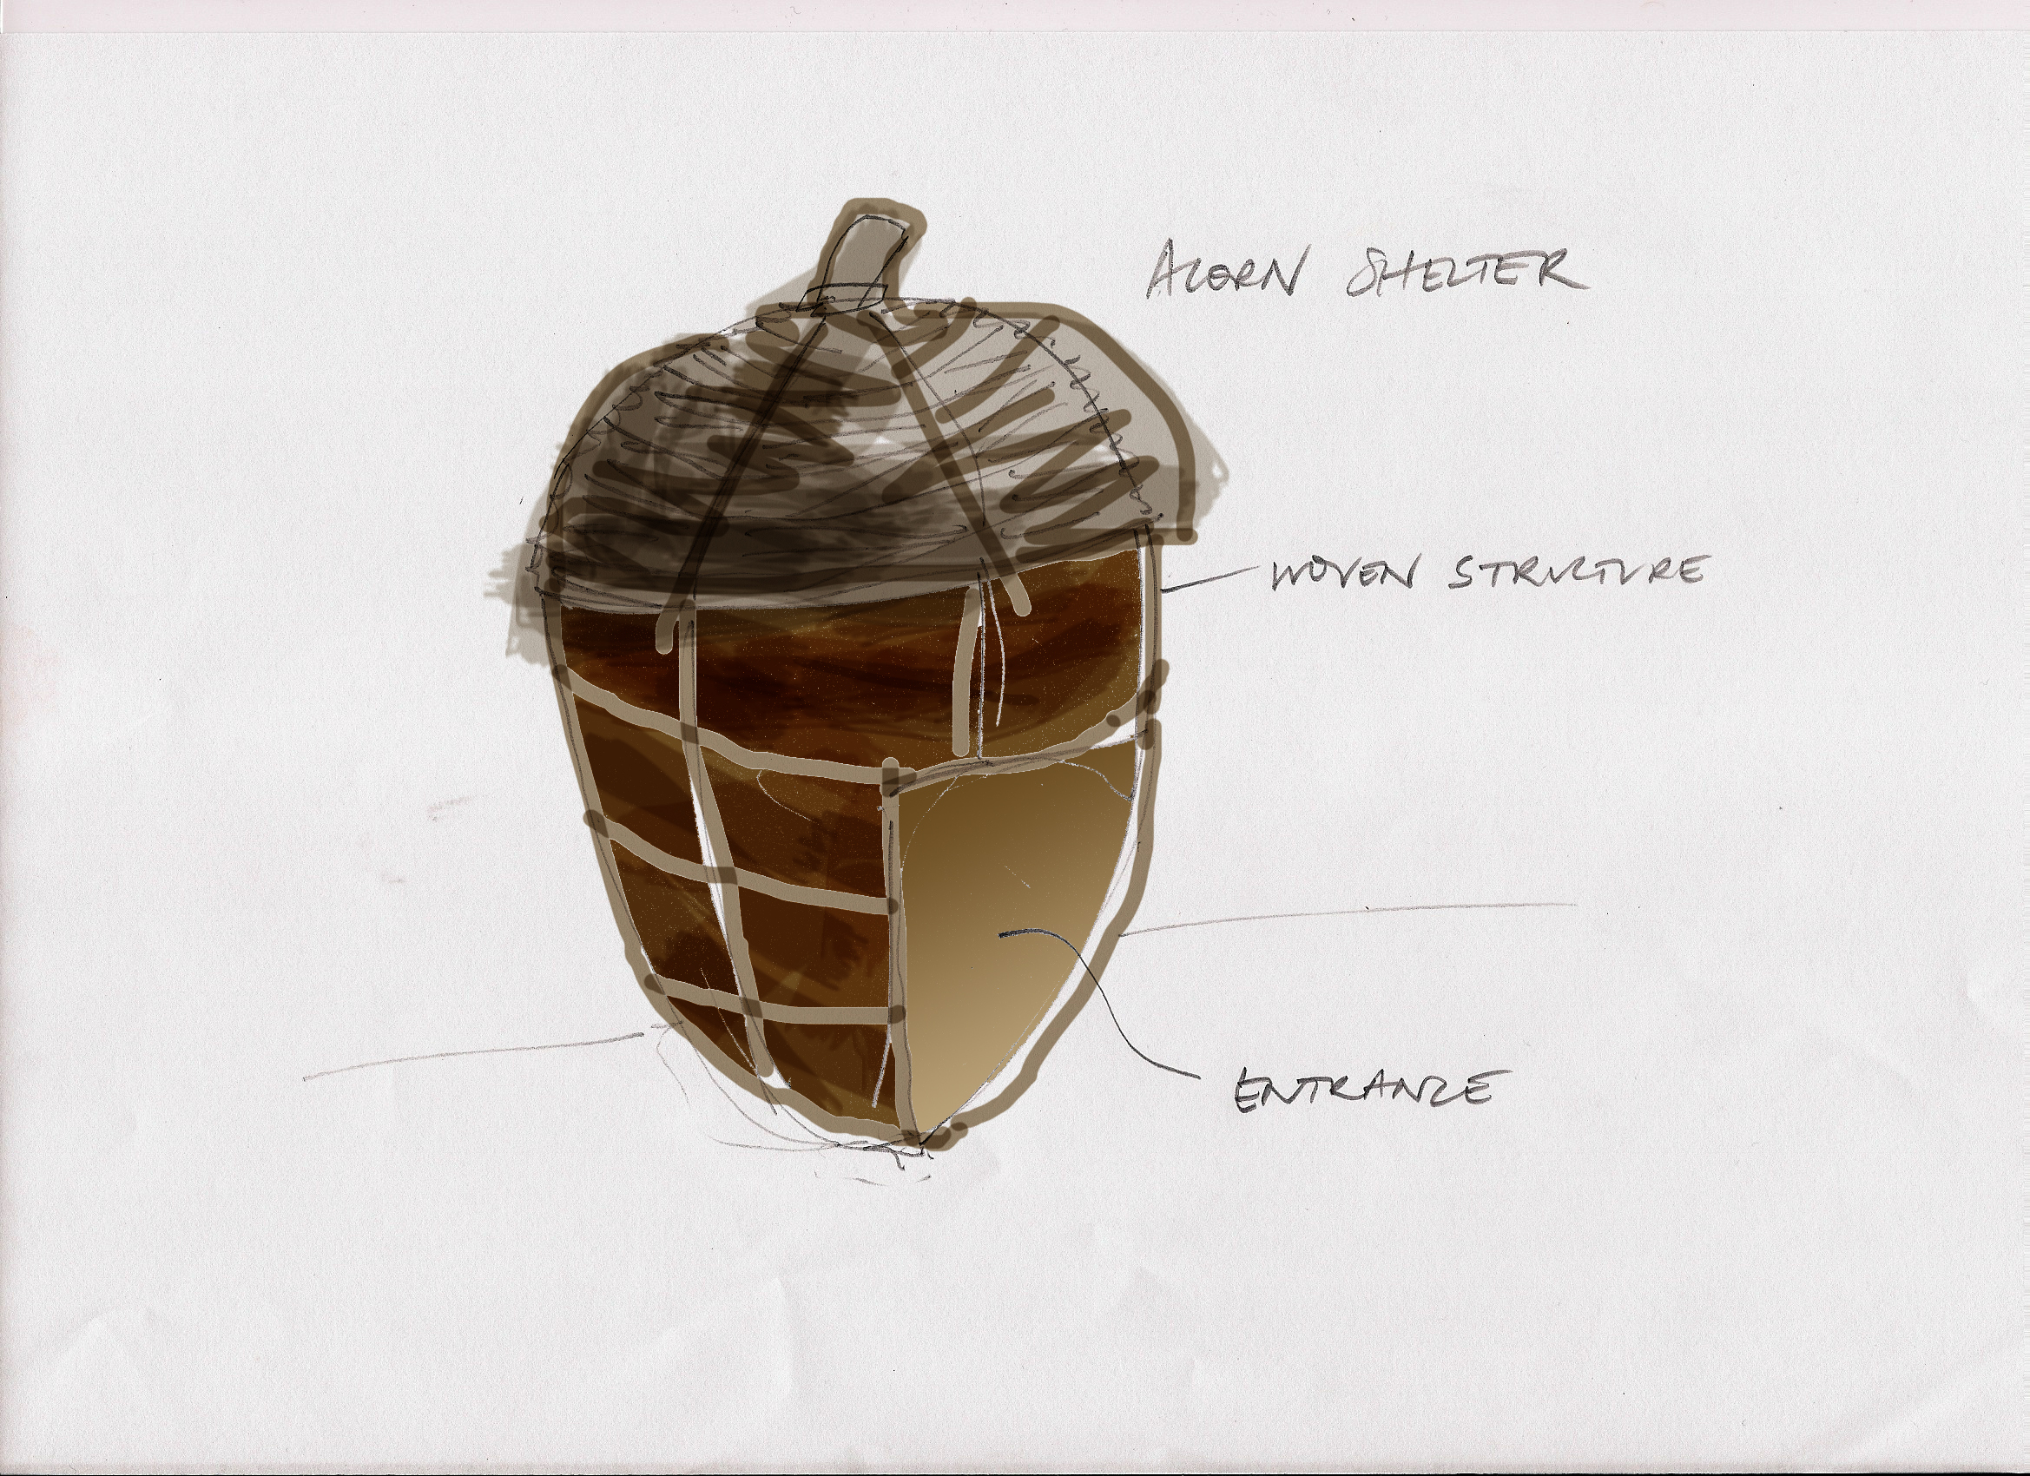
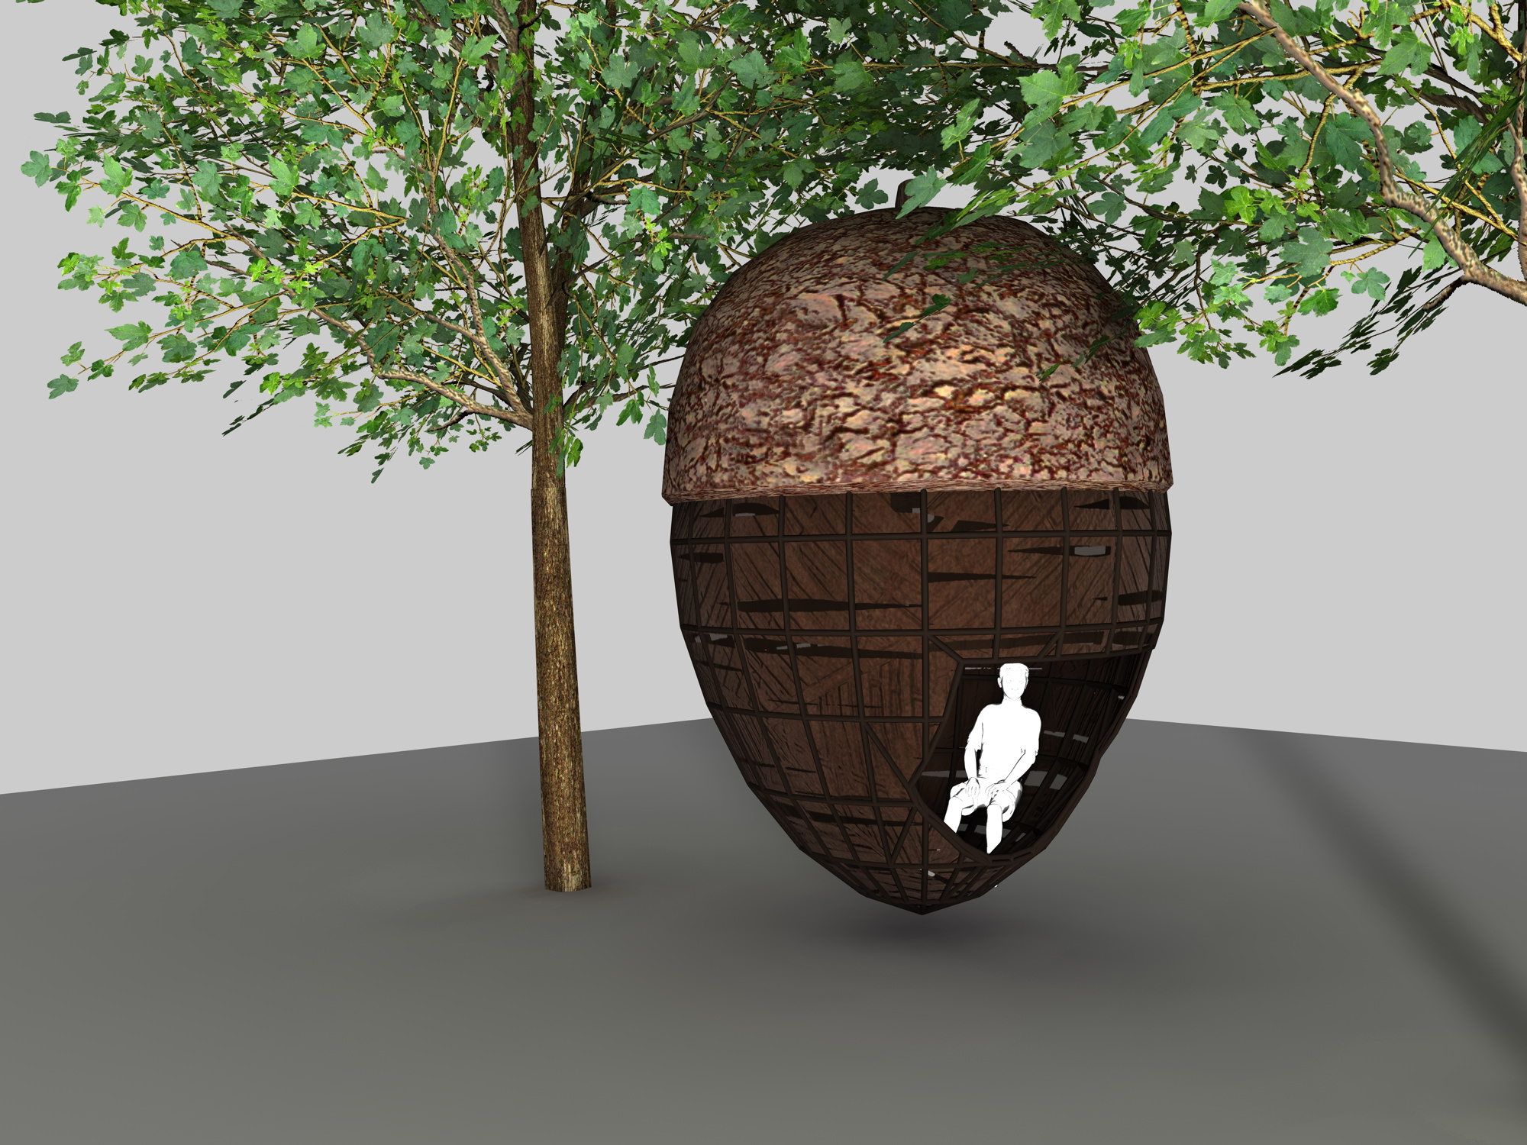
COHESION
Notes:
Authentic user formed ideas and principles – genus of the proposal

Slide 17
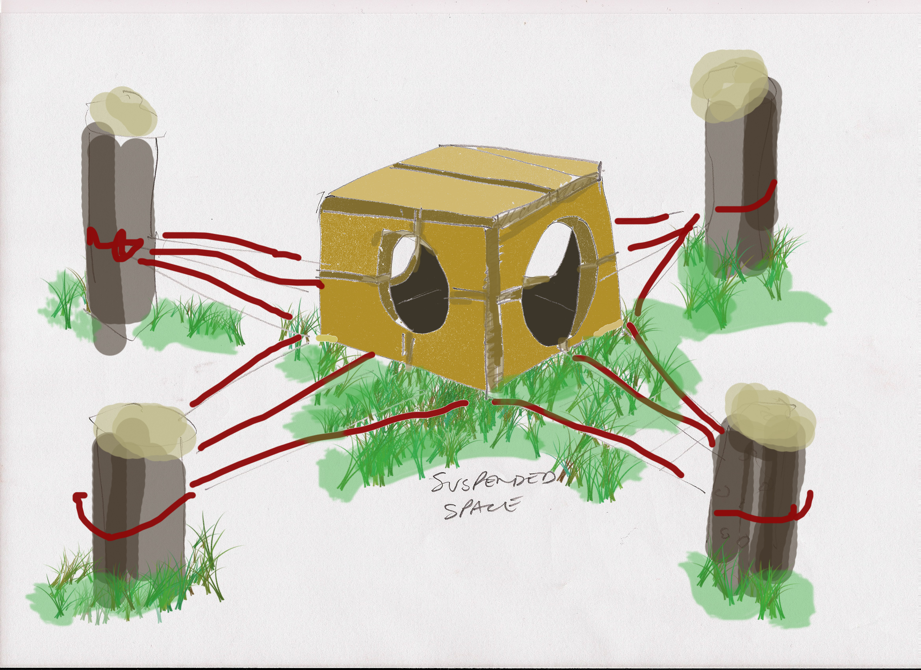
COHESION

Slide 18
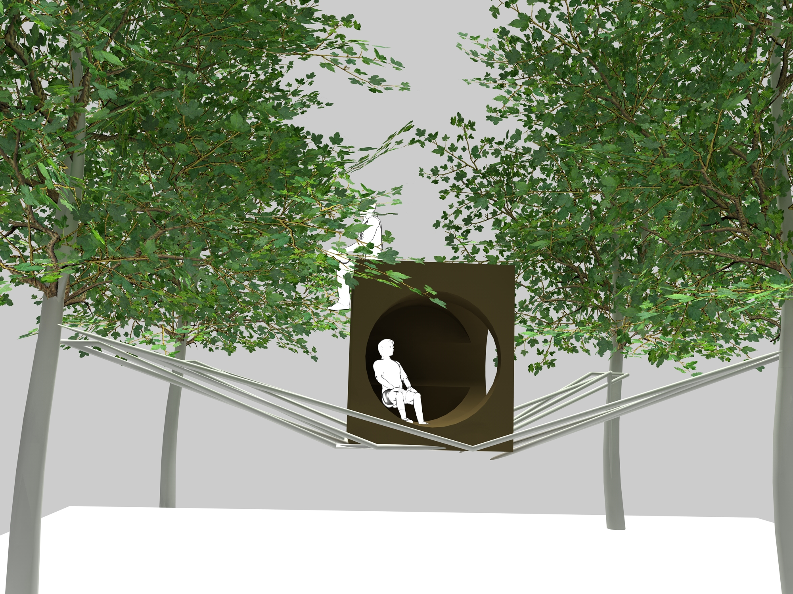
COHESION

Slide 19
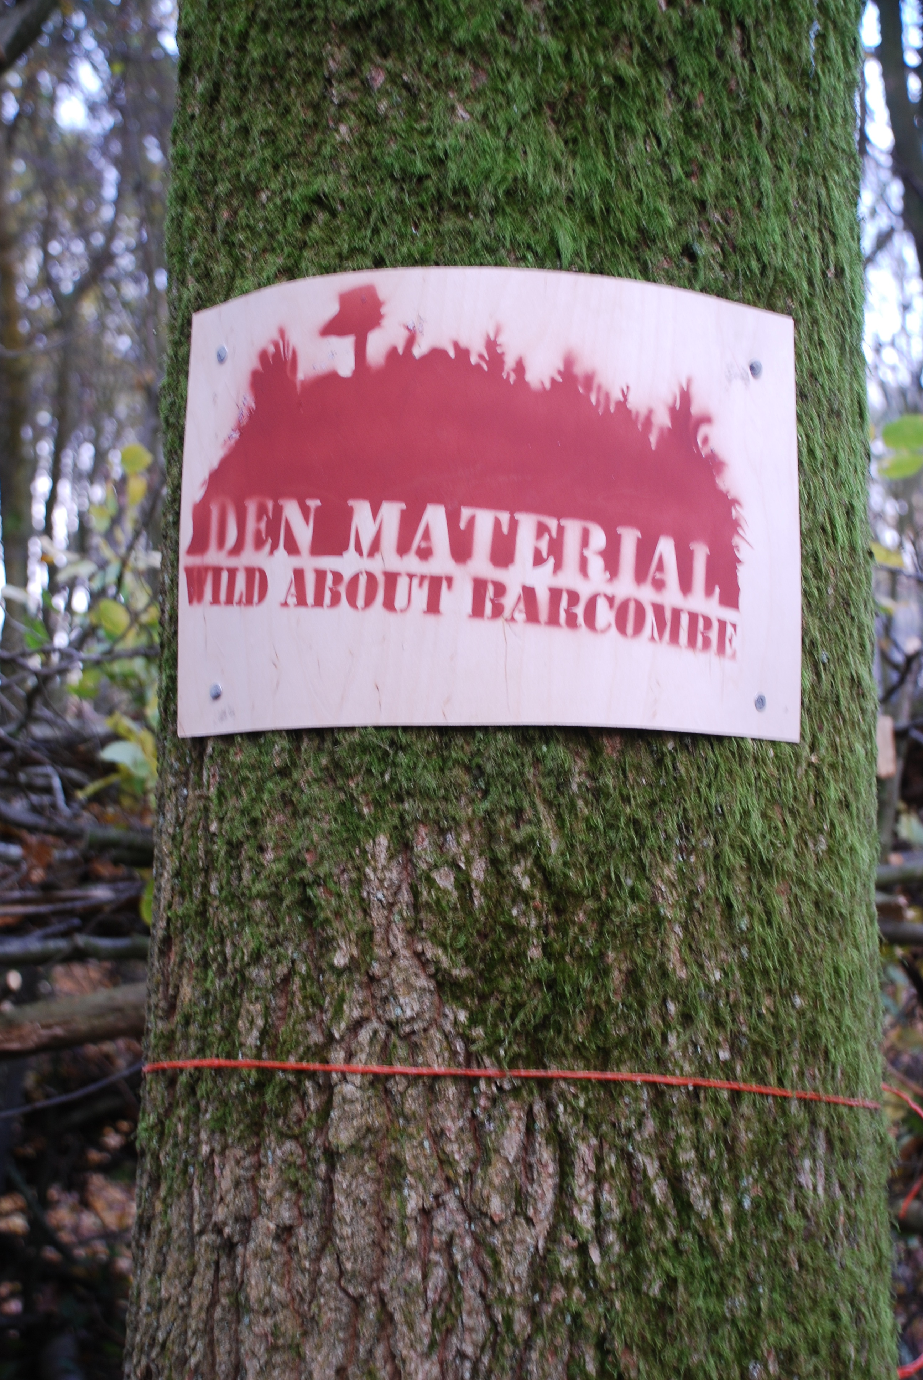
COHESION

Slide 20
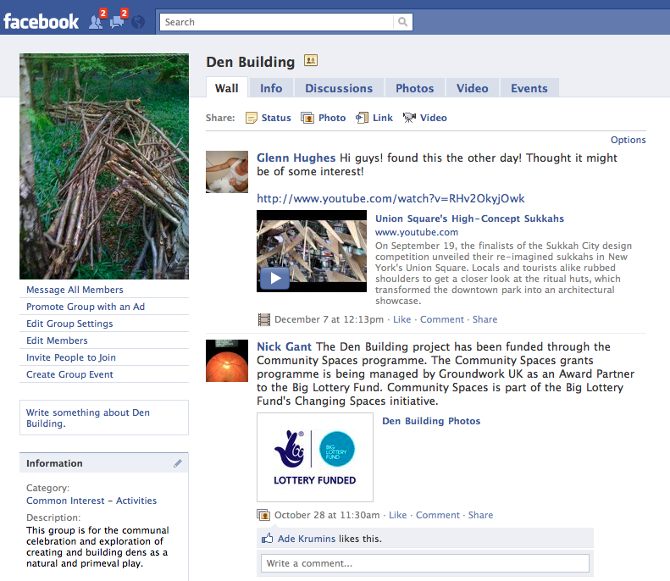
COMMUNICATION
Notes:
Lottery disseminating it nationally as an exemplar process

Slide 21
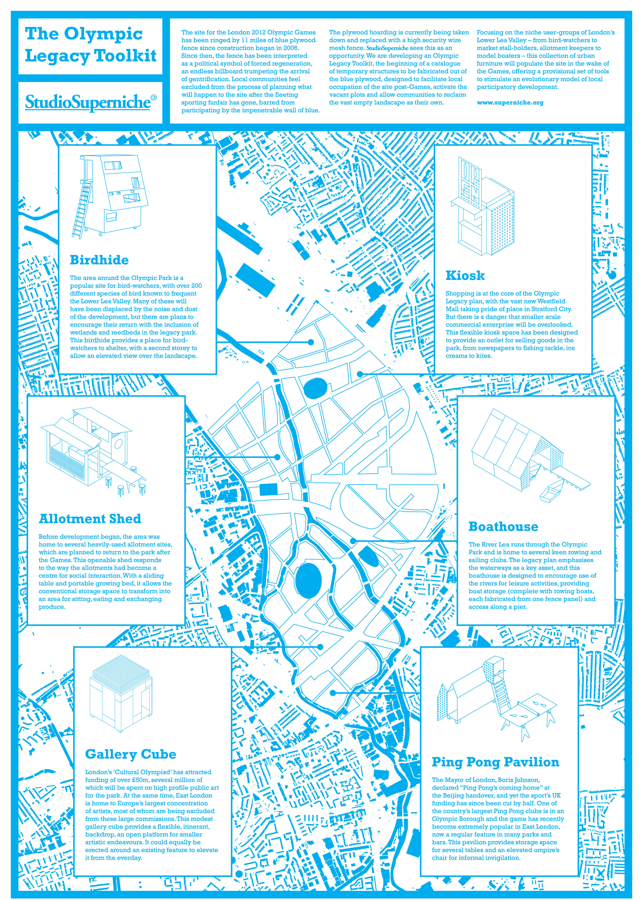
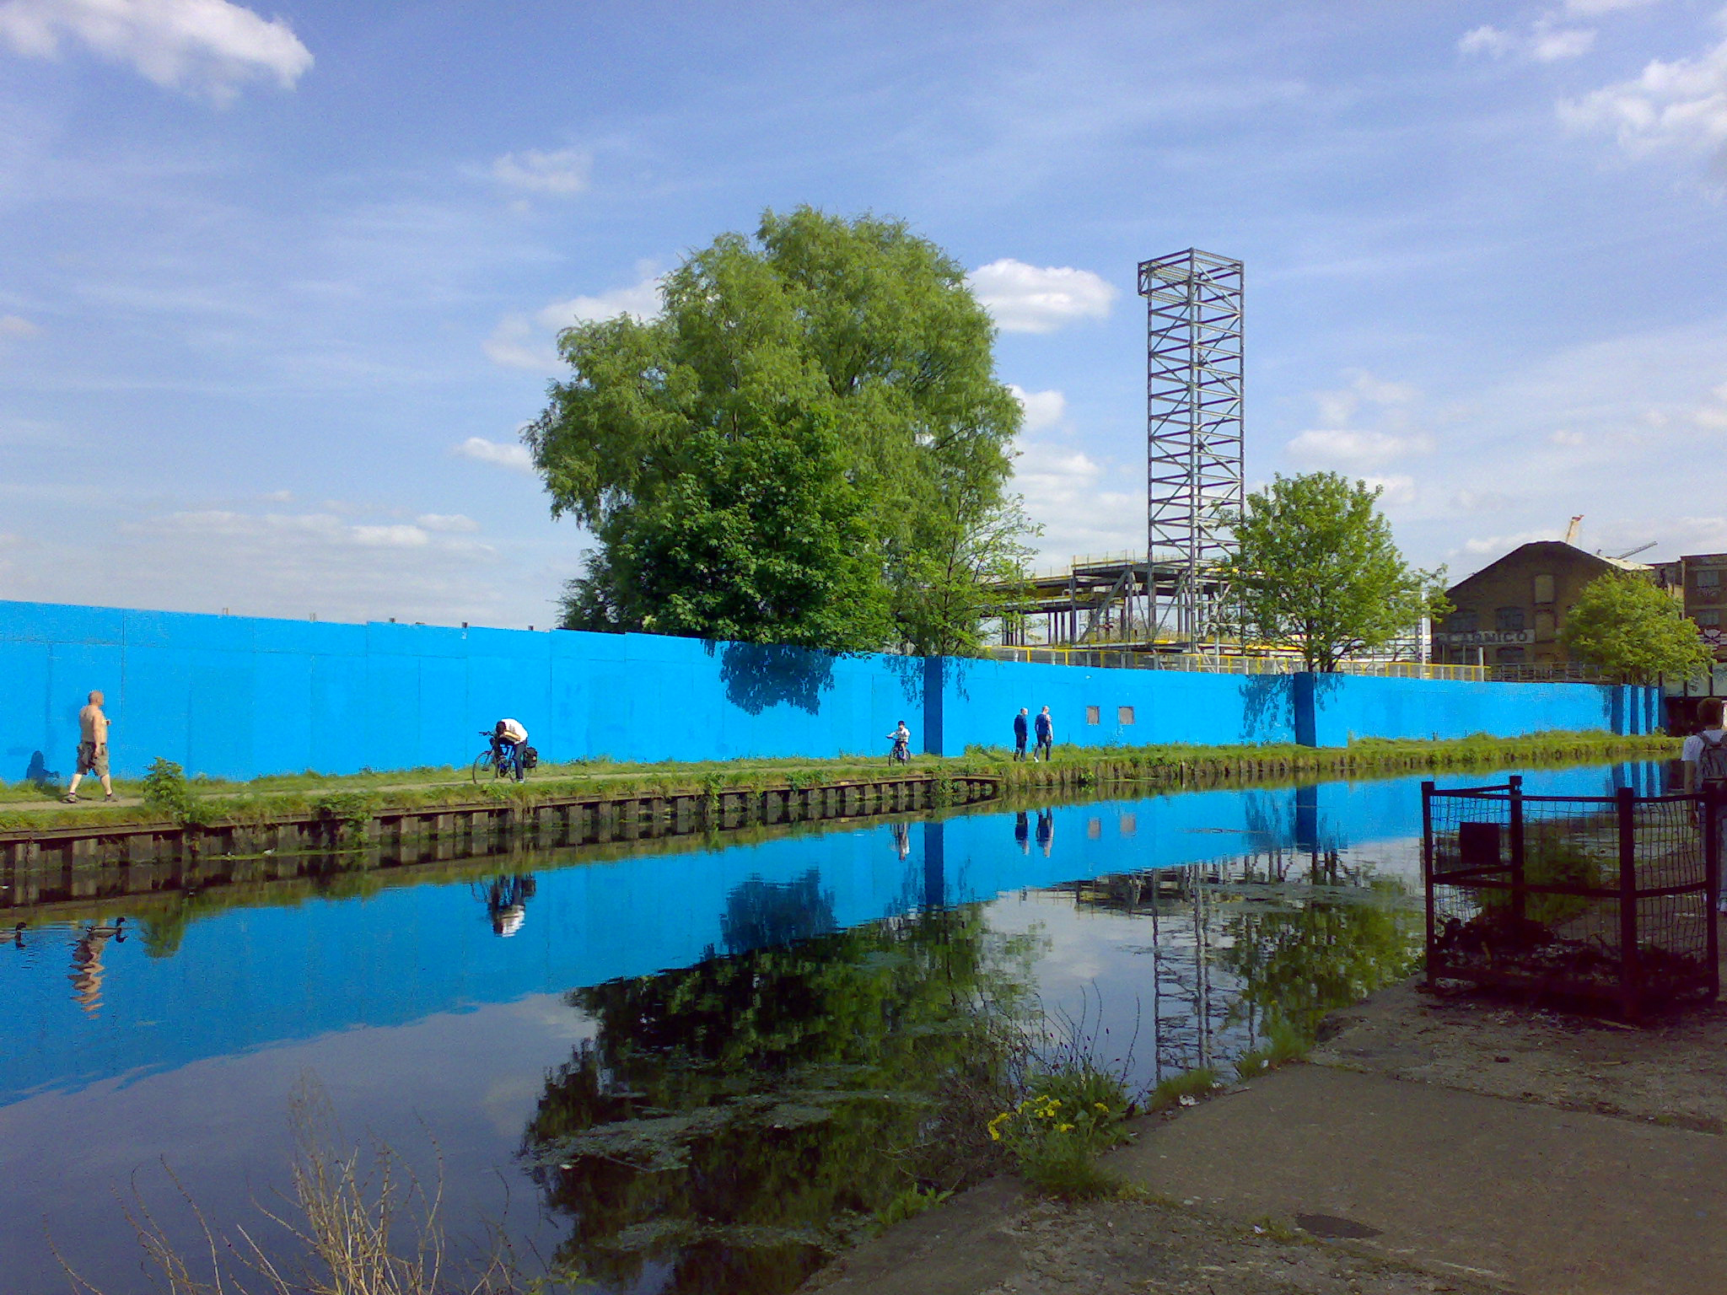
Kieran Jones – Olympic Park Perimeter
Notes:
Co-designed and produced totems

Slide 22
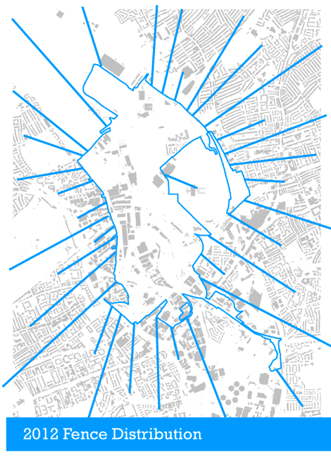
Kieran Jones – Olympic Park Perimeter

Slide 23
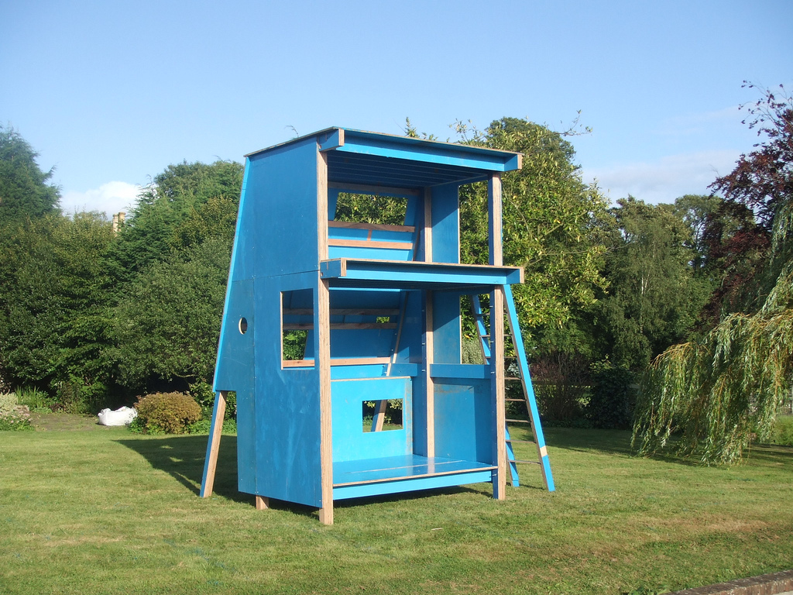
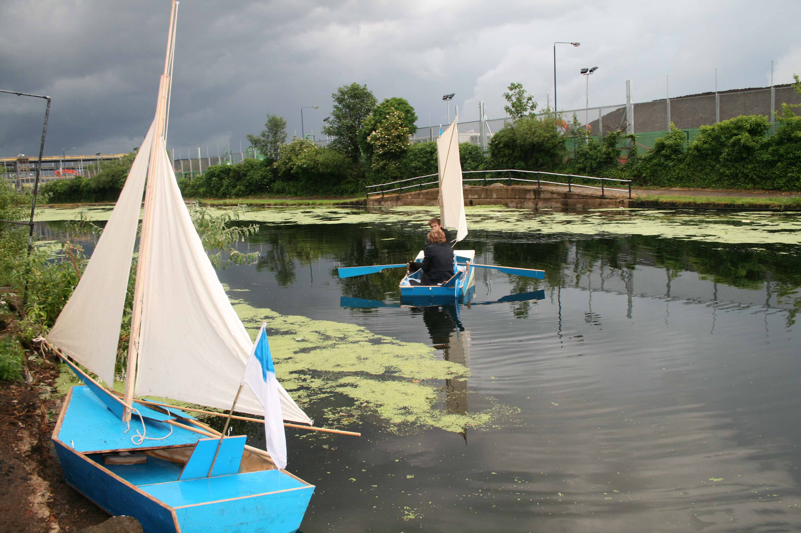
Kieran Jones – Olympic Park Perimeter

Slide 24
Values:
Co-ownership for extended life-spans and mutual respect
Collaboration form connections and bonds with peers
Education learn new skills and principles in practice
Co create collective authorship and authentic user inputs / values
Cohesion better relations between community members
COHESION

Slide 26

Social network and planning toolbox for sustainable communities
COMMUNITY
Notes:
Partnership between UOB and AIRS (RCC) –
Social network is not new – coupled with established movement of community led planning
Parish Councilor

Slide 27
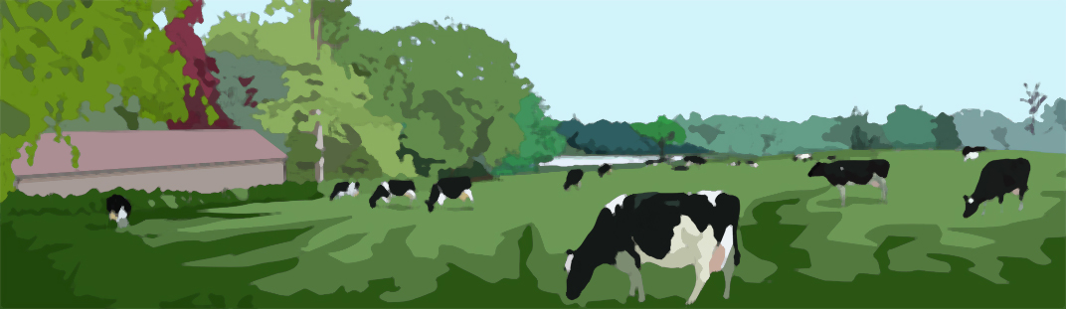
Misperception of “Green” and pleasant land
Many Villages are Land-locked islands that are often more dependant on non-renewables (especially oil).
London is the most ecologically sound place to live and rural inhabitants are less ‘sustainable’ than urban
counterparts.
(PD Smith 2009 (EPSRC ‘State of The Nation’)
COMMUNITY
Notes:
Rural citizenship

Slide 28
Misperception of “Green” and pleasant land
Many Villages are Land-locked islands that are often more dependant on non-renewables (especially oil).
London is the most ecologically sound place to live and rural inhabitants are less ‘sustainable’ than urban
counterparts.
(PD Smith 2009 (EPSRC ‘State of The Nation’)
COMMUNITY
Notes:
Rural citizenship

Slide 29

Don’t mention the ‘S’ word
COMMUNITY
Notes:
Rural citizenship

Slide 30
Don’t mention the ‘S’ word
Sustainability is unhelpfully loaded as a term for positive community action
Divisive - climate change ‘believer’ or ‘denier’
Polemic and absolute - either you are 100% ‘green’ or you aren’t
Abstract - global catastrophe / what’s a megatonne?! / who can really relate to the plight of polar bears!?
Unobtainable – too big a problem / over-facing
COMMUNITY
Notes:
Rural citizenship

Slide 31
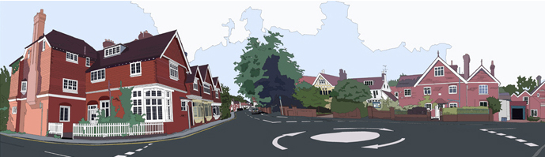
Most of our practical concerns are introspective and localised (not global)
Example: What issues of sustainability concern you most?
(Question asked as part of village action plan survey of 540 respondents - 2009)
“We need cardboard recycling bins”
“We must keep our shop and post-office”
“We have had our oil stolen”
“The road has flooded four times this year”
“The bus does not run often enough”
COMMUNITY
Notes:
Rural citizenship

Slide 32
Most of our practical concerns are introspective and localised (not global)
“Sustainability can be a by-product of a lifestyle choice that may initially have nothing to do with
environmental concerns”.
(Resolve Group / EPSRC State of the Nation 2009)
eg; smaller car is more efficient, cheaper to run and easier to park / an insulated house or village hall is
cheaper to heat…etc
= Eco-logical
COMMUNITY
Notes:
Rural citizenship

Slide 33
Rural Community Action Network [RCAN]
38 across England
Action in Rural Sussex
73% of villages have undertaken at least one ‘action plan’
In Plumpton Village 83% of residents participated in the Action Plan
consultation
COMMUNITY LED PLANNING
Notes:
Envisioning the future of the community

Slide 34
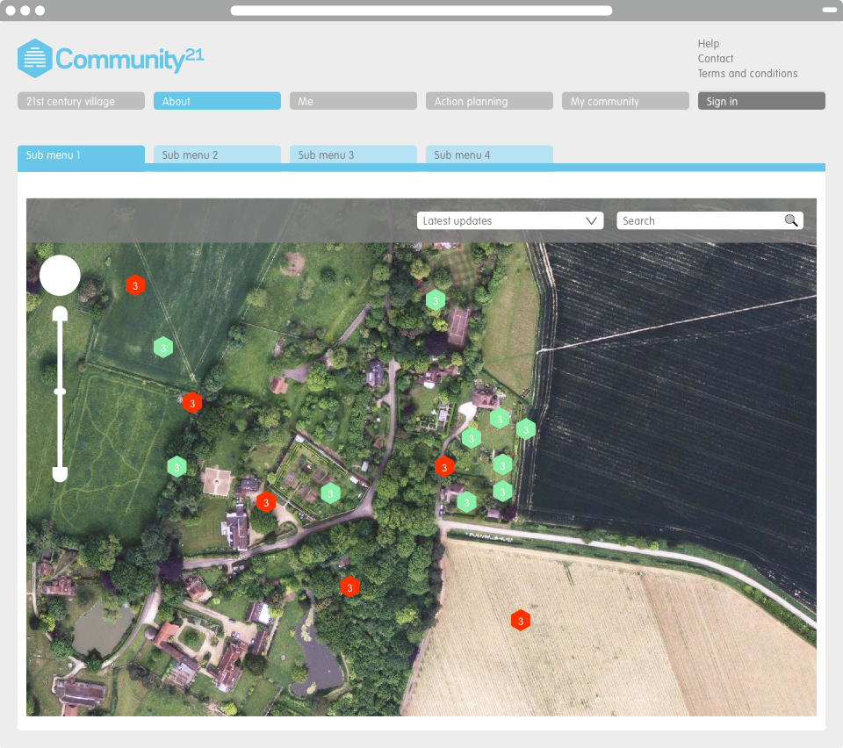
Notes:
Asset map / treasure map - build a informative recognisable image of the community

Slide 35
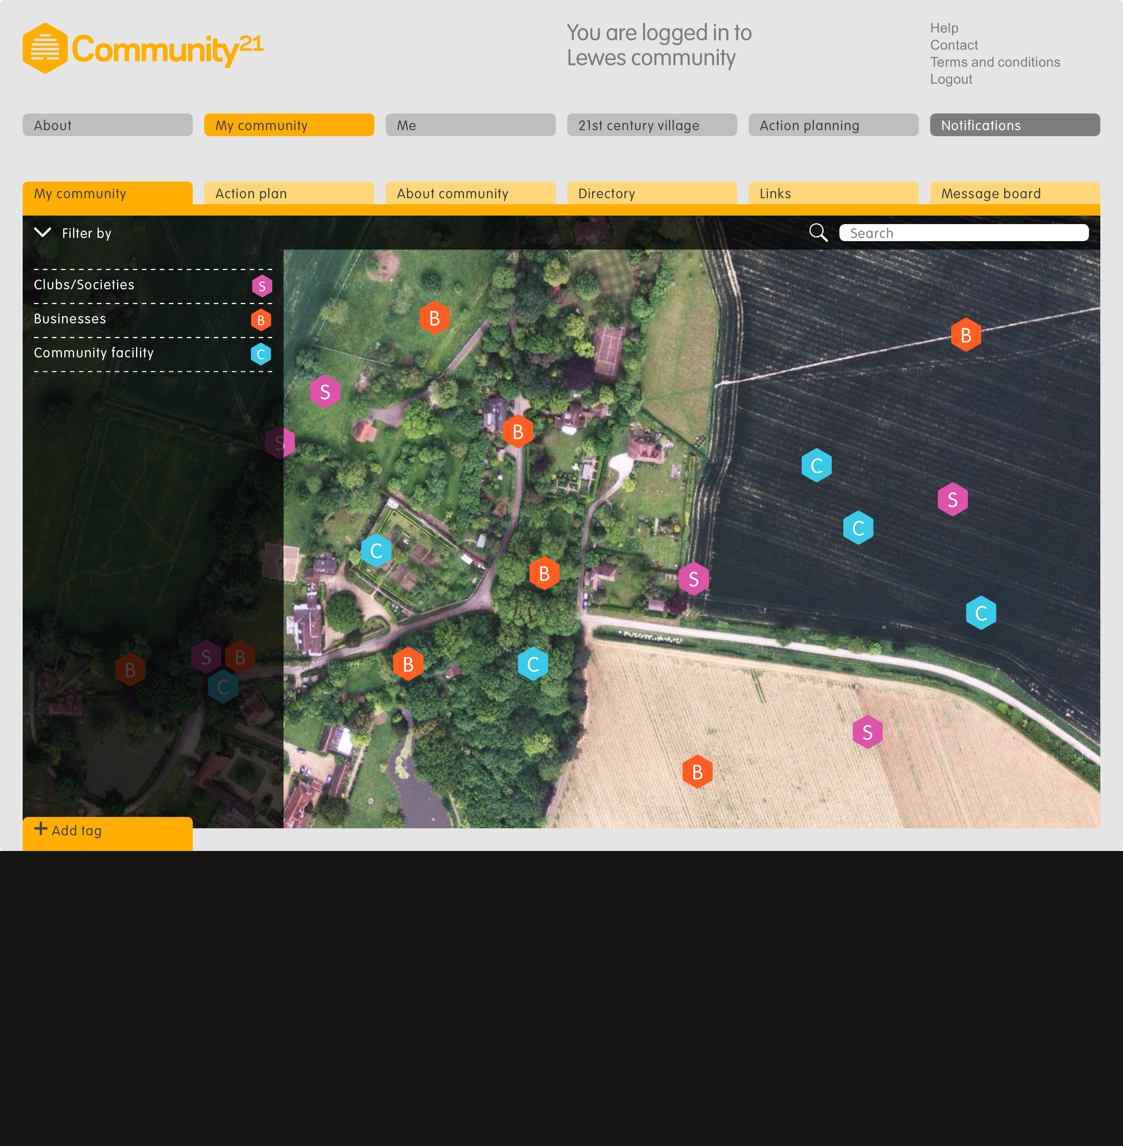
Notes:
Asset map – physical and cultural charater, heritage

Slide 36
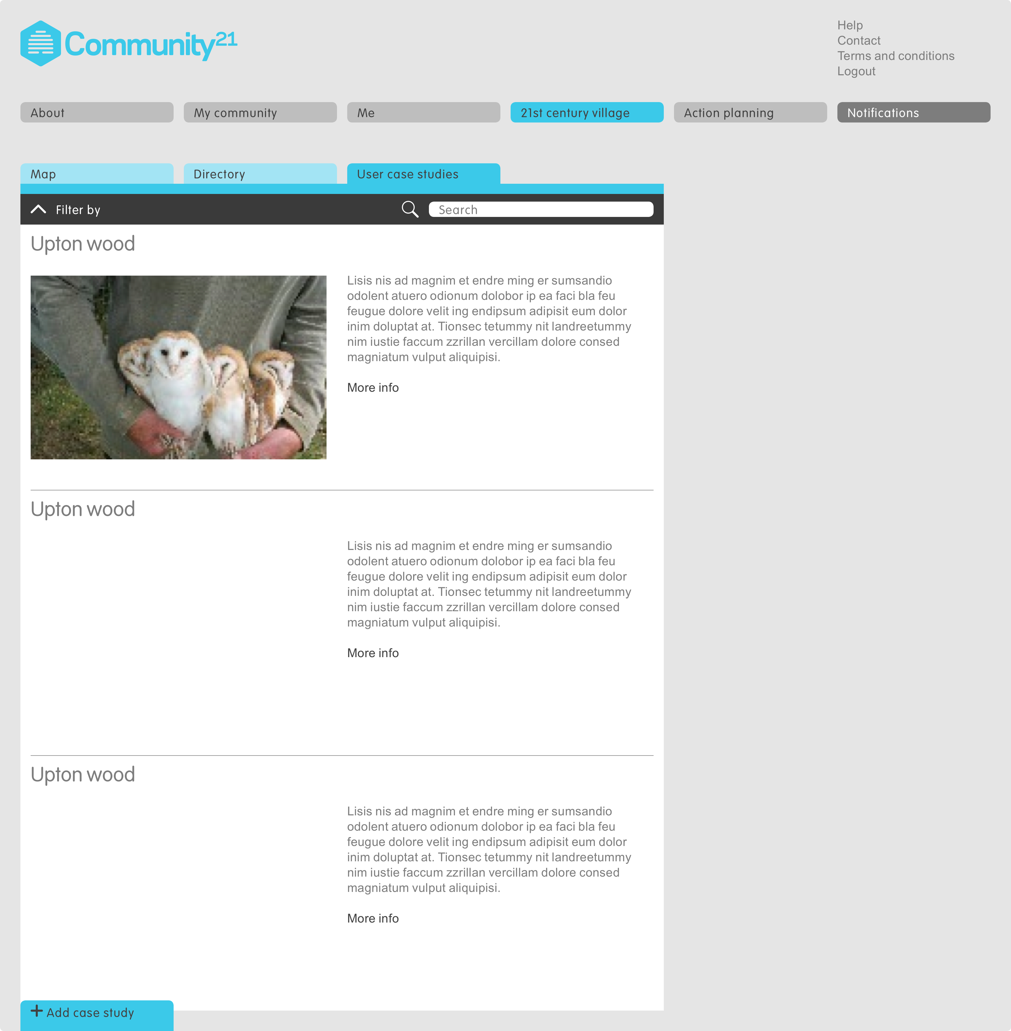
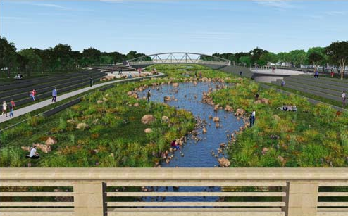
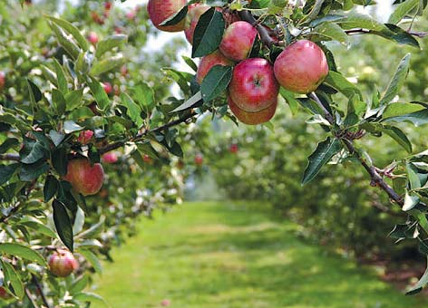
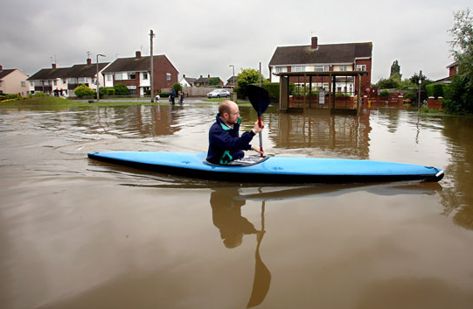
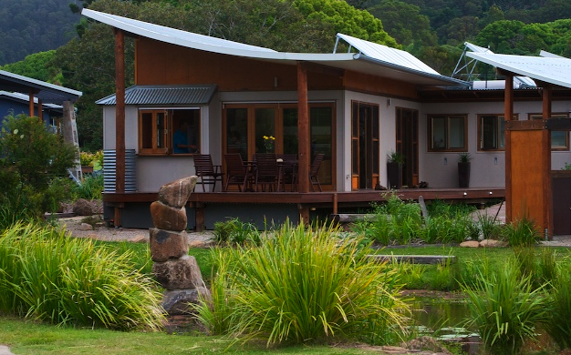
Community members began to
‘envision’ a future for the village that
explores opportunities for water based
recreation and energy production
Over the last 50 years Upton has flooded
6 times with 4 of these being within the
last decade
If this continues then the village needs
To prepare more thoroughly and even
embrace almost permanent land loss at
certain times of the year.
Notes:
Future village – European funding
Designs for our future
Envisioning the future based on evidence and records
Contentious but engaging

Slide 37
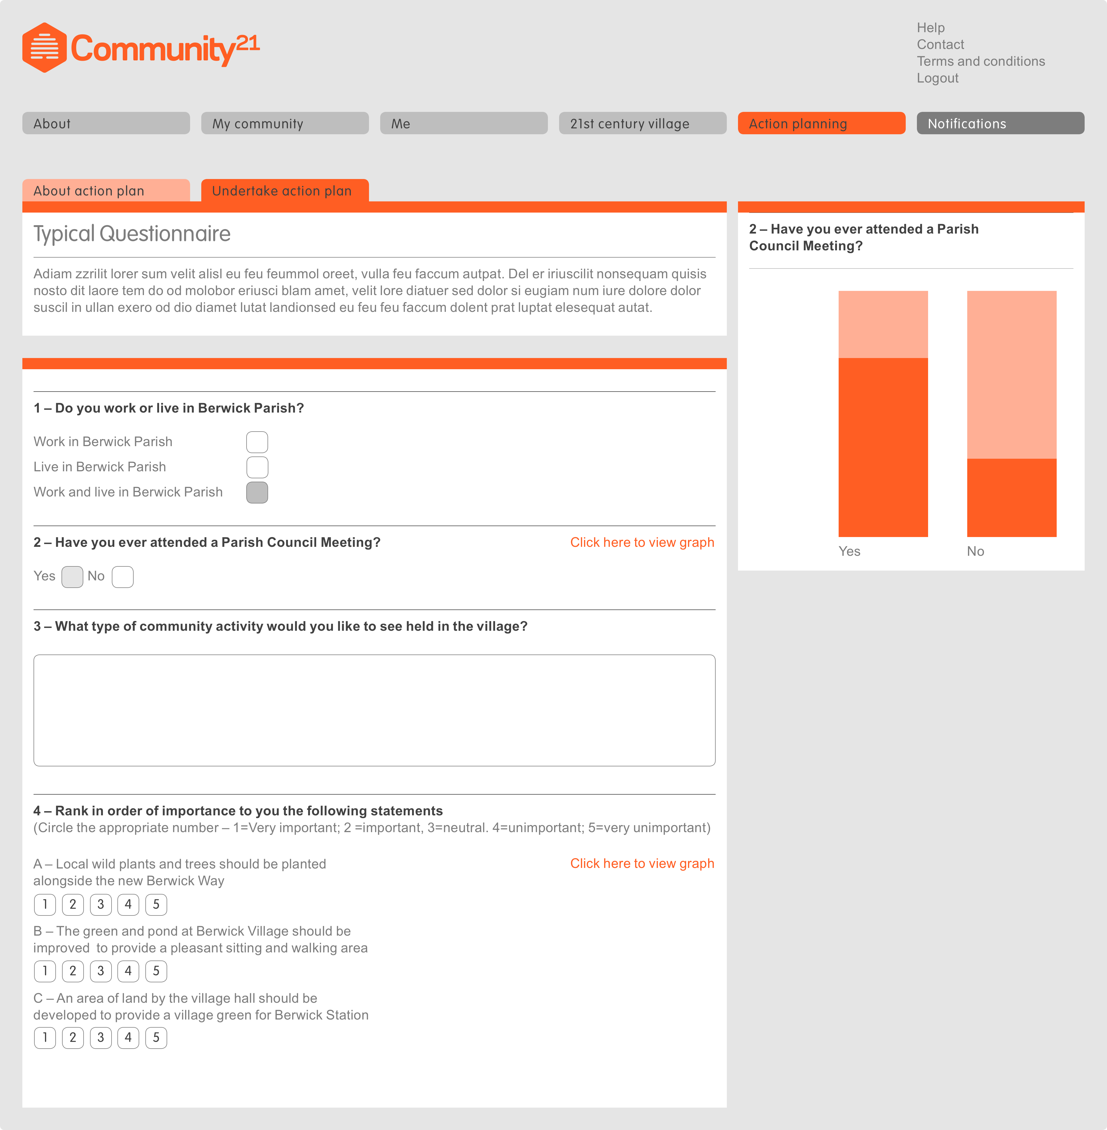

Slide 38
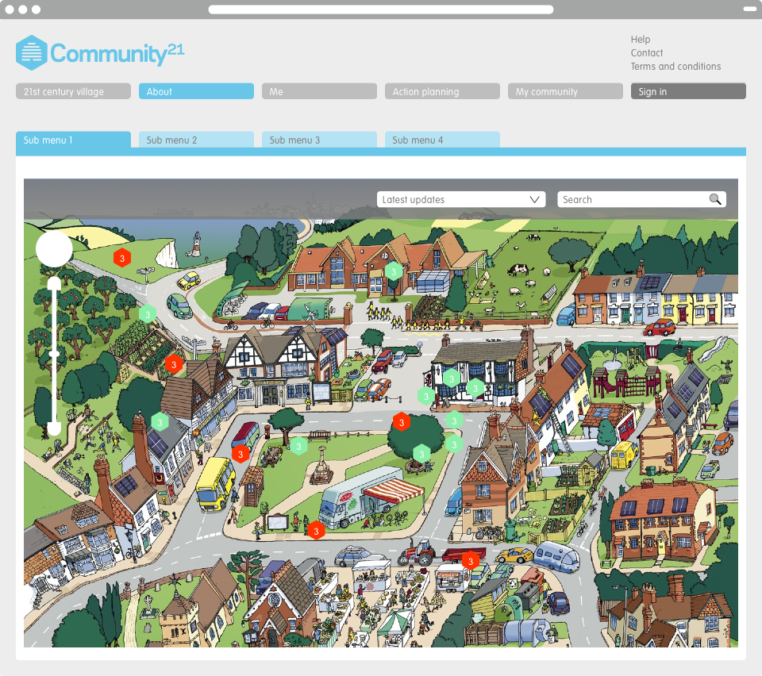

Slide 39
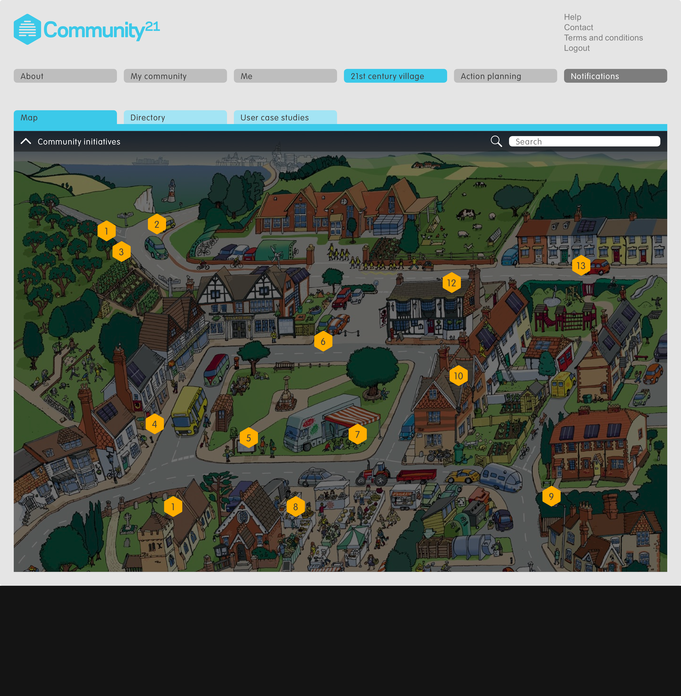

Slide 40
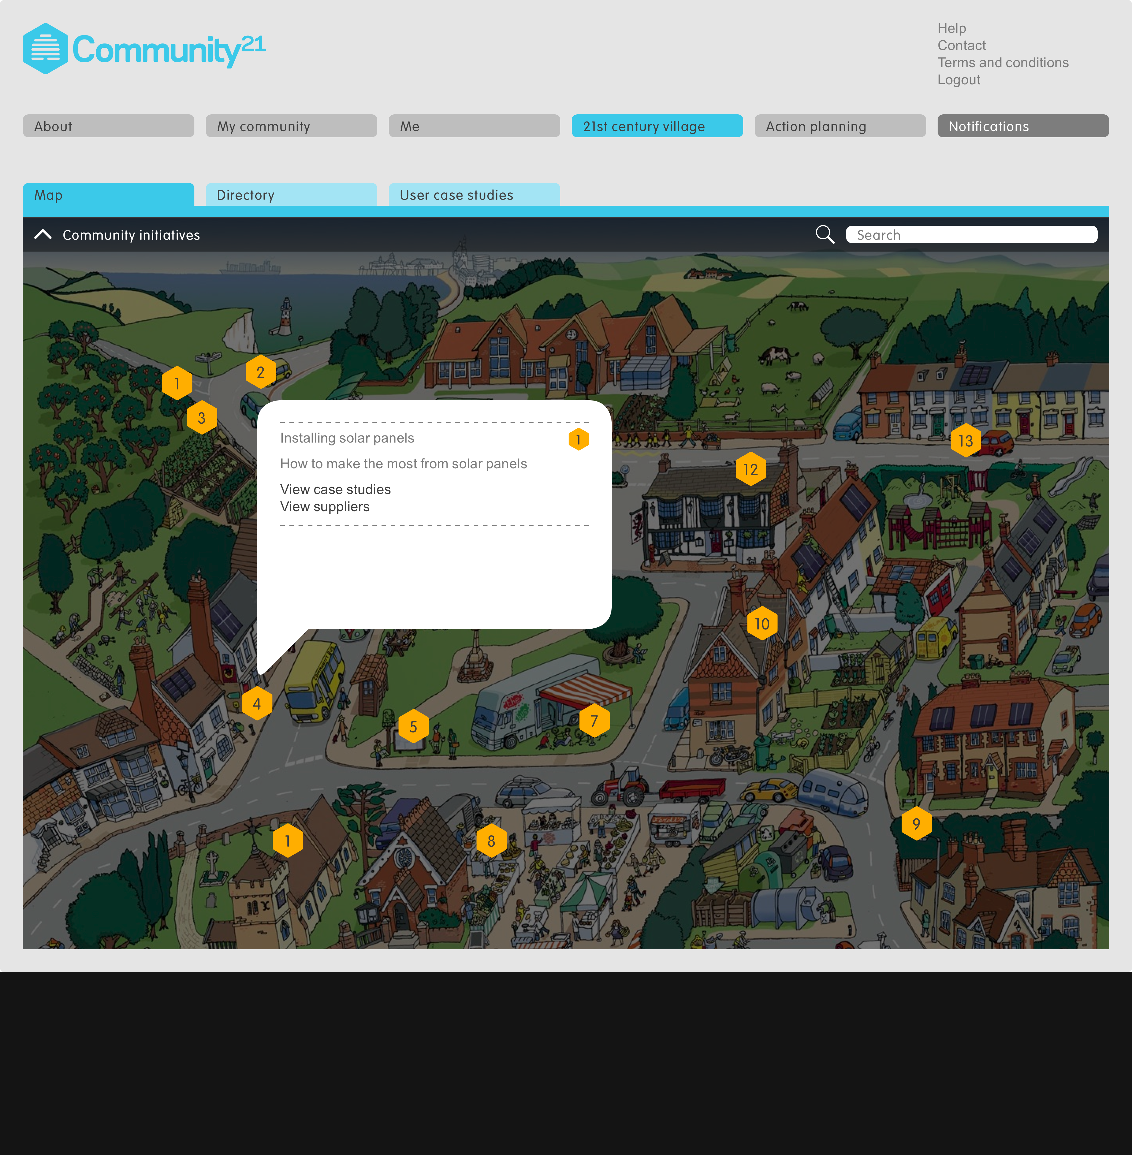

Slide 41
Notes:
Authentic knowledge / shared good practice via interconnected network
Scale of actions co designed projects - Communal orchard and growing scheme / 12 affordable houses / Eco-village hall / Hydro electric + wood fuel supply

Slide 42
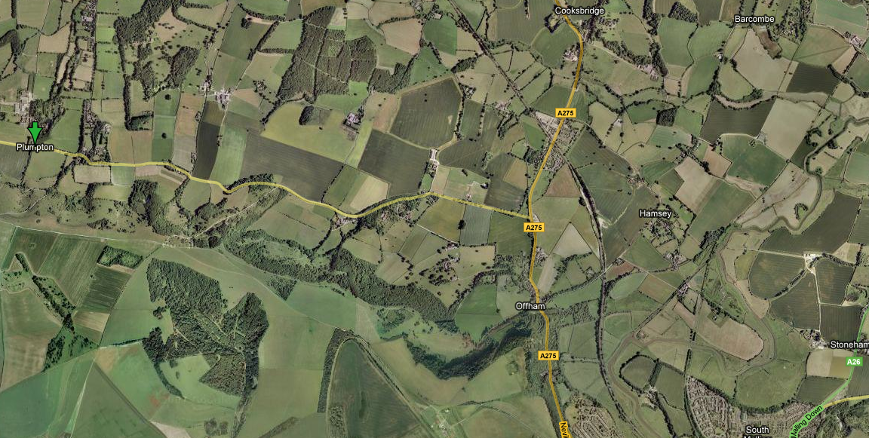
Multi-Local Society - a network of interconnected communities and places, at the same time open and localized. Prof Ezio Manzini - Designers Visionaries and Other Stories (Earthscan 2007) ; Gant and Chapman
COMMUNITY OF COMMUNITIES
Notes:
Community of communities
Concerns overlap and are shared –
knowledge exchanged -
Communities planned and designed by the communities themselves
progress communally asserted through democratic and collaborative input
Not the picture the media presents

Slide 43
Values:
Co-operation democratic design and planning process
better efficiency and cohesion between community members, their community and service providers
Exchange collective authorship and authentic user inputs / values
and exchange of knowledge
Resilience sustainable development (eco-logic)
Engage greater transparency, enriched interfaces, more users
connection (interconnection) with the big issues, through localism
Action learn new skills and principles in practice
make positive, collective change
CO-DESIGN
Notes:
Minister for environment climate change
Research Network
Counties

Slide 44
CO - DESIGN

Slide 45
The purpose of co-design is the creation of new societal values to balance
human happiness and ecological truths. In doing so, design contests the
notion of material and economic progress, and its inherent untruths.
Fuad-Luke; ‘Designers, Visionaries and Other Stories’, Chapman and Gant, Earthscan2007
CO - DESIGN

