Slide 1
Introducing Values Technology
We want to:
  Enable the transition into a flourishing, sustainable global society
  This entails increasing our capacity to walk our talk
  Distinctive features of Hall-Tonna offer the means to contribute to this capability.
Notes:
”

Slide 2
Multiple ways of illuminating the invisible. What do we need for this?
Clear definitions of values so that we are talking about the same thing, not only subjective
Appreciation of full range of values, the dynamic of their shift, how they cluster together and what this means
The ability to map the gaps between lived values and aspirational values—those required for sustainability
To be able to know how to move the values towards sustainability (how to promote the ‘great transition’)
A developmental understanding, which includes, what are the pre-requisites to live out aspirational values; dynamics of regression, challenges of communication between different stages of development
Notes:
The Ht uncovers the motivational pull from the future – it is predictive….something that makes it unique.

Slide 3
For what purpose?
To understand
  Ourselves
  Others
  Our collectivities, including businesses, partners, competitors and multiple stakeholders
  What is needed for performance enhancement
  To facilitate and create
  True communication between different values-perspectives
  Transitions
  Transformation into sustainability
Notes:
And align all these stakeholder including doucument via document analysis of strategic plans and policies

Slide 4
Values Technology:
Background
Came out of Dr Brian Hall’s work in Latin America and 17 years of research at Santa Clara University.
With a team of linguists, anthropologists, psychologists and others, he honed definitions of 125 universal human values, a way to map them, a technology to measure them and a practice to move them.
Hall and VT is under-published and not well known.
Notes:
Tonna was a sociiolist. He made a hufe contribution

Slide 5
Defining Values:
Important to mean the same things when we communicate.
Values are priorities expressed in our behaviors. They reflect our worldview.
Values are bridges—they mediate—between our inner and outer worlds.
Values are embedded in language and manifest in behavior. All relationships, conscious or not, are underpinned by the values priorities we hold in common (in those relationships). We are always communicating our values.
Values shape and are subsequently shaped by relationships. Relationships shape the hard and soft structures of all organisations, technologies, and institutions.
The question is not, is an organisation (business) ‘values led’ but does it know which values it is manifesting – and which values it needs to manifest to achieve its goals?
Notes:
Let’s not assume business community is not interested in sustainability. Some businesses are outperforming governmetns and NGOs – restorative enterprises
“Bridges” or mediates inner and outer….whatever makes more sense to you.

Slide 6
Distinctive?
A nuanced, developmental perspective
Developmental: Values build on one another.
  An appreciation of transitions—what individuals and organisations have to deal with in order to move through major transitions.
2. Practical Aspects: values are Map-able, Measurable, and Moveable; applicable and useful to all scales of society.
3. Links values to skills, behaviors, and communication effectiveness
4. Universality, which has significant implications for standardisation, contextual expression, and working across sectors
Ample room for further action-research
:
Notes:
2. Indiviual and Group reports,
This is a very nuanced, granial perspective
Skills are named and linked to values

Slide 7
Values: Universal or Context-specific?
Values, as ‘pockets of energy’ that mediate our inner and outer worlds, are essential aspects of what it means to be human. Hall-Tonna attempted to name the inherently un-namable by distinguishing 125 universal human values.
Example: Ecority: Personal Value: the capacity, skills and personal, organizational or conceptual influence to enable persons to take authority for the created order of the world and to enhance its beauty and balance through creative technology in ways that have world-wide influence.
Corporate Value: the capacity, skills and personal, organizational and conceptual influence to enable the business to contribute to global ecological balance through creative technology in ways that have world-wide influence.
Each person and culture’s expression of these values may differ.
Discovering and resonating with one’s values—seeing one’s life stories in values tracks—is a significant ‘ah hah’ moment. Yes, that’s who I am!
Notes:
– attempts to put into language elements that are inherently un-nameable, in part (ironically) because they live in language.

Slide 8
How values work (1): Developmental
Values Develop – Development is neither good or bad.
  They build on one another. We can imagine this development as a spiral.
    Thus, there are Foundational Values, Focus Values and Vision Values.
  Thus, they move over the course of our lives and we encounter different contexts – from personal relationships to globalisation. There is a dynamic of values shift.
  There might be gaps that will need to be filled if aspired-to values are to become lived values.
  Understanding the developmental trajectory of different tracks enables intervention and action.
  Different levels of collective development make different demands demands on communication, leadership and knowledge
  Sustainability requires values development.
Notes:
Link to ability to handle increasing levels of complexity.

Slide 9
How values work (2): phases
Elements of World
Phase I
Phase II
Phase III
Phase IV
View
How the world is
A mystery over
A problem
with
A project in
A mystery
for
perceived by the
which I have
which I must
which
I must
which we must
individual
no control
cope
participate
care
Ego is the
Ego seeks to
Self acts and
Self acts as
How the individual
center of an
belong by
initiates
“we” with
alien and
approval of
creatively,
others to
functions in the world
oppressive
significant
independently
enhance
environment
others & by
with
quality of life
succeeding
conscience
globally
Human needs
the
Social needs:
Personal
World
Physical
acceptance,
fulfillment:
community:
person seeks to
needs: food,
approval,
meaning,
harmony, by
satisfy
warmth,
shelter
achievement
creativity,
communal
insight
action
Types of Values
Phase I
Phase II
Phase III
Phase IV
Self
Goal
Values
-
Self-Worth
Self-
Truth/Wisdom
Preservation
Actualization
Ecority
Means Values
Safety
Education
Independence
Convivial
Technology
Notes:
Refer to How global warming is perceived by people at different phases of values development and what this means for possibilities for behavioural change. Grand Transition. This can measure where people are in relationship to this grand transition. Different ways of describing the phases – ego, etc.

Slide 10
Values working at work
Useful in businesses for both:
1. What a business’ values’ lived and vision values are – where they actually are.
  This impacts: strategy, working with partners, mergers, human resources (esp hiring and firing), communications, team work, how to work with resistance.
  This can be done through generating reports at individual and group level and the use of document analysis, individual and systemic reflection, multi-level interviews, coaching, working with institutional structures.
2. Businesses seeking to enable sustainability
  Esp partnerships between businesses, NGOs, public sector, etc.

Slide 11
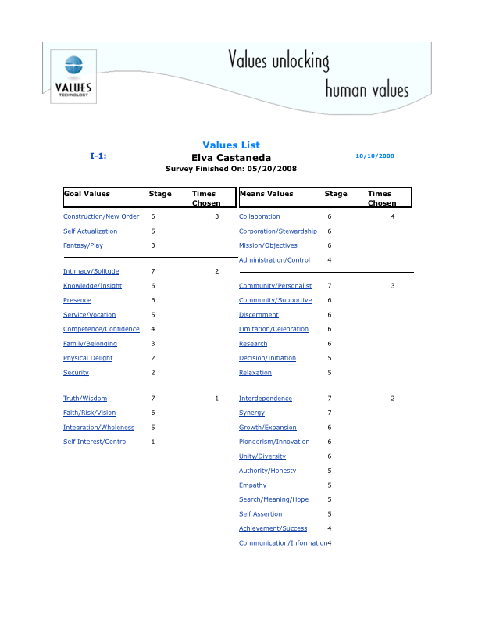
Notes:
Example: Individuals

Slide 12
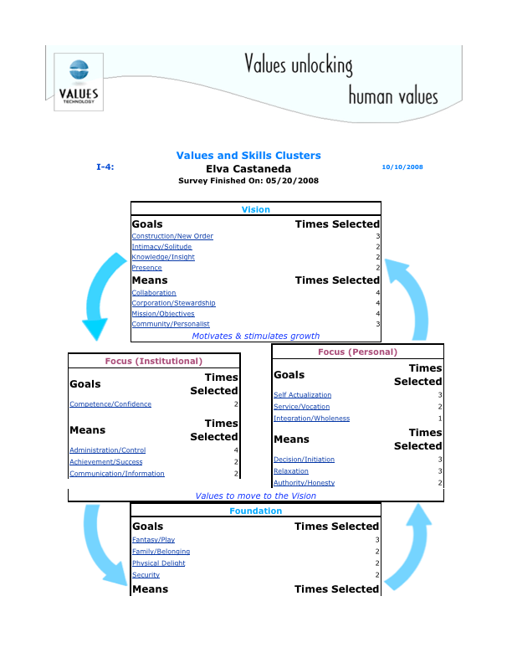

Slide 13
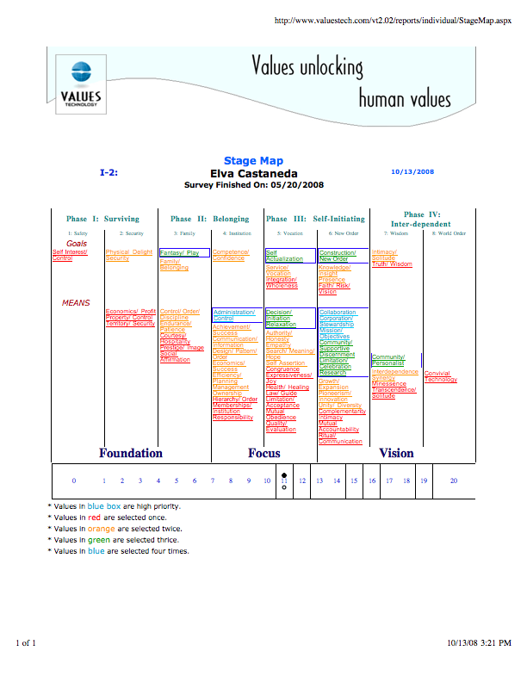

Slide 14
Examples
Tamil Nadu
Using our understanding – are we going ‘forward’ or ‘backward’? What do we need if we are to go forward?
Notes:
Use personal example? YES!! Great question “forward or backward?” THIS WILL BE COVERED MORE BY OTHER LADY

Slide 15
Creating a community of Practice
Processes
  Systemic reflection
  What is the role of the consultant?
  Walking our talk and modeling change
Ethics
  Whose values count?
  Confidentiality
  Dangers – this is powerful stuff!
Action Research – bringing models together, best practices, explore societal shifts
Further implications
  Tremendous potential for societal development
Notes:
Fundamentally, its about what works to get us into the next transition OR to manage the transition we are already in the middle of
Nice work sarah and Len!! Thanks very much. I a here

