Slide 1
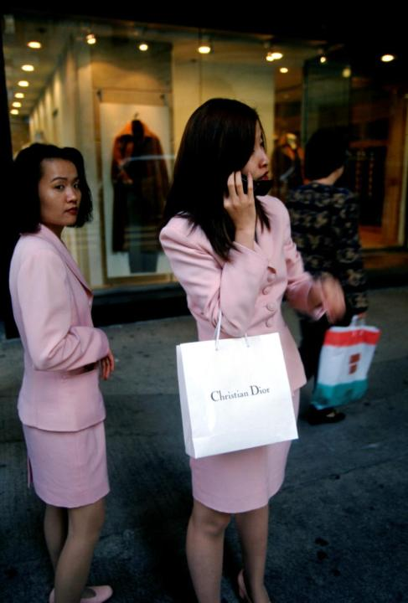
Paul Murray
Beyond Decadence
Engaging the Sustainable Self
Paul Murray
Picture source: Panos Pictures and Mark Henley

Slide 2
Our agenda
What influences sustainability?
our role as individuals?
The significance of personal core values

Slide 3
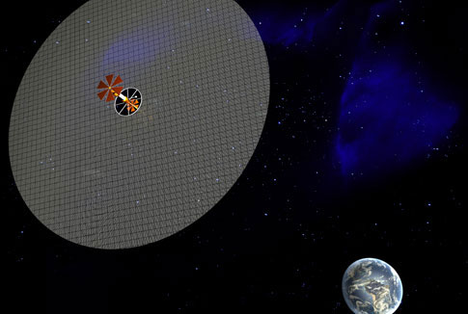
Paul Murray
Sustainability
A technological problem?
Image: John Macneil ww.popsci.com/environment/article/2005-06/how-earth-scale-engineering-can-save-planet

Slide 4
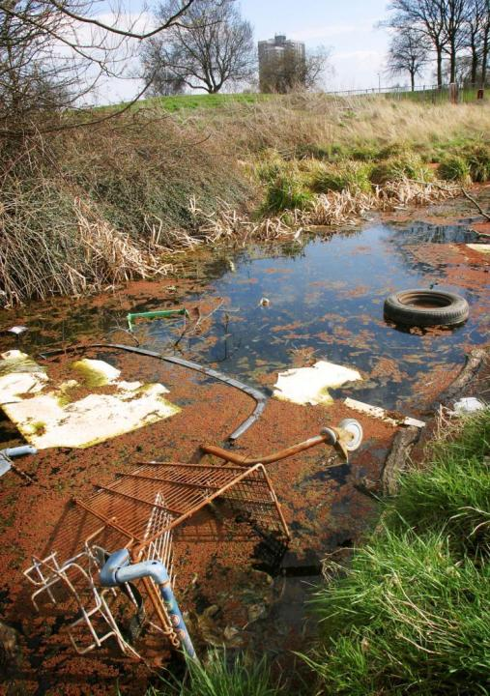
or a people problem?
© Panos Pictures and Martin Chivers

Slide 5
Humanity’s Impact
I = P x A x T
I = Impact; P = Population; A = Affluence*; T = Level of Technological Advance
* or decadence?
(Source: Ehrlich and Holdren 1972)

Slide 6
Population: rising fast
2008: 6.7 billion

Slide 7
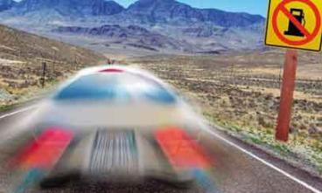
Affluence: Rising fast
© Panos Pictures and Martin Chivers

Slide 8
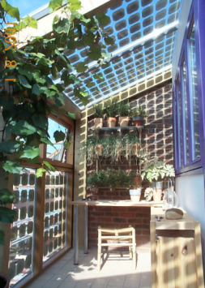
Technology: the solution?
Raises living standards?
Inspires us?
Reduces waste?
Reduces pollution?
Saves lives?
Improves mobility?
Creates jobs?
Improves efficiency?
.
DUPONT: reduced greenhouse gas emissions by 72% 1991-2007
DOW CHEMICALS: 22% energy efficiency gains between 1994-2004 and 2004; 25% more by 2015

Slide 9
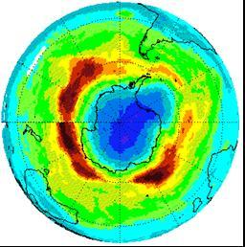
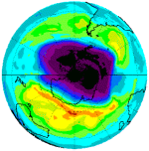
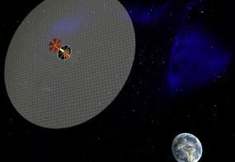
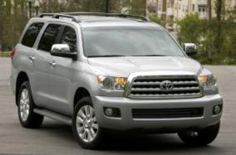
Technology’s limits?
Life cycle impacts?
Unintended outcomes? http://earthobservatory.nasa.gov
Distraction?
Poor take up?

Slide 10
Human frailty: Chernobyl
Source: Panos Pictures and Gerd Ludwig
© Panos Pictures and Martin Chivers

Slide 11
BHOPAL

Slide 12
Values
Human Behaviour Matters
Technology has its role
Governments have their role
Businesses have their role
Institutions have their role
Communities have their role
People influence all the above
People’s actions matter
People’s values influence their behaviour

Slide 13
Behavioural influences
Behaviour
Skills
Knowledge
Beliefs
Prevailing Values
Attitudes & automatic thoughts
External Infrastructure
Social norms
Economic climate
Understanding

Slide 14
Engaging The Sustainable Self
Changing the way we think: and act
Understanding: it’s not just up to others - institutions, governments, NGOs
YOU and ME: Personal Change
Mobilising our values, attitudes, beliefs

Slide 15
Sustainability Training
Core Values
Making meaning
Making connections
Cultivating motivation
Feeling empowered
Becoming equipped
Sustainable behaviour within & outside work

Slide 16
Heart of the training: exploring core values
“I value most above other things ….”
1. .......................................................................................................................
2. .......................................................................................................................
3. .......................................................................................................................

Slide 17
Sustainability Values?

Slide 18
Exploring your values can be
inherited from ......?
learned from ........?
influenced by .......?
mobilised by ........?
Are these REALLY our core values?
Are they ‘should have’ values?
Do our actions align with our core values?
(When no one is looking)

Slide 19
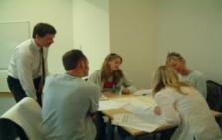
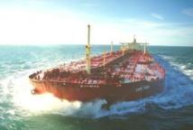
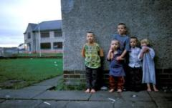
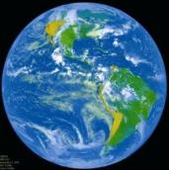
Engaging our values
To cultivate positive attitudes Care; compassion; respect; openness
To cultivate empowering beliefs
To motivate learning
To motivate behaviours
TO OURSELVES
TO CHANGE
TO OTHERS
TO NATURE
© Univ Plymouth/ Fotoflite/ Panos Pictures and Jez Coulson/NASA respectively

Slide 20
Engaging the Sustainable Self
Right Awareness
Right Values
Right Attitudes
Right Beliefs
Right Knowledge
Skilful means
Right Practise
The Sustainable Self
Awareness
Understanding
Skilful Means
Motivation
Values attitudes
Empowerment
Beliefs
Knowledge
Practice

Slide 21
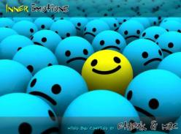
Engaging the Sustainable Self affects
What we do
How we feel
How we do
How we influence

Slide 22
The Sustainable Self
Sustainability is as much about the individual as anything else
The Sustainable Self learns from the past, pays attention to the present and is concerned for the future
Sustainability starts where we sit
Engaging the Sustainable Self will promote personal, community and planetary wellbeing
..“The thought manifests the word; the word manifests the deed”
(Thict Nah Hanh)
pmurray@plymouth.ac.uk

Slide 23
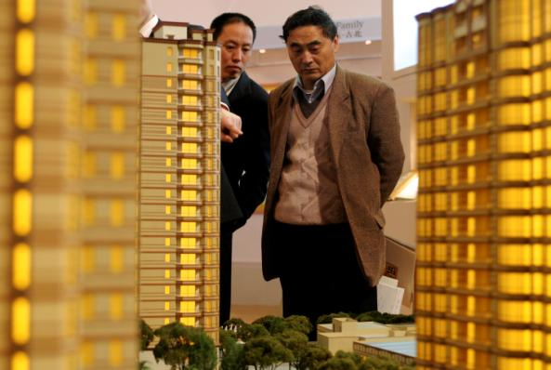
Human
cause
© Panos Pictures and Qilai Shan

Slide 24
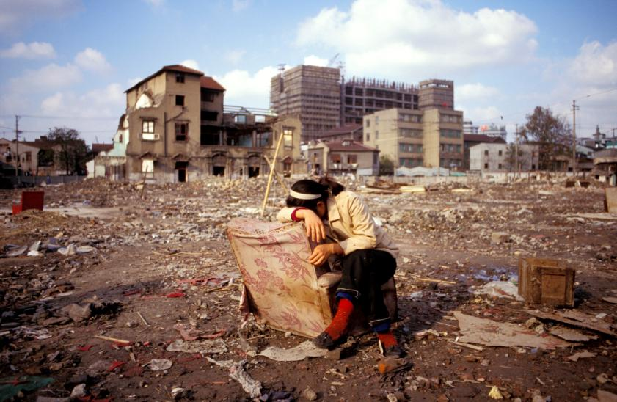
Human effect
© Panos Pictures and Mark Henley

