Slide 1

The role of values, caring and creativity
in achieving “the good life” (buen vivir)
Victoria W. Thoresen
UNESCO Chair for Education about Sustainable Lifestyles
Director of the Center for Collaborative Learning for Sustainable Development
Santa Cruz, Bolivia
7 September 2016
Partnership for Education and Research about Responsible Living
Partnership for Education and Research about Responsible Living

Slide 2
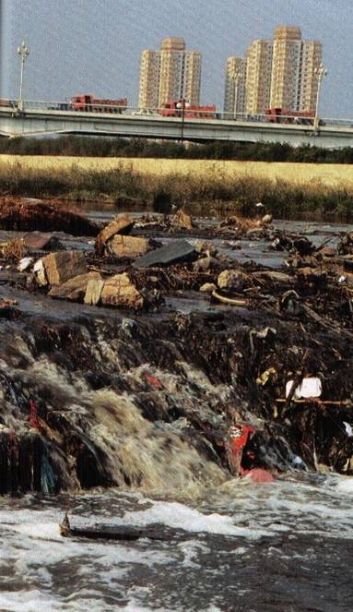
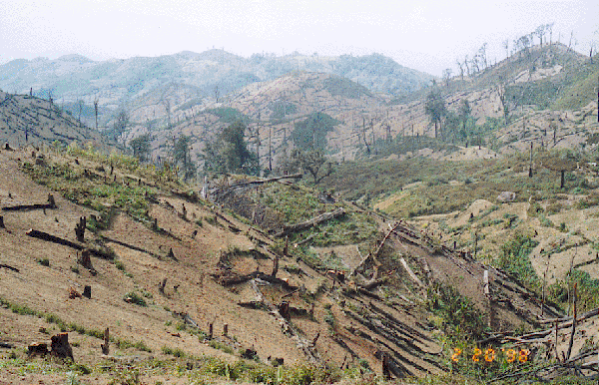
Partnership for Education and Research about Responsible Living

Slide 3
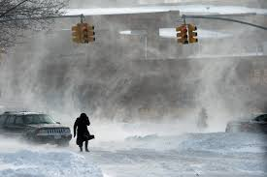
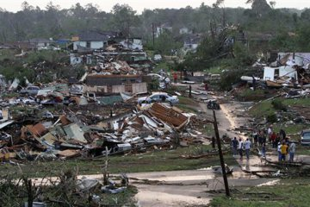
Partnership for Education and Research about Responsible Living

Slide 4
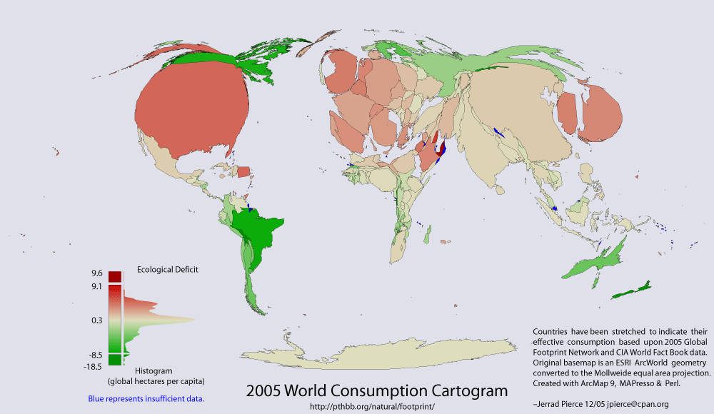
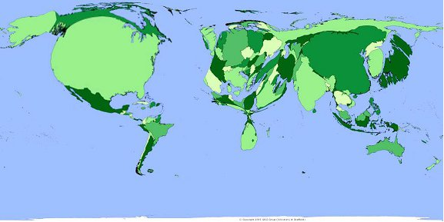
  2010 World Consumption Cartogram
  CO2 impact adjusted
Partnership for Education and Research about Responsible Living

Slide 5
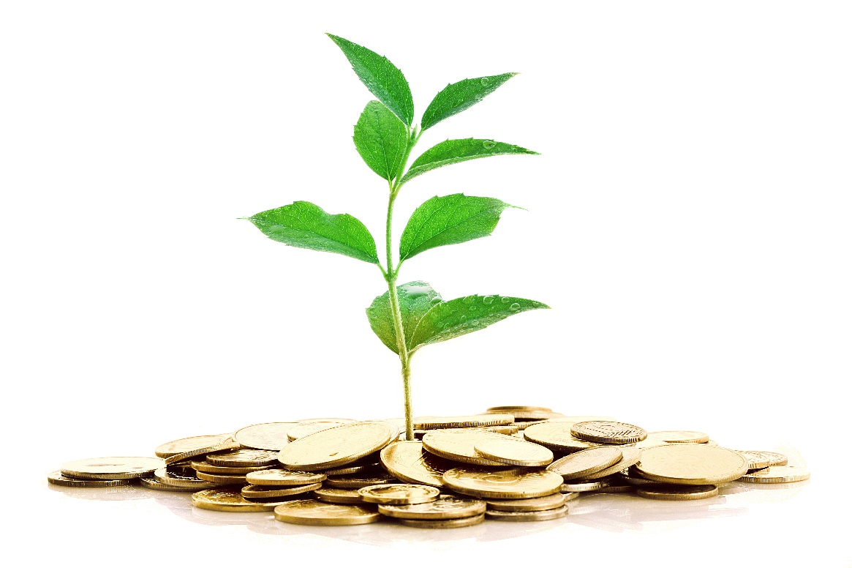
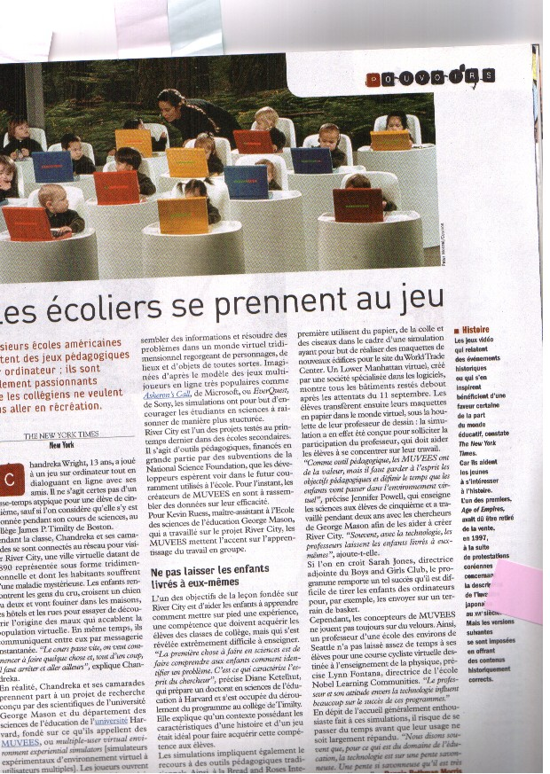
Partnership for Education and Research about Responsible Living
Partnership for Education and Research about Responsible Living

Slide 6
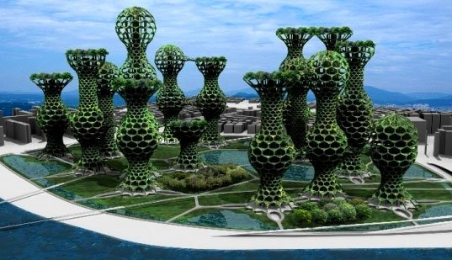
Partnership for Education and Research about Responsible Living

Slide 7

Vincent Callebaut Architectures
Partnership for Education and Research about Responsible Living

Slide 8

Partnership for Education and Research about Responsible Living

Slide 9

Partnership for Education and Research about Responsible Living

Slide 10
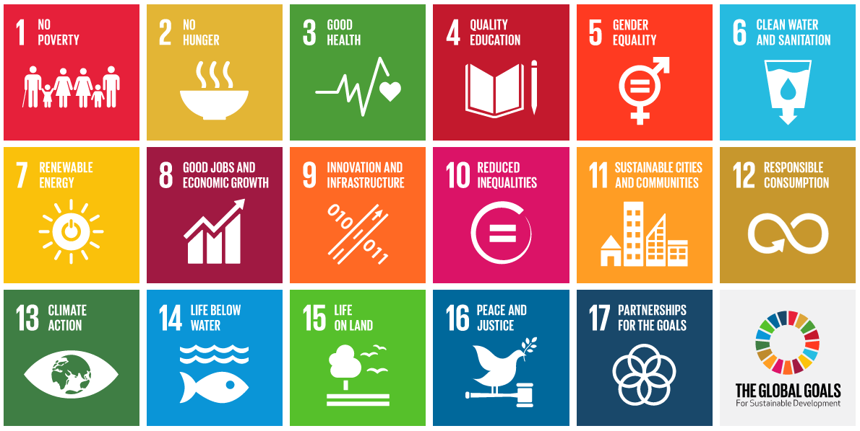

Partnership for Education and Research about Responsible Living

Slide 11
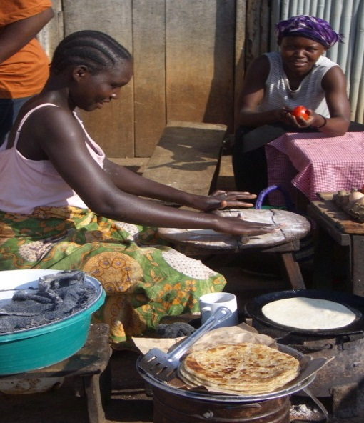
The transition to sustainability...
“Beyond informed policies and greener technologies,
it is a transformation that will require
an earnest examination of our understanding of
human nature
and of the cultural frameworks driving
institutions of government, business,
education and media around the world.”
(Rethinking Prosperity. BIC, 2010)
Partnership for Education and Research about Responsible Living

Slide 12
Values
Partnership for Education and Research about Responsible Living

Slide 13
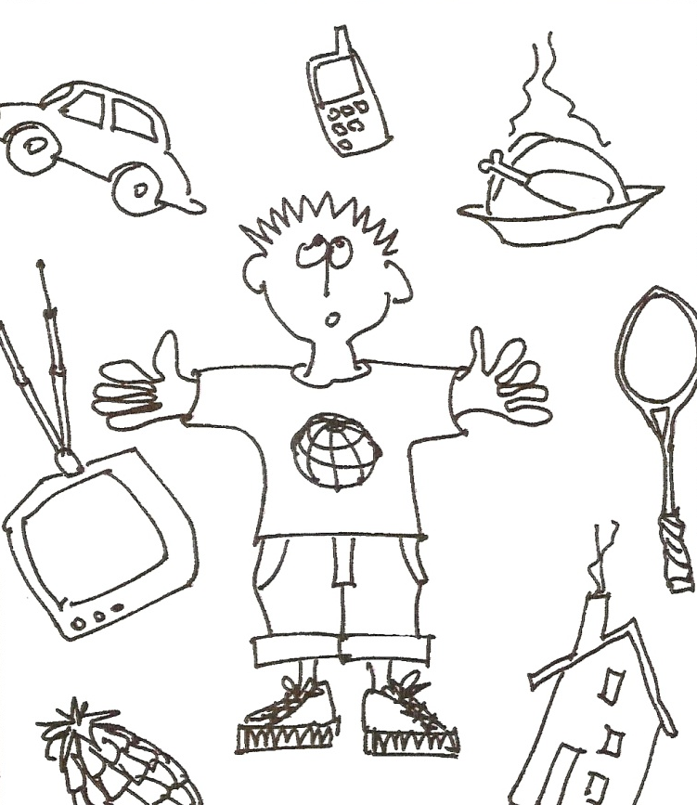
What are our values? What do we prioritize in our lives?
Partnership for Education and Research about Responsible Living

Slide 14
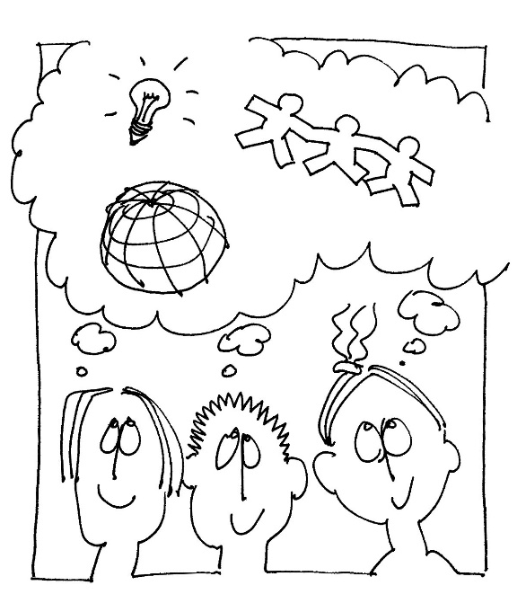
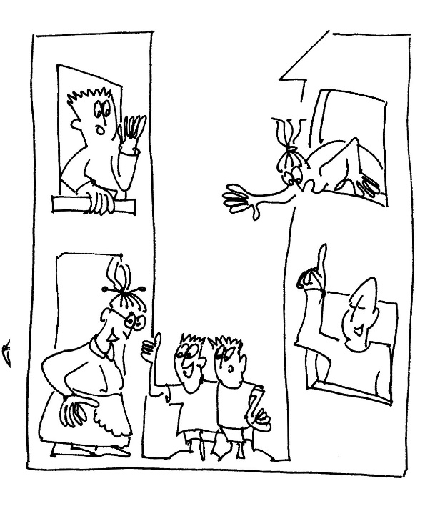
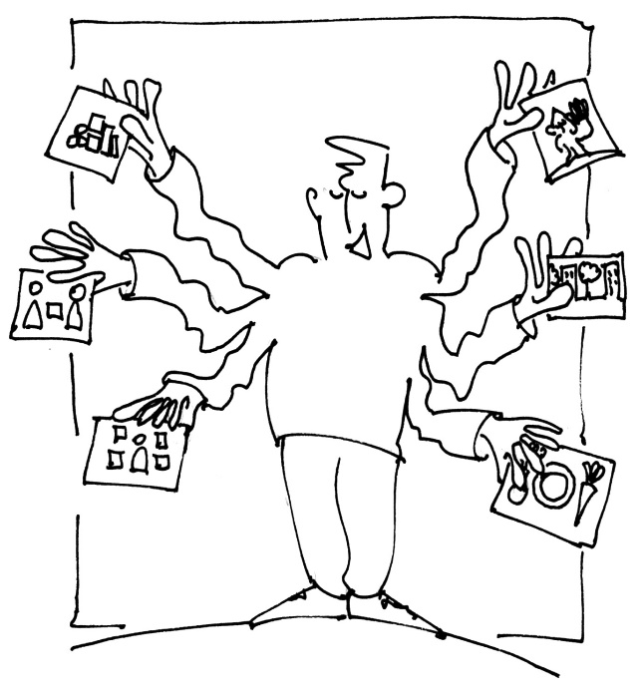
“value/action gap” – a disparity between what people mean they value, say they value and how they actually implement these values in everyday life.
Partnership for Education and Research about Responsible Living

Slide 15

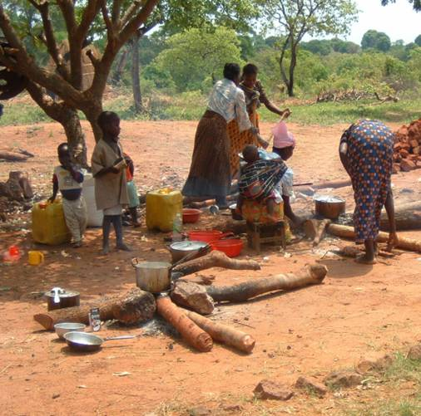
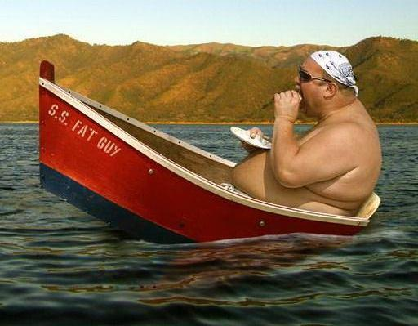
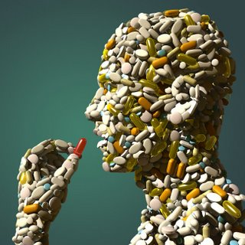
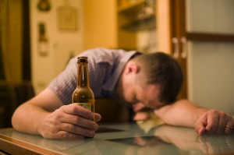
equity
«true» prosperity
Well-being
Partnership for Education and Research about Responsible Living

Slide 16
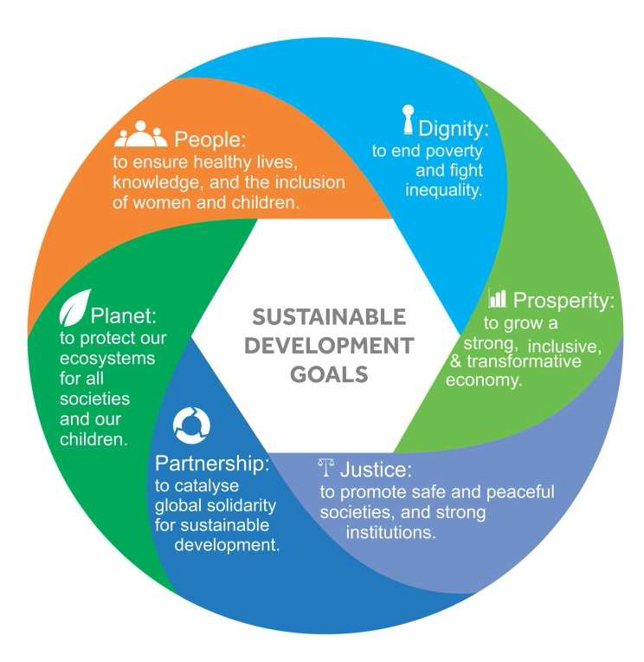
From The Synthesis Report of the U.N. Secretaty General on the Post-2015 Agenda
Partnership for Education and Research about Responsible Living

Slide 17
Caring
Partnership for Education and Research about Responsible Living

Slide 18
Sustainable lifestyles are enabled by both efficient infrastructures and individual actions and choices.
It means rethinking how we put our values into action, how we organize our daily life, socialize, share, learn and educate.
It also means rethinking our ways of living, how we buy
and what we consume.
Learning, un-learning, re-learning
Partnership for Education and Research about Responsible Living

Slide 19
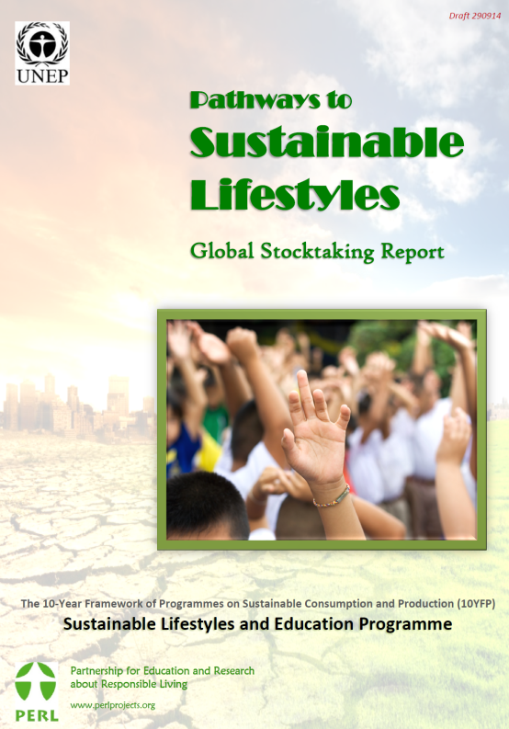
  Human development needs
  Environmental degradation
  Well-being/health problems
  Concerns around education
  Governance issues (community, national and international levels)
Partnership for Education and Research about Responsible Living

Slide 20
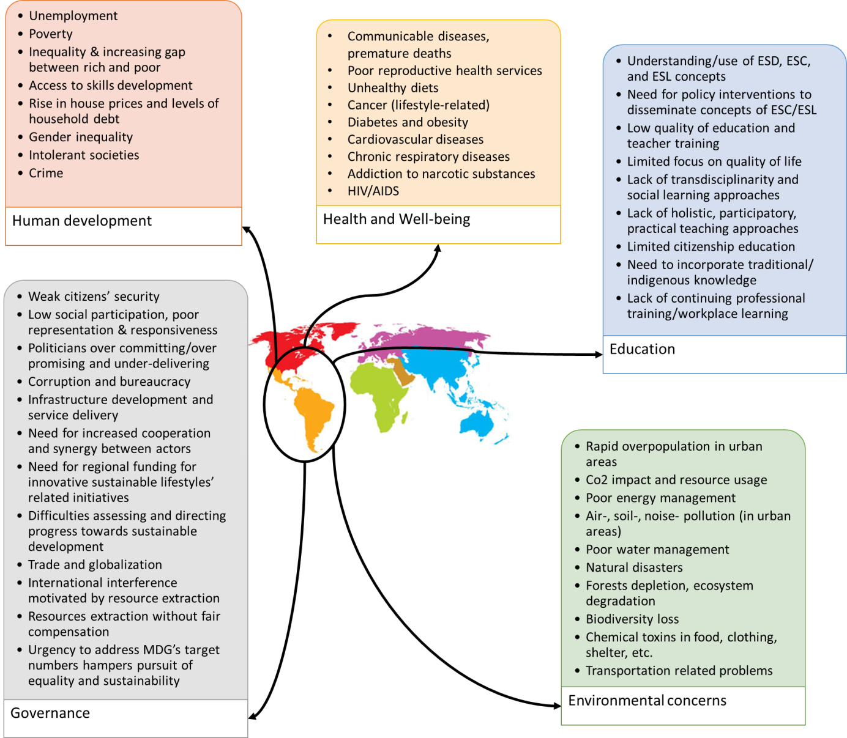
  Latin America Analysis of background, trends and problems for Sustainable Lifestyles
Partnership for Education and Research about Responsible Living

Slide 21
Learning to care:
-Advancing policy
-Integrating sustainability practices into education and training environments (whole-institution approaches)
-Increasing the capacity of educators and trainers
-Empowering and mobilizing youth
-Encouraging local communities and municipal authorities to develop community-based ESD programmes.
Partnership for Education and Research about Responsible Living

Slide 22
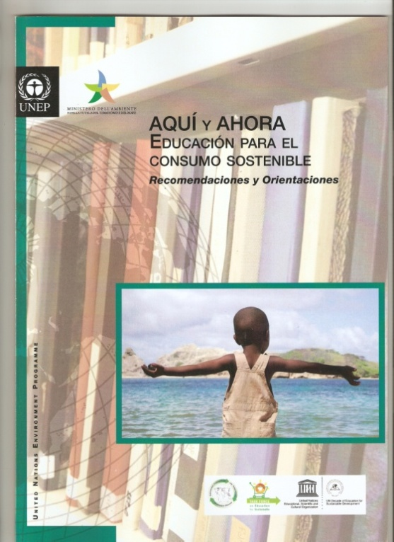
Partnership for Education and Research about Responsible Living

Slide 23
Partnership for Education and Research about Responsible Living

Slide 24
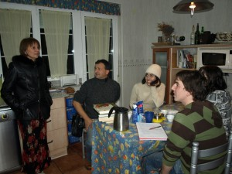
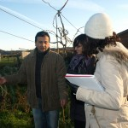
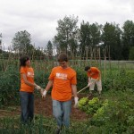
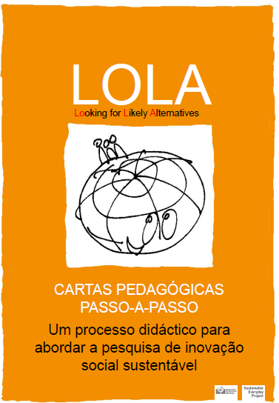
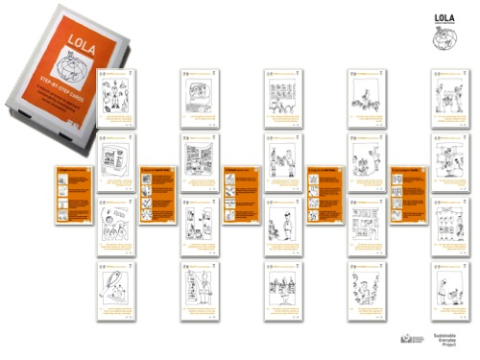
Partnership for Education and Research about Responsible Living

Slide 25
Creativity
Partnership for Education and Research about Responsible Living

Slide 26
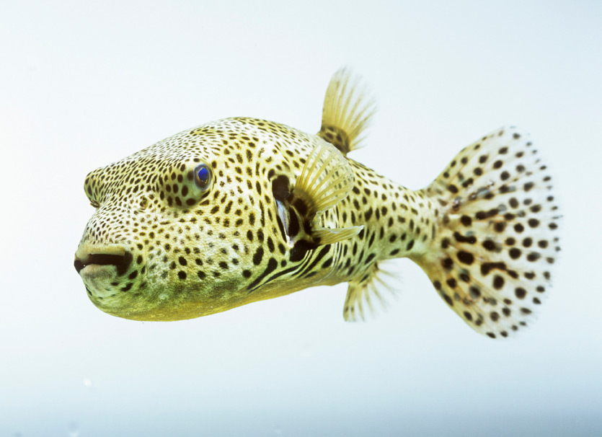
Partnership for Education and Research about Responsible Living
Partnership for Education and Research about Responsible Living

Slide 27
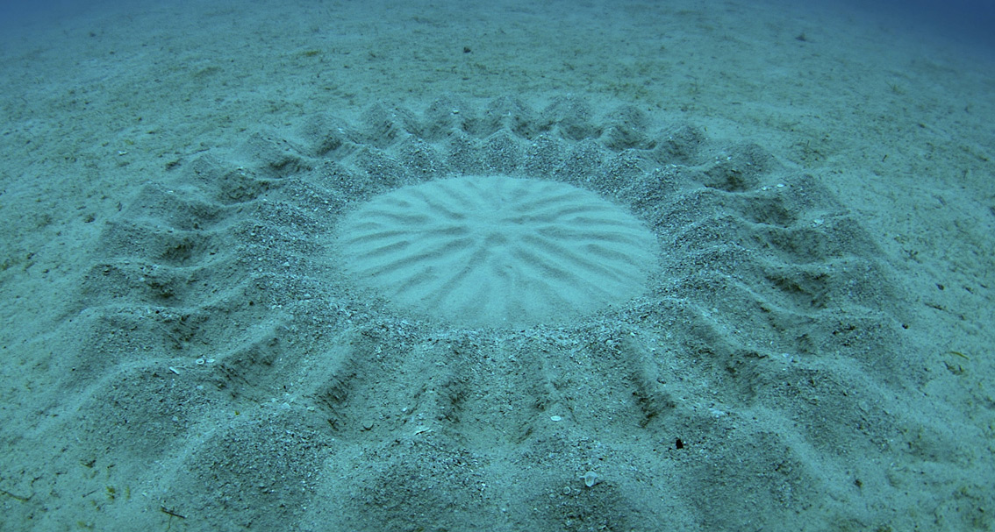
Partnership for Education and Research about Responsible Living
Partnership for Education and Research about Responsible Living

Slide 28
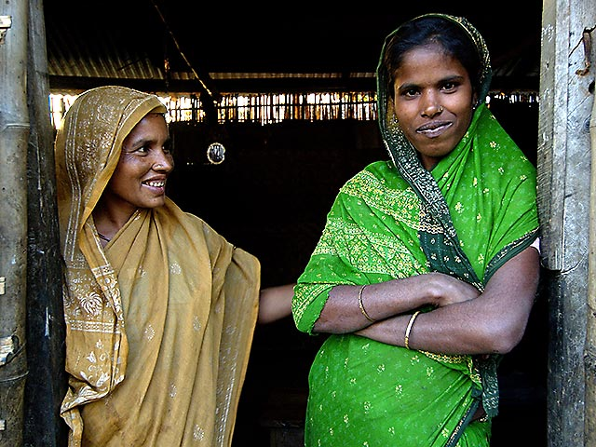
Stimulates a transformation of both our inner life and external conditions.
Partnership for Education and Research about Responsible Living

Slide 29
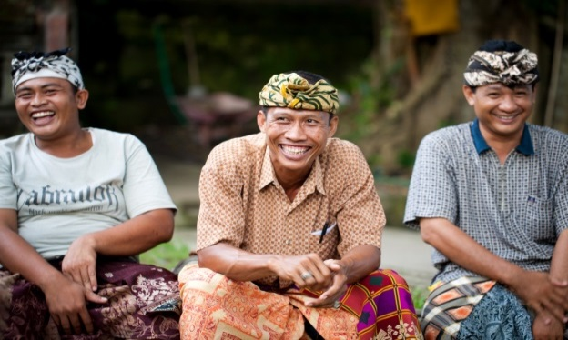
Helps us become more fully human and achieving a dynamic coherence between material and non-material requirements of life.
Partnership for Education and Research about Responsible Living

Slide 30
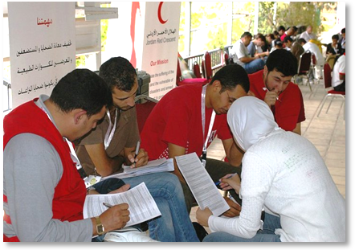
                Acquire an understanding of
                systems and processes
Gain insight into interconnections
Partnership for Education and Research about Responsible Living

Slide 31
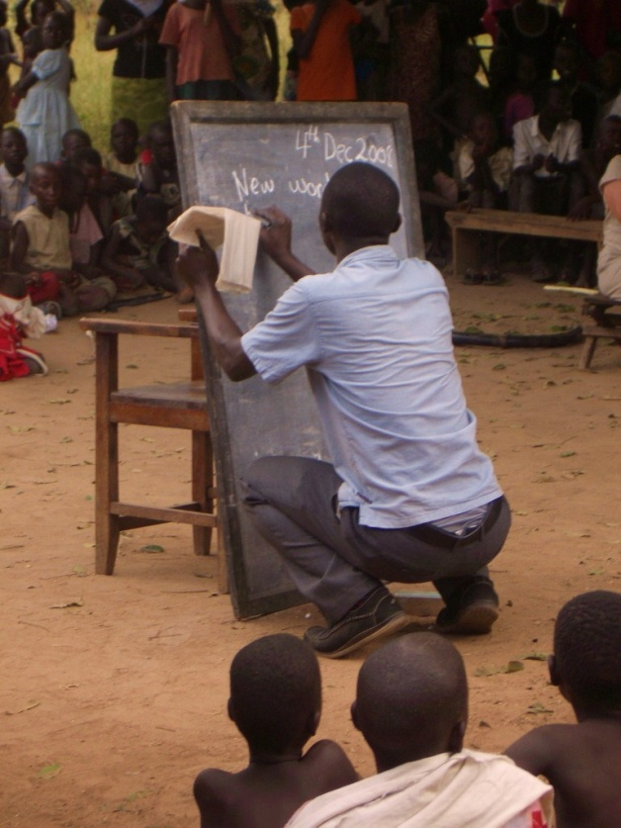
Recognize that our understanding changes and grows.
What we once thought was right may not always be so.
Partnership for Education and Research about Responsible Living

Slide 32
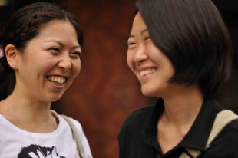
Develop trust and compassion
and
inspire the capacity for service
Partnership for Education and Research about Responsible Living

Slide 33
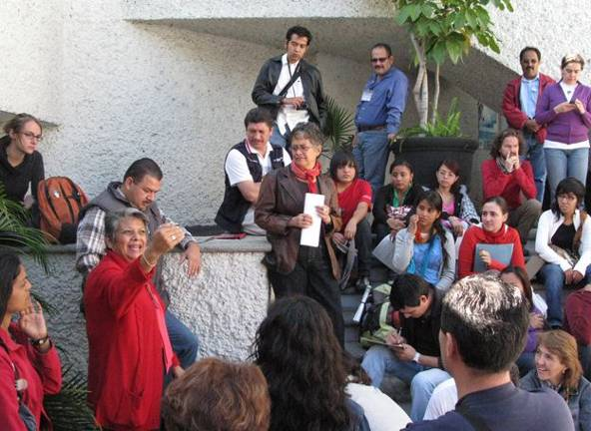
Foster a vibrant community life
in neighborhoods and villages,
characterized by such a keen sense
of purpose.
Partnership for Education and Research about Responsible Living

Slide 34
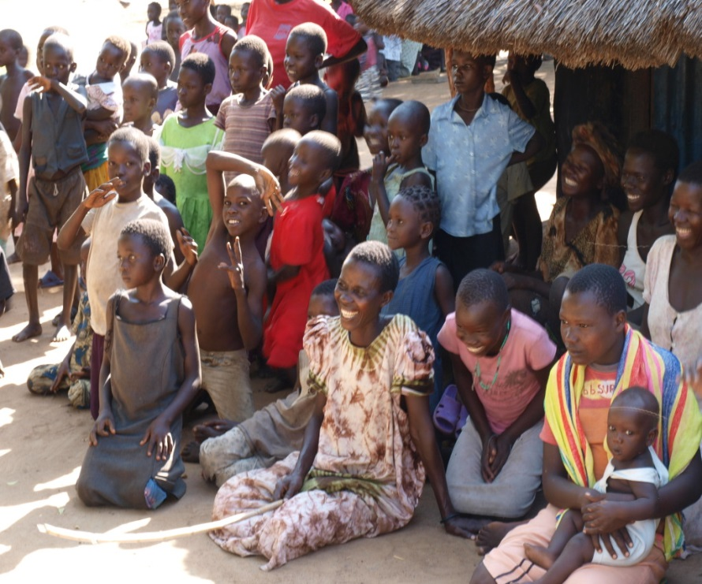

Global citizenship
--not only:
personally responsible citizenship
(how one leads one’s own life),
nor merely participatory citizenship
(how one interacts with others)--
But transformative citizenship leading to
compassionate connectedness
based on empathy, collective social learning, moderation and sharing.
Partnership for Education and Research about Responsible Living

Slide 35
“Broader visions of human purpose and prosperity are moving from the periphery to the center of public discourse….
….As the sweeping tides of consumerism, unfettered consumption, extreme poverty and marginalization recede, they will reveal the human capacities for justice, reciprocity and happiness.” (Rethinking Prosperity)
Partnership for Education and Research about Responsible Living

Slide 36
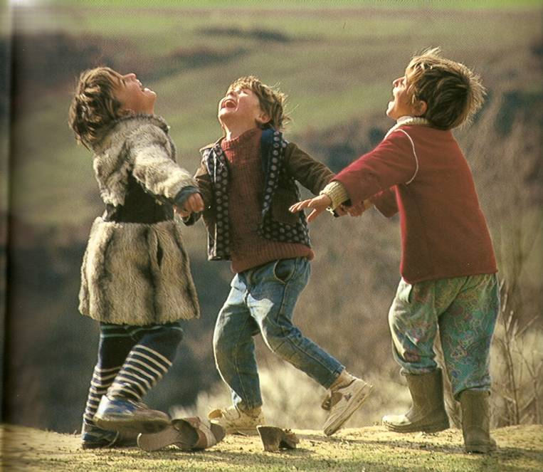
Thank you
(The Treasure Within, Delores)
Partnership for Education and Research about Responsible Living

