Slide 1




The promises and pitfalls of integration in governance
Justice conference 14 April 2017, de Poort
Sylvia Karlsson-Vinkhuyzen

Slide 2

Mainstreaming fatigue

Slide 3

Prioritization conflict

Slide 4
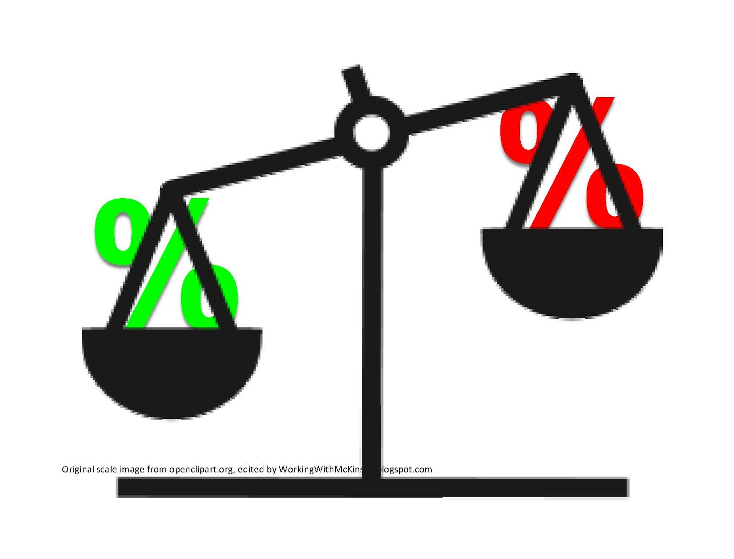
Trade-offs

Slide 5

Accountability constraints

Slide 6
Becoming protagonists of our own development
“care must be taken lest people be treated primarily as passive objects to be developed, rather than as protagonists of development in and of themselves”
Baha’i International Community, Summoning our Common Future, 2015

Slide 7
What is most important?
“the purpose of Justice is the appearance of unity among men” - Bahá'u'lláh

Slide 8
Redefining fundamental goals
“...it is clear that the honour and exaltation of man must be something more than material riches. Material comforts are only a branch, but the root...is the good attributes and virtues which are the adornments of his reality...”
– Abdu’l-Bahá –

Slide 9
Internalizing responsibility
...the love and knowledge of God, universal wisdom, intellectual perception, scientific discoveries, justice, equity, truthfulness, benevolence, natural courage and innate fortitude, the respect for rights and the keeping of agreements and covenants; rectitude in all circumstances, serving the truth under all conditions, the sacrifice of one’s life for the good of all people; kindness and esteem for all nations...”
– Abdu’l-Bahá –

Slide 10

Let’s explore together
sylviakv@xs4all.nl

