Slide 1

From Disintegration to Integration: Navigating the Forces of Our Time
Joachim Monkelbaan, PhD
De Poort, 14 April 2017

Slide 2
Overview
What are the forces of (dis)integration?
What role for innovation in addressing these forces?
How to improve such innovation ?

Slide 3
Force 1: Technology
Has brought as closer together:
A mechanism of world inter-communication will be devised, embracing the whole planet, freed from national hindrances and restrictions, and functioning with marvellous swiftness and perfect regularity.
Shoghi Effendi, 1936
Notes:
technology and innovation as the first force for (dis)integration
Tech has brought us all closer together and made our lives much easier (laundry machine freed up womens time to study and work)
Tech as innovation for more powerful weapons or more powerful medical equipment?

Slide 4
Vs. technology as
Cybercrime
Weapons or medical equipment
Smartphone over-use
Social media as confirmation of biases (polarization)
Dissemination of ‘fake’ news (independent search for truth)
Notes:
Also, social media become an increasingly important source of ‘news’ but we are fed with news and opinion based on a set of algorithms that are based on our-pre-existing preferences, so that what we read and see confirms and strengthens our preconceptions rather than that it opens us op to new perspectives.

Slide 5
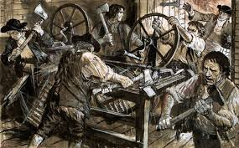
Disruption: technology as destroyer of jobs - Luddites vs. creative destruction (Schumpeter)
Notes:
The Luddites were a group of English textile workers and weavers in the 19th century who destroyed weaving machinery as a form of protest. The group was protesting the use of machinery in a "fraudulent and deceitful manner" to get around standard labour practices.[1] Luddites feared that the time spent learning the skills of their craft would go to waste as machines would replace their role in the industry.[2] It is a misconception that the Luddites protested against the machinery itself in an attempt to halt progress of technology. However, the term has come to mean one opposed to industrialisation, automation, computerisation or new technologies in general.[3] The Luddite movement began in Nottingham and culminated in a region-wide rebellion that lasted from 1811 to 1816. Mill owners took to shooting protesters and eventually the movement was brutally suppressed with military force.
On other hand, technological progress has automated manufacturing, which led to the disintegration of communities that are based on manufacturing (e.g. Detroit). And with the fourth industrial revolution, which means even more automation and the use of AI, also jobs in the services industry will be affected.
Now: tax on robots

Slide 6
Force 2: Globalization
“international integration arising from the interchange of world views, products, ideas, and other aspects of culture.”
Notes:
Technology has enabled travel and transport and thus Trade and investment, telecommunications, which have obviously connected different parts of the world.

Slide 7
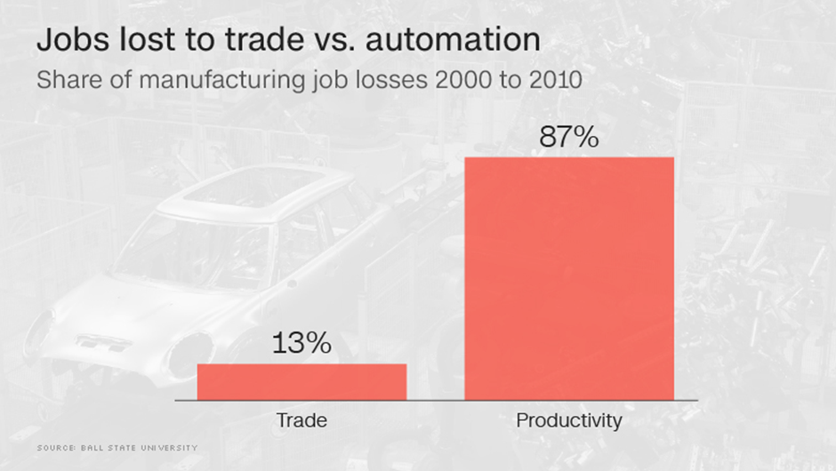
Notes:
In terms of jobs, it’s clear that many more manufacturing jobs have been lost in the US for example due to innovation than to trade

Slide 8
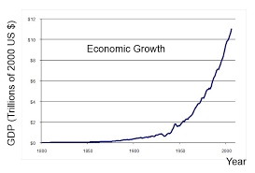
‘We’worship growth
Notes:
Globalization also often identified with capitalism, neoliberal economics, free markets, which have led to unprecedented growth, and growth remains the dominant objective of almost all governments and companies
But also led to misconceptions about inequality which is a major issue in the bahai writings, and impact on employment
I think it depends on what perspective you take.

Slide 9
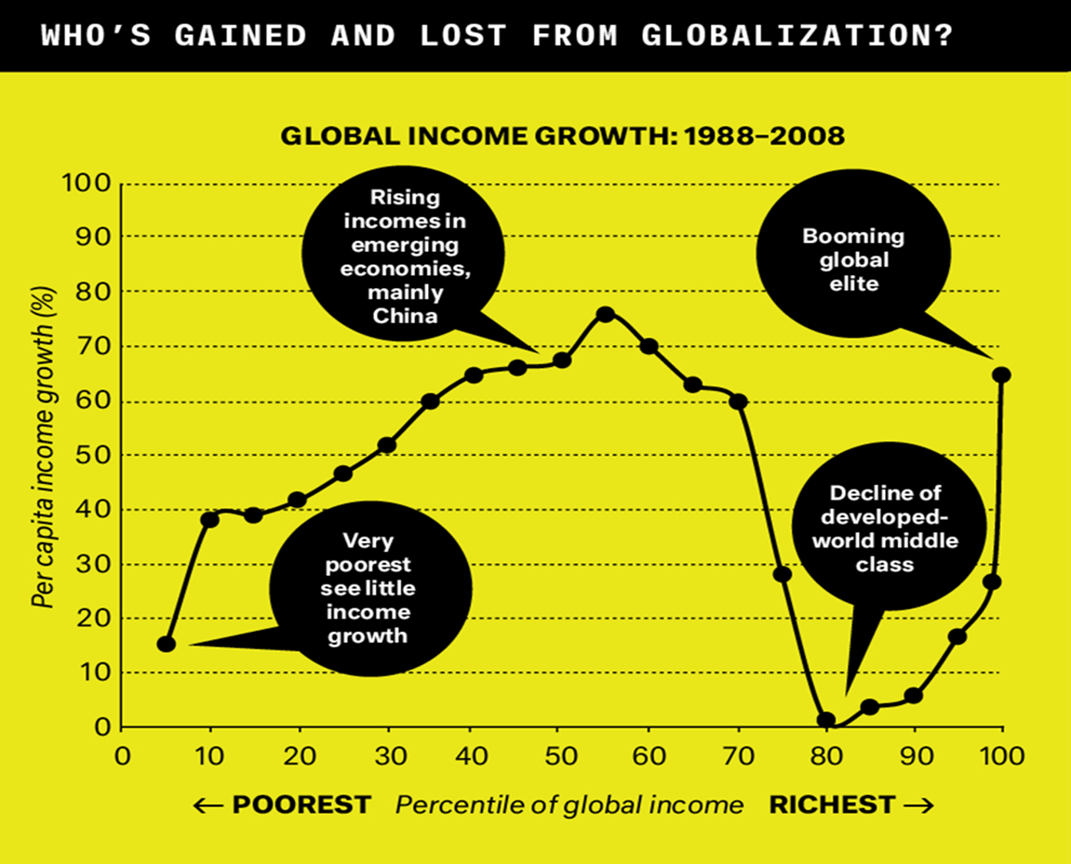
Inequality
Notes:
Elephant curve. At the global level, it’s difficult to say whether inequality is increasing or decreasing, it depends on what you measure and how. Yes, difference between the very richest (also in emerging economies) and very poorest is increasing. But at same time, the middle class (esp. in Asia, where the middle class will be 10 times bigger than the one in the US soon), which is the group that has a reasonable quality of life, in increasing. However, middle class in rich countries could halt and even reverse this process.
So, it’s important to see the bigger picture

Slide 10
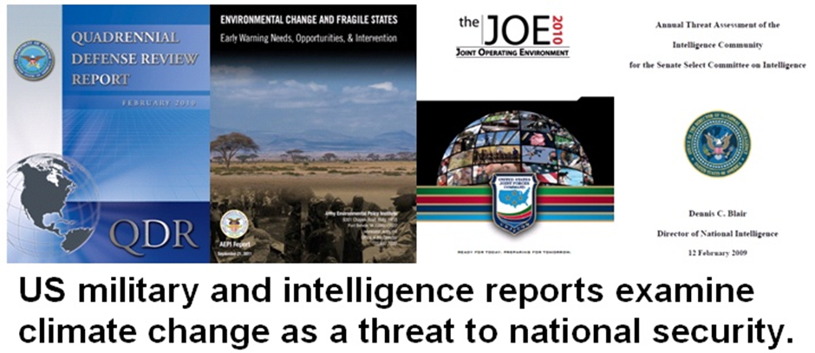
Force 3: Climate change
Notes:
But technology (e.g. coal power that fuelled the industrial revolution) and globalization have led to massive growth in consumption and energy needs and created a new force of (dis)integration: CC
Could be cause of wars and conflicts and massive migration in the future
Climate change and energy transition (military reports about security threats vs. climate change adaptation and mitigation as a unifying cause) (now twice as many jobs in solar than in coal in the US)
Strengthen water-energy-food crisis, drives migration

Slide 11
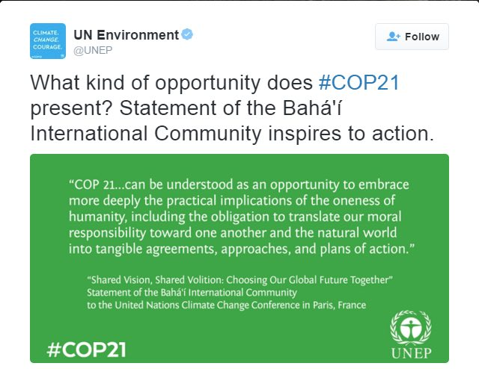

Slide 12
I(mpact) = P(opulation) x A(ffluence) x T(echnology)
So what happens when P grows by another 50% and A doubles by 2050?
Solution: Innovation?
Notes:
Sustainability challenges in general come down to a simple formula
Innovation: Innovation can be defined simply as a "new idea, device or method".[1] However, innovation is often also viewed as the application of better solutions that meet new requirements, unarticulated needs, or existing market needs.[2] In other words, I think that innovation equals change, and it should be focused on finding solutions. This is accomplished through more-effective products, processes, services, technologies, or business models that are readily available to markets, governments and society.

Slide 13
Writings: innovation as change and renewal?
The Divine Springtime is come, O Most Exalted Pen, for the Festival of
the All-Merciful is fast approaching. Bestir thyself, and magnify, before the
entire creation, the name of God, and celebrate His praise, in such wise
that all created things may be regenerated and made new.
Baha’u’llah, Gleanings from the Writings of Baha’u’llah
Although Bahá’u’lláh does not set out in His Revelation a detailed economic system, a constant theme throughout the entire corpus of His teachings is the reorganization of human society. Consideration of this theme inevitably gives rise to questions of economics. Of course, the future order conceived by Bahá’u’lláh is far beyond anything that can be imagined by the present generation. - Message from the Universal House of Justice, 1 March 2017
Notes:
“new world order”
It’s Spring time now, so this is more poetic:

Slide 14
Challenges of our time: complex and systemic
Complexity: based on relationships, and their properties of self-organisation, interconnections and evolution (e.g. raising a child)
Systemic problem such as climate change: has many interconnected causes and effects and is influenced by several factors – complex and non-linear
Systemic + systems innovation
Technological (90% exists)
        E.g. solar power, smart grids
Social (jobs, edu) Economic (e.g. steady- state economy)
Notes:
forces of Integration in themselves can increase complexity; e.g. EU
Solution for keeping good aspects of integration and avoiding disintegration = systemic innovation, couple technological innovation with social economic innovation. Of course technology and innovation shouldn’t become excuse for delaying action on sustainability; 90% of technologies that we need already exist. Also for climate change need both technological and social innovation, e.g. both switch to electric cars and find ways to share those cars. And our culture can be barrier to social innovation, esp individualism as barrier to sharing economy. Plus social innovation should be coupled w dealing w impacts of tech innovation, esp job loss (basic income) and teaching new skills.
Systems innovation: need to transform the key systems that underpin human activity - like food, transport, energy and finance - sustainable housing, e-mobility, health care, cities, transport, trade, and energy metabolism. On the adaptation side, there will also be impacts on those systems.
When we talk about integration and disintegration, we talk about different elements that are presumably connected. This also means that a systemic problem cannot really be solved (wicked problems), because changing one parameter also changes all other ones. They can only be dealth with more or less well. Still, people demand solutions from leaders that pretend to be strong and that can do the job. Increase complexity requires more energy and resources, this is why Roman empire collapsed.

Slide 15
Required approaches to integrativesystems innovation (how?):
Envisioning the future, backcasting
Learning/reflexivity/adaptiveness
Systems thinking to address complexity and realize transformational change at scale (big picture, plan – act – reflect)
Participation: involve stakeholders to affect the way systems work (consultation)
Serendipity/leverage crisis: Purposive or compulsive decision-making (cf. Hoppmann et al., 2014)? Great disruption? (Paul Gilding)
Notes:
In order to realize the opportunities and address barriers to integration, and temper the forces of disintegration
According to Dahl (2012) and Capra (2002), sustainability problems are the result of failures of holistic thinking. Instead we need systems thinking to clarify the functioning of complex adaptive systems. Systems thinking = bigger picture that includes seeing overall structures, patterns and cycles in a system, rather than only individual events.
Thinking systemically is performed through a dynamic cycle of action, observation/reflection and consultation among stakeholders. It means thinking about the different aspects of a system or process, and integrating all the dimensions and their interactions
Education plays a key role in the Bahai Faith and Learning is at the heart of the Ruhi institute
Learning requires Reflexivity (or in Giddens’ terminology ‘reflexive monitoring’401) is concerned with the human competence to reflect, learn, and to adapt = re-orientate behaviour subsequently.
Learning mostly about skills, lifelong learning, and human capital

Slide 16
Humans are fundamentally spiritual beings
Human behaviour drives climate change
Humans are multi-dimensional: need understanding of behavioural, psychological, and spiritual aspects
Complexity beyond evolution; need revolution in awareness (awakening)
Notes:
But formula is technocratic. If it were that easy, we would have found solutions already. And this is a people’s business, need behavioural approaches and respect spiritual essence of humans.
Considering behavioral insights: the human dimension of governance
So far, research on sustainability governance has focused largely on institutional actors and on the proximate drivers of governance (e.g. technology and demographics). Decision-making and behaviour at the individual level which ultimately drive societal change have received much less attention. (Clayton et al., 2015) It can be argued that it is crucial to examine the role of psychological research in order to understand human behaviour and motivations that can lead to effective sustainability governance.
Optimism bias and knowledge no guarantee for behaviour change
Emotions may play an important role in individual decisions and behaviours related to sustainable energy, over and above considerations of utility, beliefs, and behavioural norms.
denialism, The phenomenon of disattention to the impacts from climate change is particularly prevalent in communities struck and threatened by climate-related disasters. Marshall (2014) finds that communities recovering from disasters tend to have a high spirit of cooperation and communal endeavour, and they do not want to be confronted with the possibility of future calamities from climate change.
They become intolerant of divisive issues like climate change, which they see as a threat to the reestablishment of normality.
Climate change evokes fear, guilt and helplessness.
Our brain was built to deal with immediate danger; not a danger that is at the global level and evolves over decades and centuries

Slide 17
Tool: integral theory
 | Interior | Exterior
Individual | 1. Individual/psychological Reflection and reflexivity Personal beliefs, values, awareness, and willingness | 2. (Inter-personal) behaviour of individual Trust, knowledge and understanding
Collective | 3. Community: Social and Cultural Fairness and justice, collective worldviews, values and beliefs | 4. Structural and systemic Governance, strategy, decision-making procedures, rules, policies, institutions
Notes:
Integral theory represents an ongoing attempt to acknowledge complexity by placing a wide variety of theories (e.g. on psychology, economics and sociology) into one single framework. Integral theory can be useful for mapping the integration of the interior dimensions and the exterior dimensions of governance at both the individual and collective level. (Wilber, 2000)
The ‘All Quadrants All Levels’ (AQAL) model (Table 10 below) forms the basis for integral theory. The governance theories previously covered in this dissertation illustrate mainly the exterior quadrants in Table X (the behaviour in quadrant 1. and the structural in quadrant 2.). With the exception of metagovernance, few governance theories explicitly acknowledge the importance of the cultural dimension (quadrant 3.). The AQAL model can be used for identifying these dimensions of governance which otherwise remain neglected. The five framework conditions for metagovernance (also see section 3.3.1) fit in the four different AQAL quadrants. Collective action is placed here by the author at the heart of the four quadrants, as collective action requires the beliefs and norms and understanding of (many) different individuals, and collective values and governance structures.

Slide 18
Theory, and practice?
Climate-kic.org: unique EU initiative (public-private partnership) on fostering innovation for climate change
Connects researchers with business (markets), education, and governments (at all levels!)
Transitions Hub: laboratory that develops and provides methods and tools for decision-making and learning on systems innovation for climate change through ‘planning- action – reflection’ cycle

Slide 19
Not ‘good’ or ‘bad’
Bahá’ís are encouraged to see in the
revolutionary changes taking place in every sphere
of life the interaction of two fundamental processes.
One is destructive in nature, while the other is integrative; both serve to carry humanity, each in its own way, along the path leading towards its full maturity. Universal House of Justice, To the Bahá’ís of Iran, 2 March 2013
Notes:
We have les than 50 years to understand what we didnt understand for the past 2500 years

Slide 20

In Taoism, the interaction between Yin and Yang, between integration and disintegration, is taken to produce and change the universe, to create being and non-being.
Notes:
Modesty and not thinking in terms of good or bad, negative or positive

